Slide 1
To Get “LinkedIn” To Success, Network!
Presented by: Salem State Career Services

Slide 2
You may be wondering:
What is it?
What is networking?
How do I start?
What do I put into my profile?
What can I do with it?

Slide 3
LinkedIn is…
A social media platform that acts as an online resume and/or portfolio
A resource to identify learning opportunities, jobs, and internships
A networking tool that allows you to give and receive recommendations from connections
A way to include more depth and personality in your professional image

Slide 4
What can I do with LinkedIn?
Search for Alumni
Explore Job/Internship postings
Join groups
Browse company pages
Stay informed about industry
Showcase your “brand”
Include projects on profile
Learn
Create blog posts or share articles
Network!

Slide 5
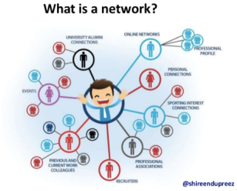
What is Networking?
Your network includes:
Classmates
Student club members
Professors
Coworkers
Alumni
Supervisors
Mentors
Professional Associations
Friends
Social Media connections (like LinkedIn!)

Slide 6
Why should I network?
To get fresh ideas, information, and potentially job or internship opportunities
More people to provide support, referrals and advice via informational interviews
Stronger credibility and reputation in field (through mutually beneficial networking relationships)
In some cases, it really can be “who you know”
Even though you are “getting” a lot, these relationships are also about paying it forward!
Mentorship
Learning
Opportunity

Slide 7
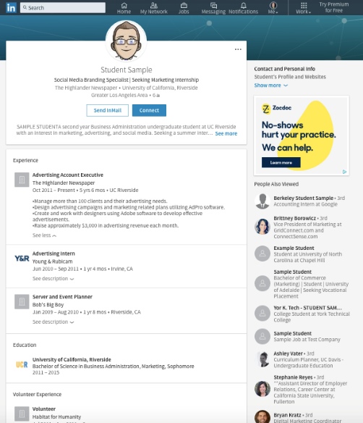
Anatomy of Your Profile
Include:
Professional Photo*
Headline
Summary
Experience
Education
Volunteering
Organizations/ Involvement
Skills (soft & technical)
Related Courses/ Projects/Portfolios
Honors & Achievements

Slide 8
What’s next?
Develop Profile
Continue to add; Edit sections
Explore Tools
Job Search; Alumni Search; Suggested Connections
Get Involved
Comment/Like; Follow Groups; Articles
Develop Network Connect Intentionally; Informational Interviews

Slide 9
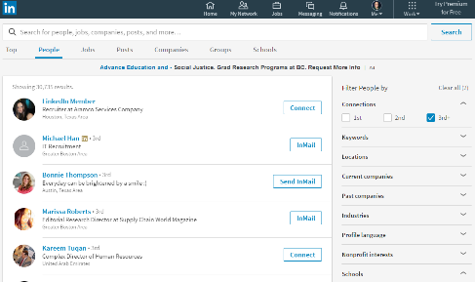
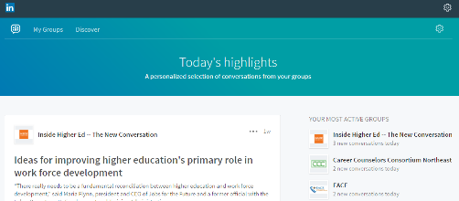
Building your Network
Search for connections using:
Name
Schools attended
Common interests
Volunteering
Keywords
Company
Join groups in your field:
Select the “work” tab on the top right side of the main page to select “Groups”
Choose groups that are related to your industry or interests

Slide 10
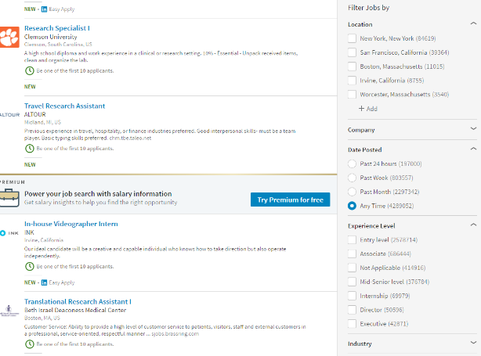
Job Search
You may want to limit by:
Location
Experience level
Date posted
Explore more about a position by looking at the company page or searching employees.
*But, remember that people can see when you look at their page!

Slide 11
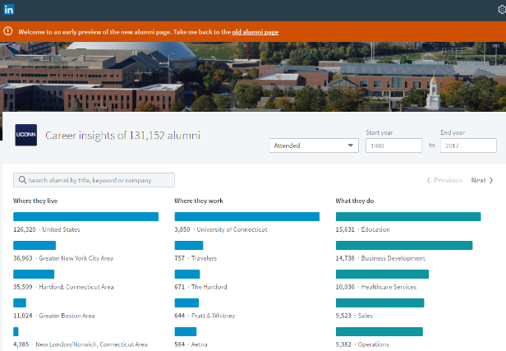
Alumni
To find alumni, search for the school in the search bar.
Select Salem State and click “See alumni” near the top
That brings you to this (interactive) page →
Use this to:
Look for SSU alumni in companies you are interested in
See career trajectories in your field
Request informational interviews

Slide 12
Questions?

