Slide 1
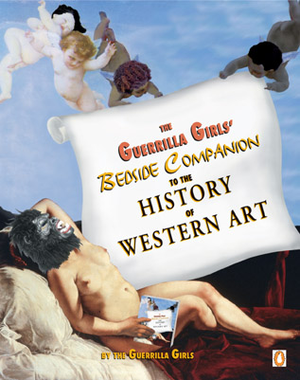

Slide 5
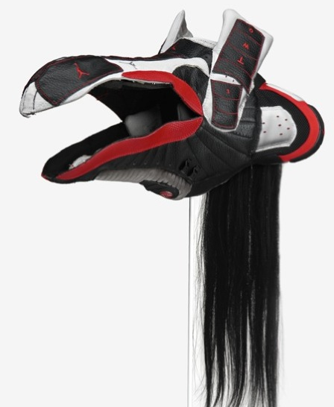
Big Idea: Globalization
Brian Jungen, Canadian
Explores Consumerism and Indigenous Cultures
Morphs Air Jordons into N.W. Native Masks

Slide 6
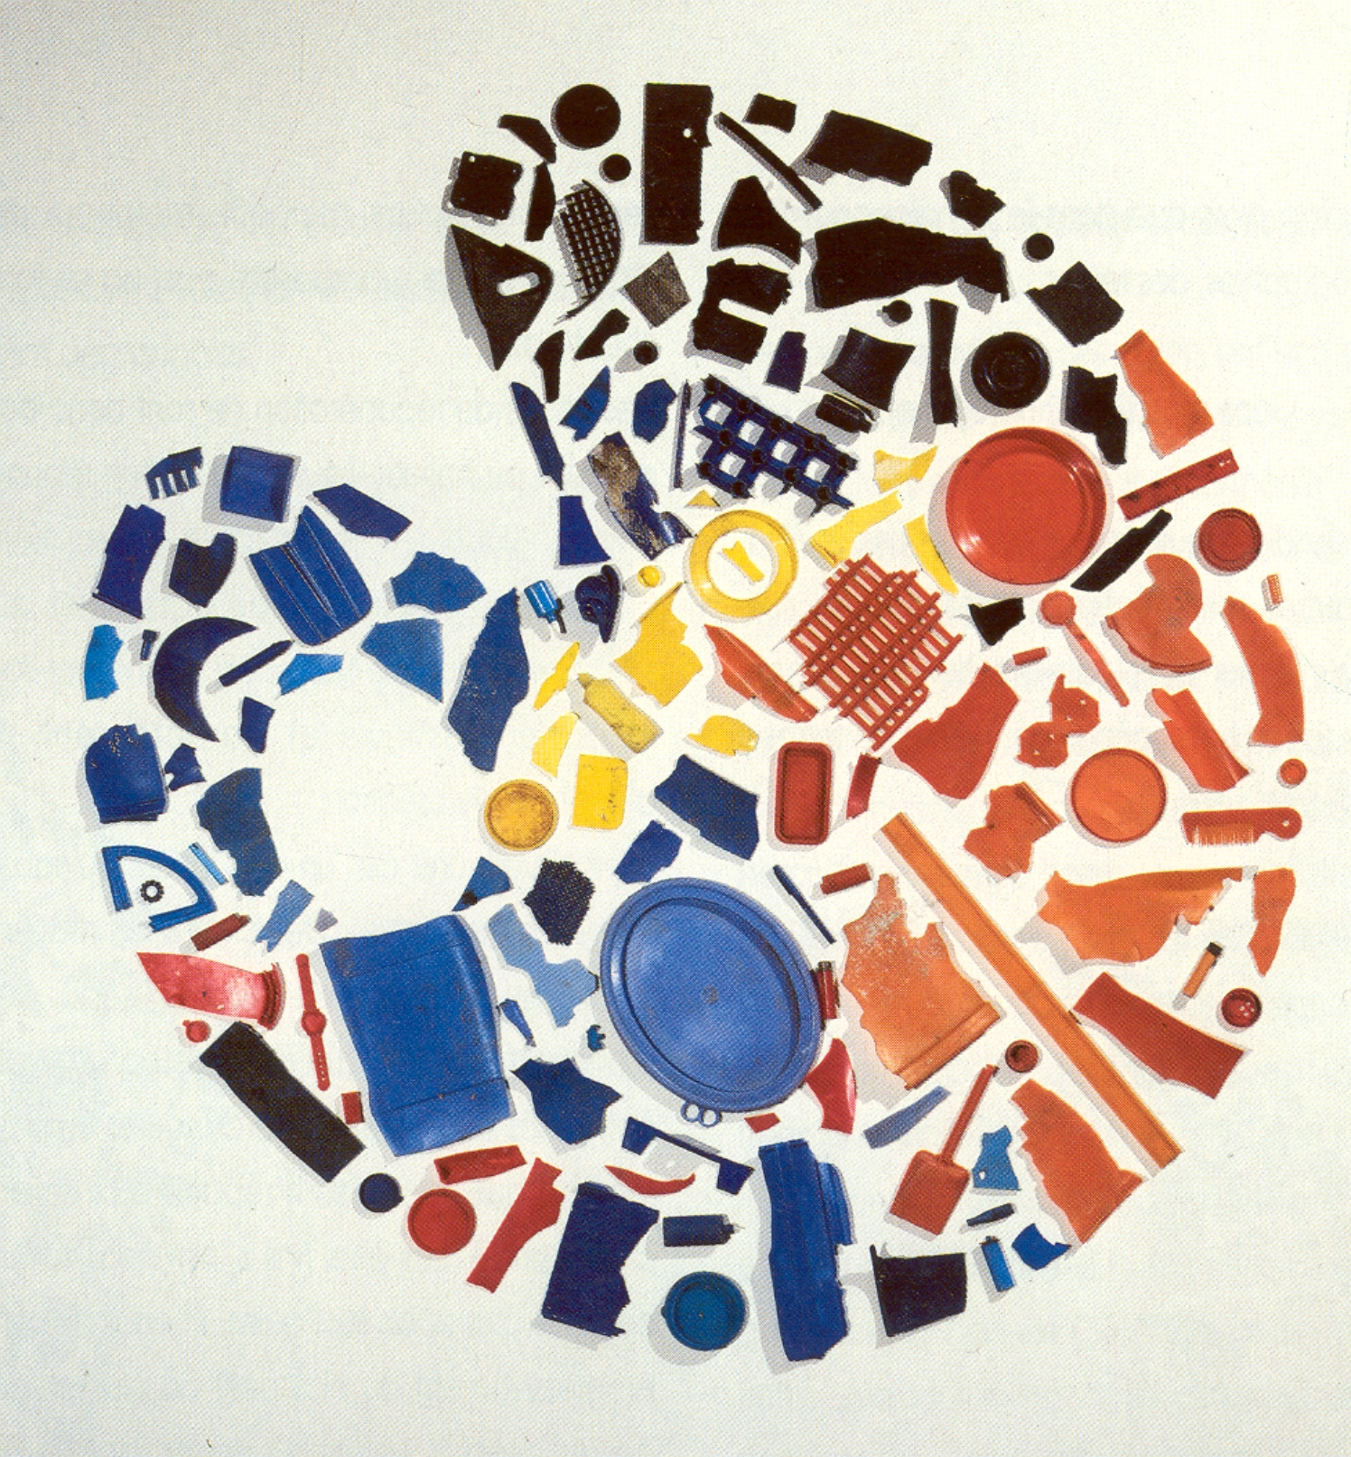
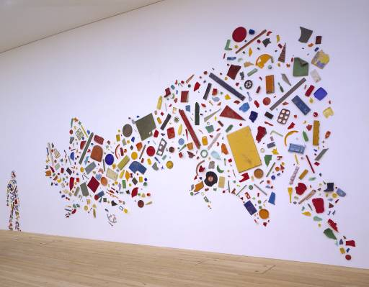
Tony Cragg, England
Plastic and the remains of mass production

Slide 8
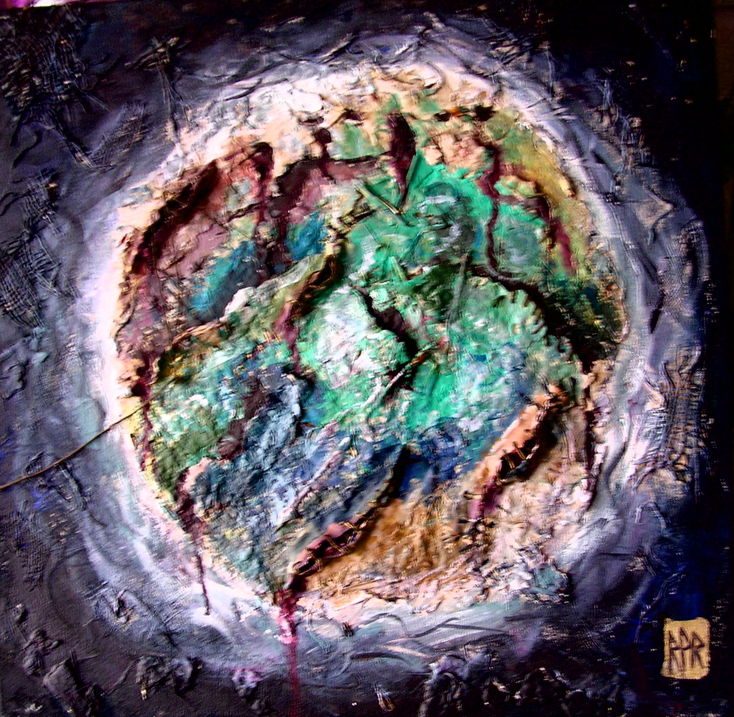

Slide 9
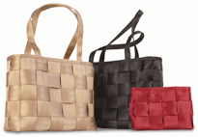
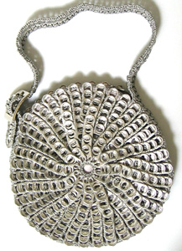
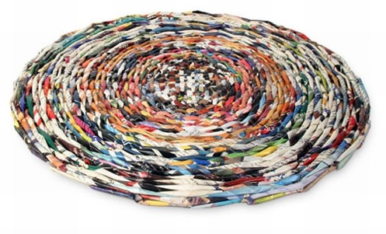
Re-Using Recycled Materials
Soda Tab purse
Seat Belt Purses
Table mats with Magazines

Slide 10
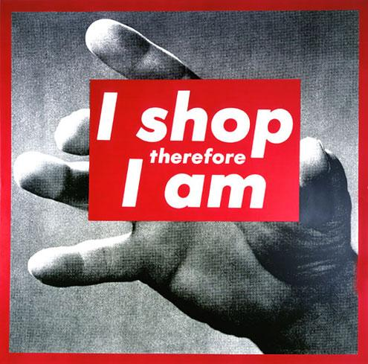
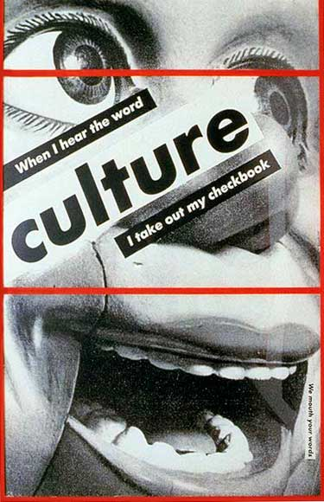
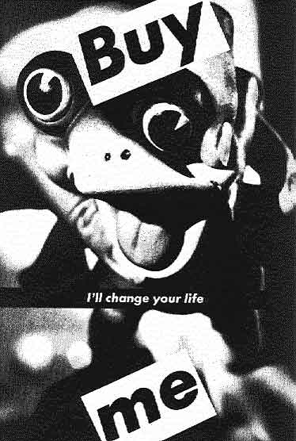
Barbara Kruger
Curricular Themes
The Influence
of Advertising
Original versus
mass-produced
ideas
Public Art, 1987

Slide 11
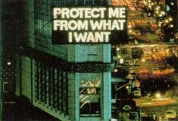
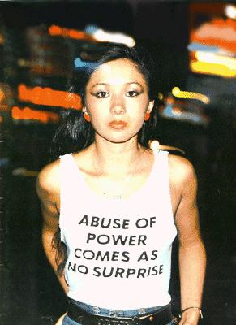
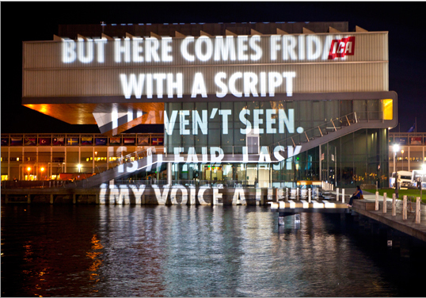
Jenny Holtzer, Truisms Using Text & Projected Light
Boston, ICA, 2010

Slide 12
Merchants of “Cool” Body Collages
Students gathered artifacts from purchases made over the semester
Bodies as sites of consumption:
Students outlined bodies on banner paper - used mixed media to create collages with artifacts
Post project reflection on artifacts and space it owns in personal life and social experiences

Slide 13
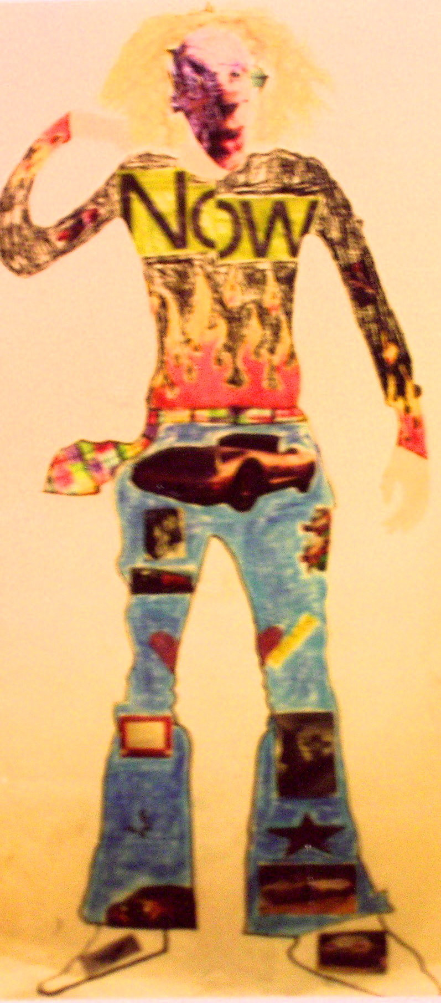
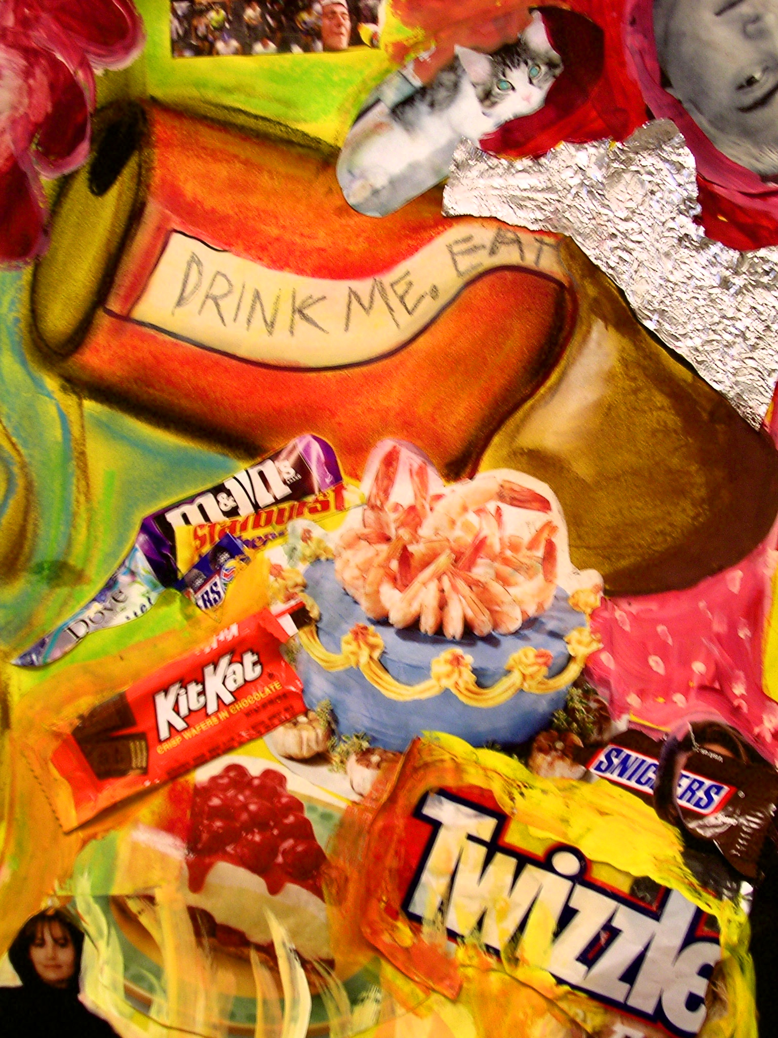

Slide 14
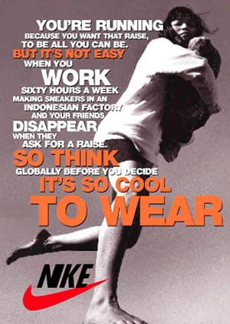
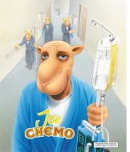
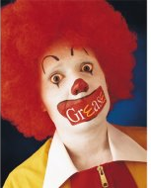
Adbusters- Culture Jamming, 2006
Spoof Ads that
Uncover “Hidden
Truths” about
companies, which
consumers
take for granted

Slide 15
“Toyz R us”
RP ROHLOFF 2003
Notes:
I began thinking more about the powerful connections between consumption, the quest for meaning and the role of cultural storytellers.. To what extent was my sense of identity as a teen influenced by a consumer and entertainment culture?

Slide 16
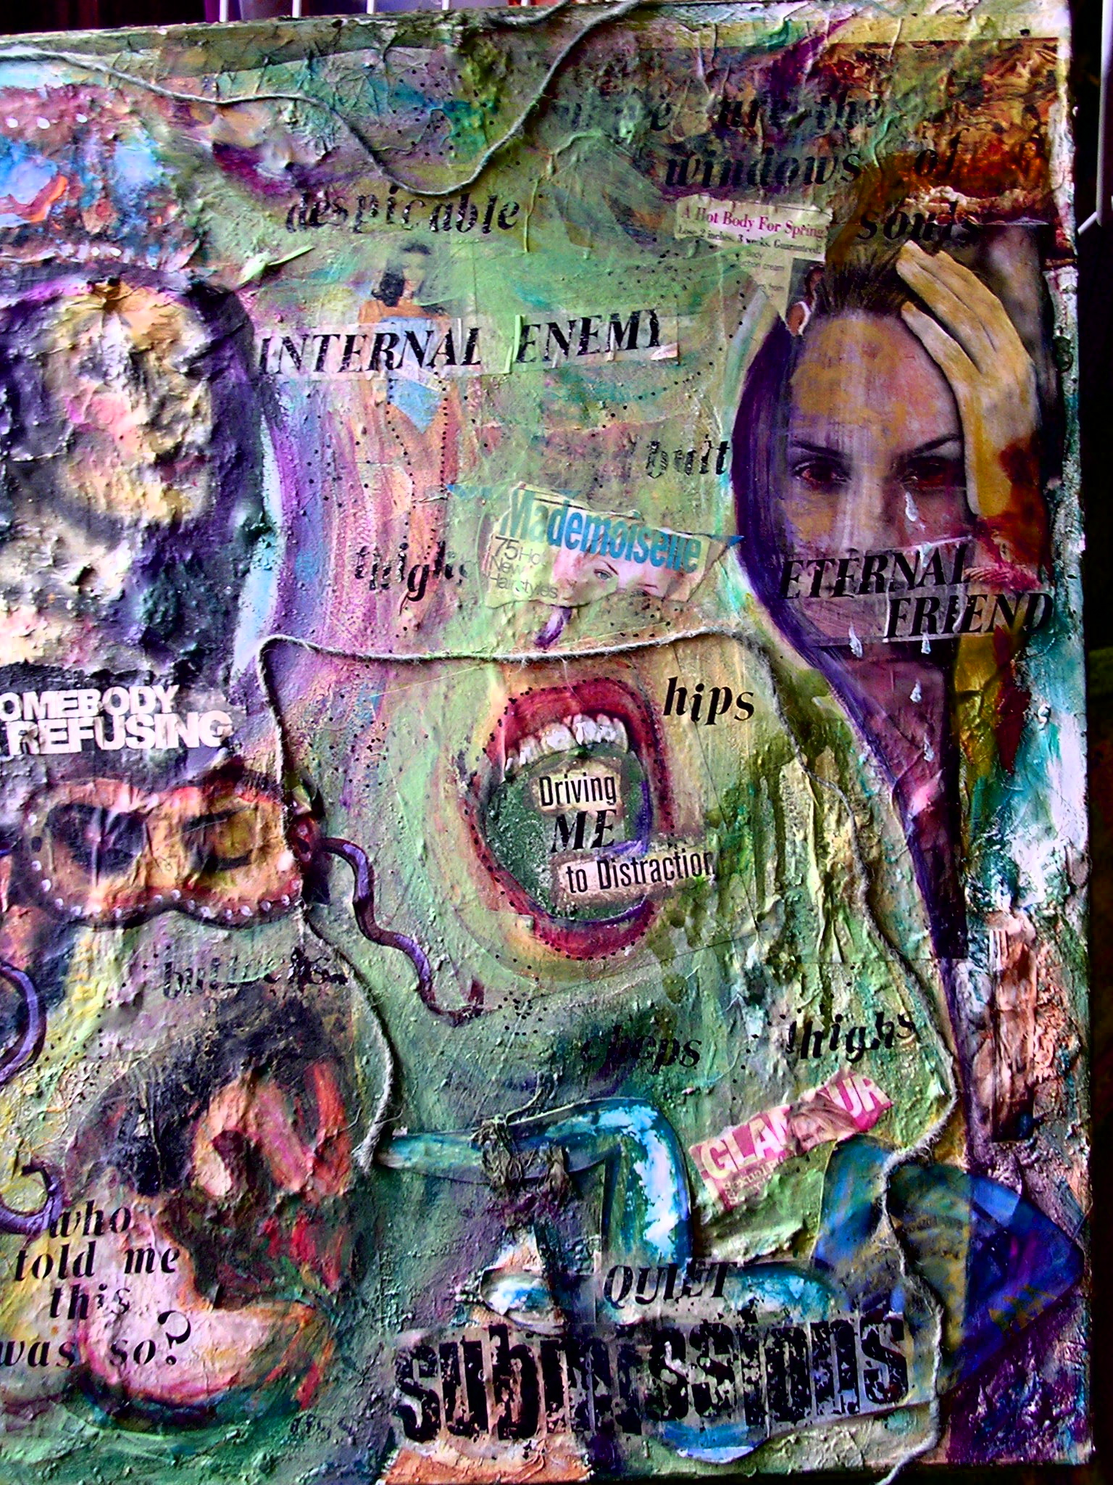
“This Is Not My Body Politic”
“What is my Beauty Worth?”
Mixed Media on Panel R.P. ROHLOFF 2002-2003
Notes:
In my research in media studies, I began to reflect on the ways that I had come to view myself through the lens of an ideal standard of beauty and body influenced by the constant consumption of MTV, teen mags, Tv programs. I experienced a crisis of identity and soon began to recognize how these narratives had deeply effected my worldview and my quality of life. I also became accutely aware of my consumption patterns and their limitations to articulate lasting and profound meaning.

Slide 17
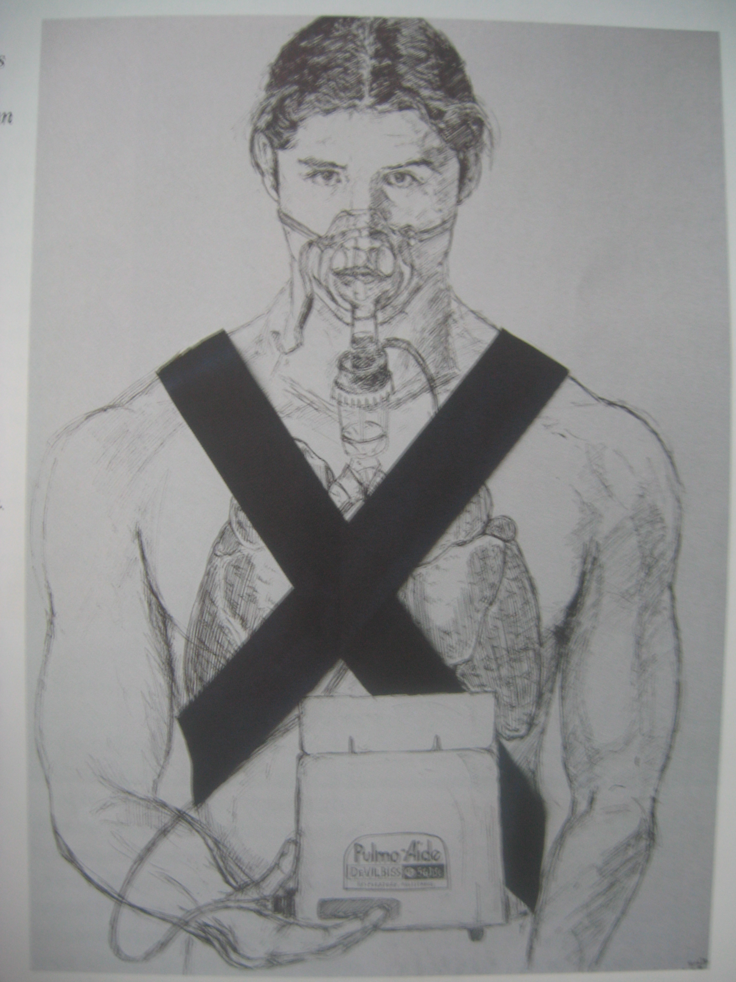

Slide 18
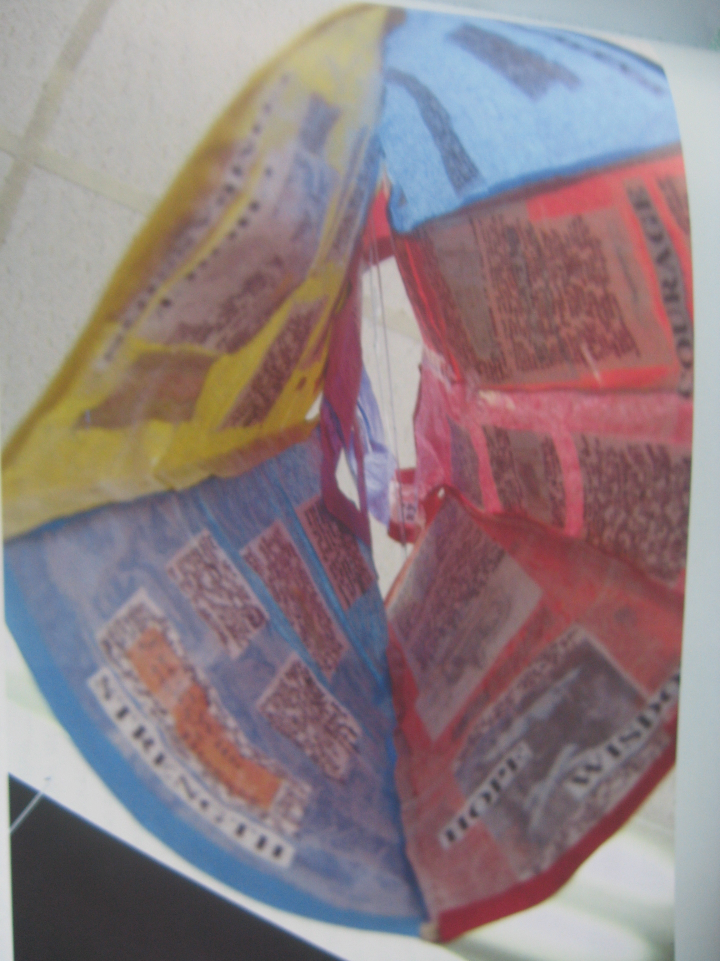

Slide 19
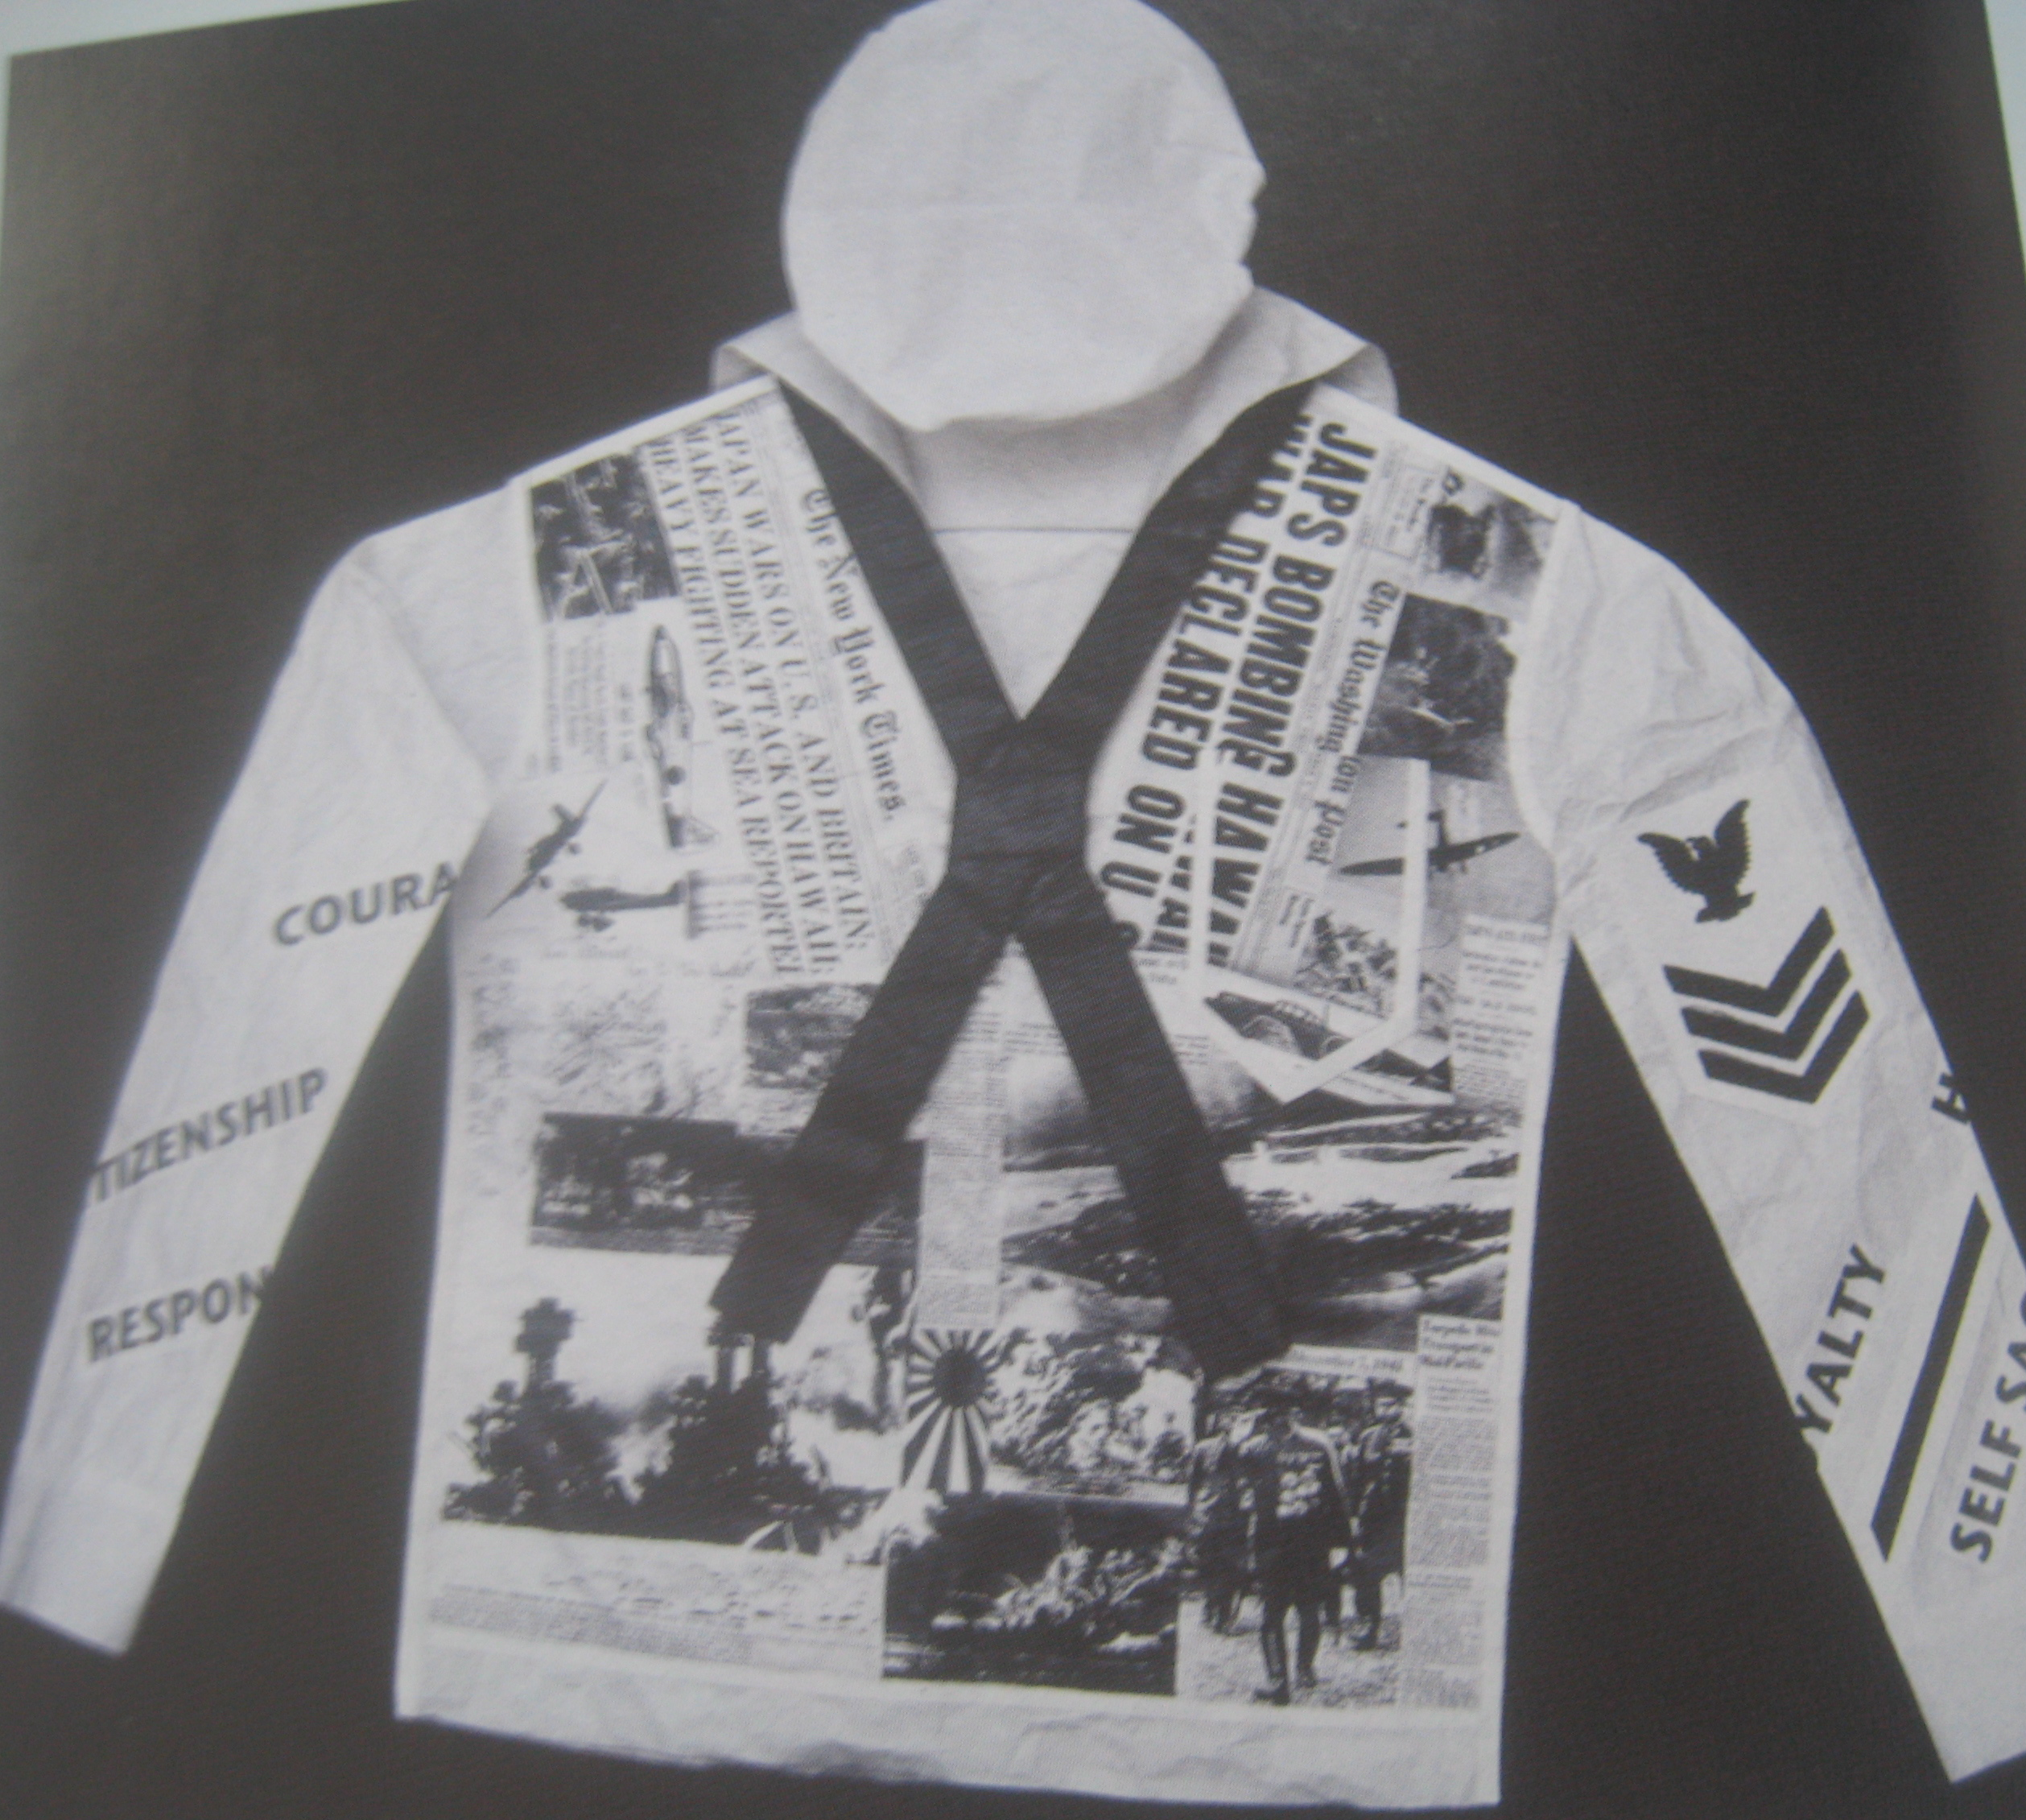

Slide 21
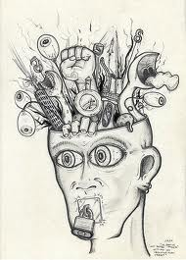

Slide 23
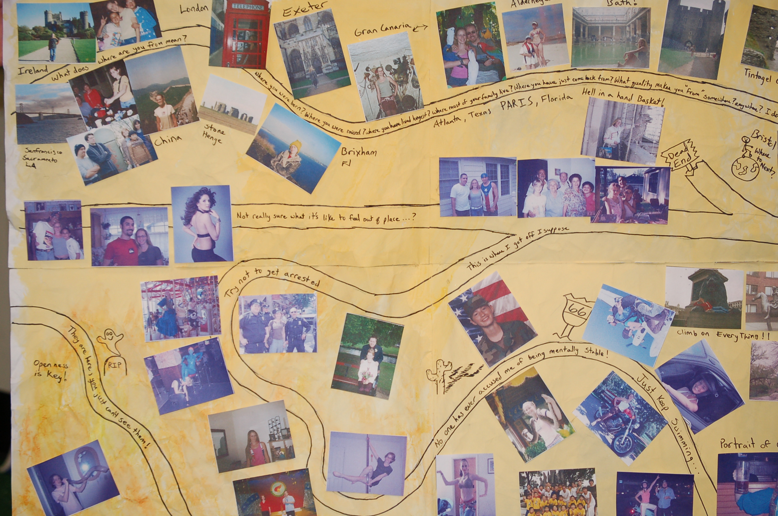
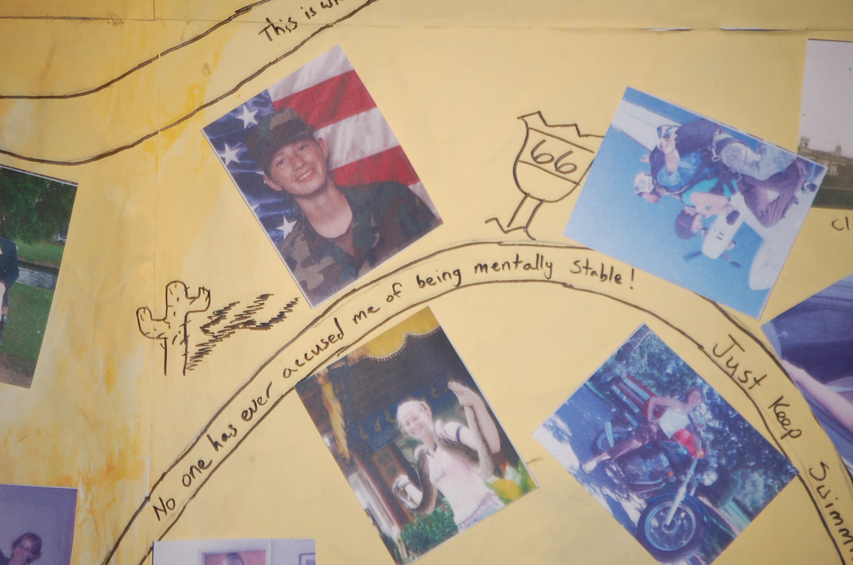
The Game Board of Life

Slide 24
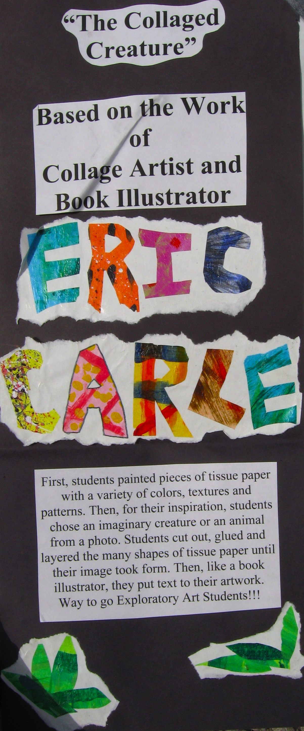

Slide 26
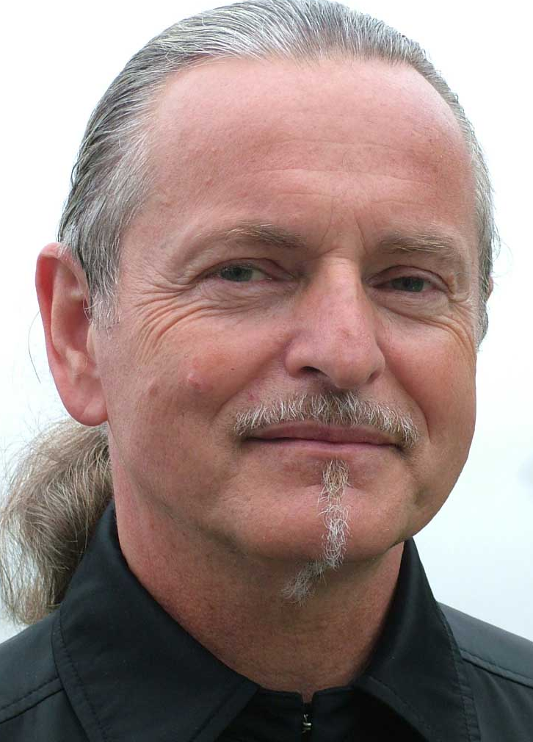
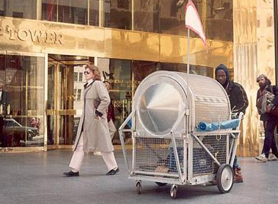
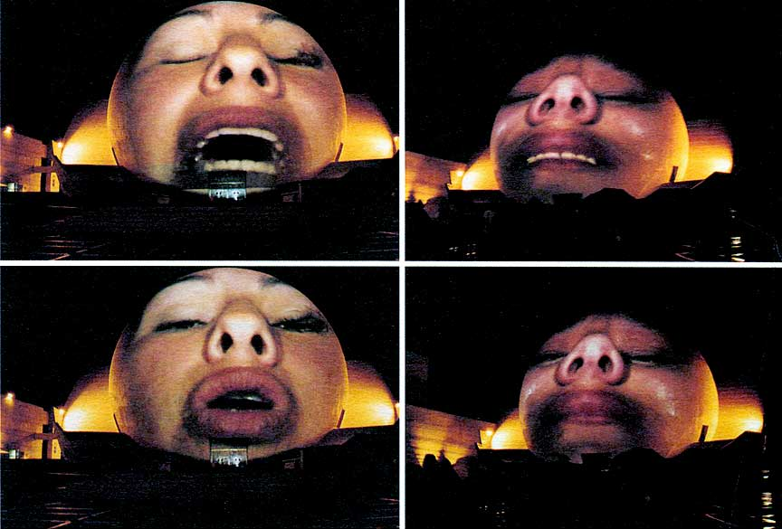
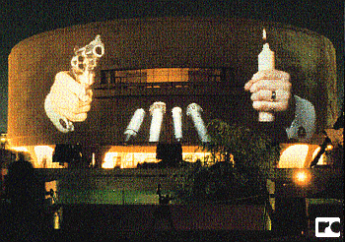
Krzysztof Wodiczko
Homeless
vehicles, 1988
Wall projections: Speaking Stories
(On the Tiajuana Border & at Prisons)

Slide 27
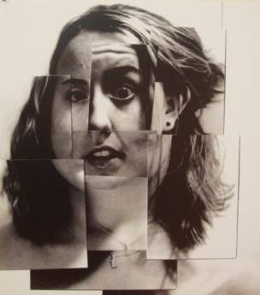
Investigating Alternative Selves Using a Camera & the Photo Copier
Photograph expressive face of student
Make multiple copies of the photo
Cut apart copies and create an “alter self”
4) Trade copies with peers and make a community collage

