Slide 1
Inspiring Artists in History for Secondary Students

Slide 2
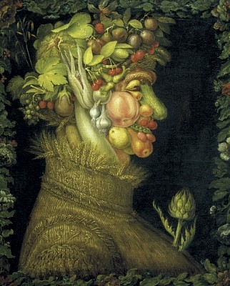
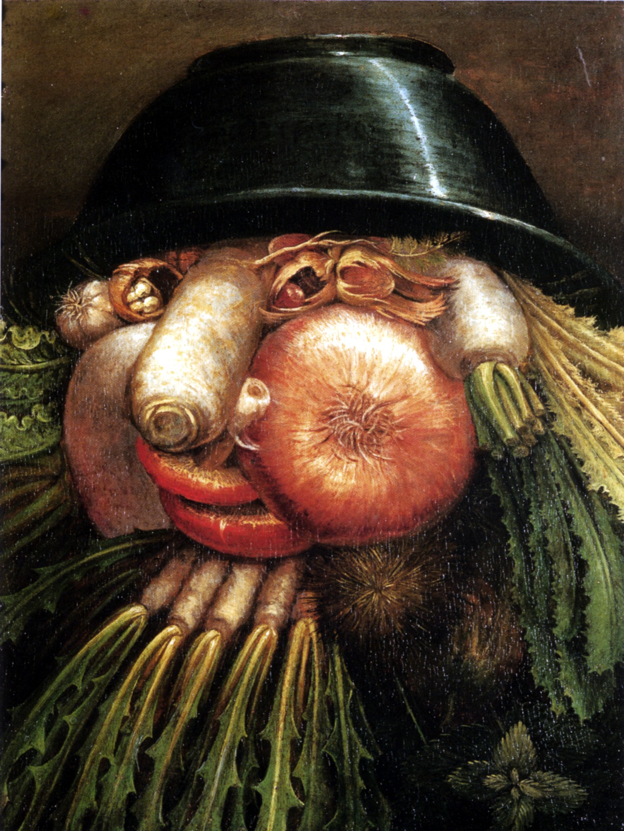
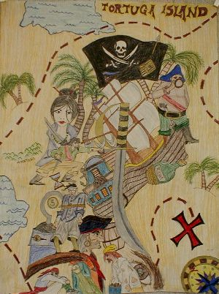
Guiseppe Arcimboldo 1527- 1593
Summer
1573

Slide 3
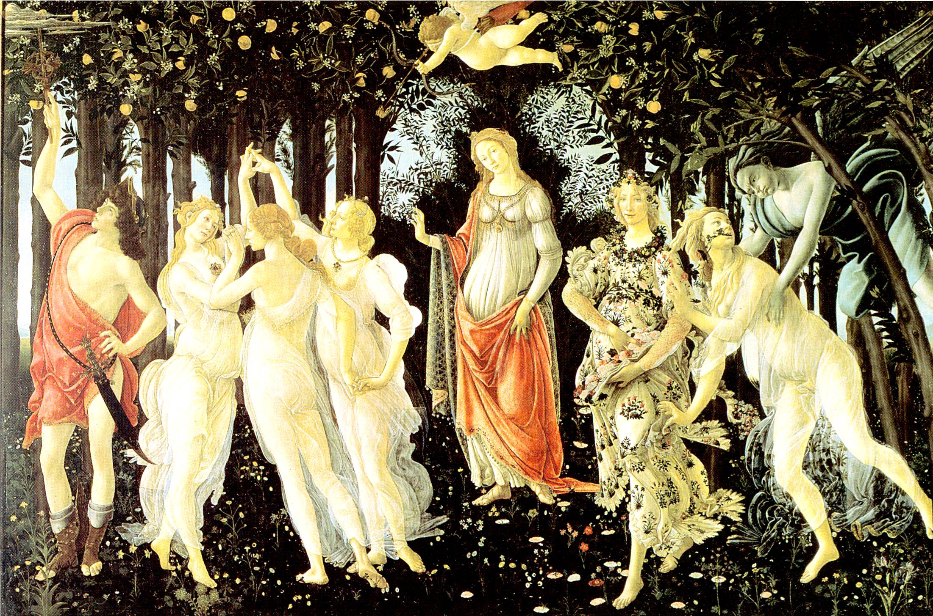
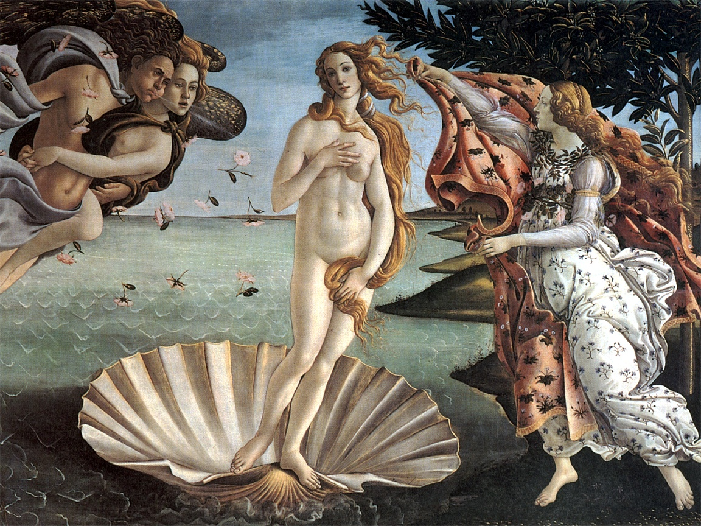
Sandro Botticelli, Italian Renaissance
Birth of Venus, 1486
Primavera, 1482 Tempera Panel

Slide 4
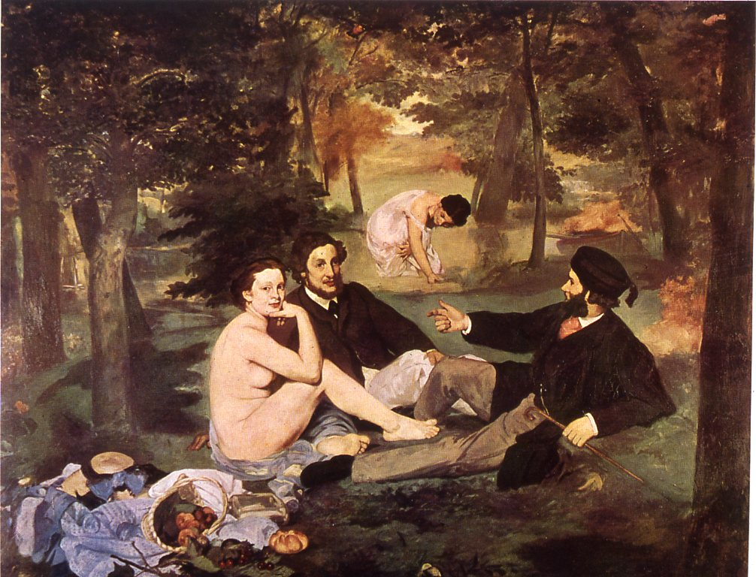
French painting, 19th century, Manet The Picnic.

Slide 5
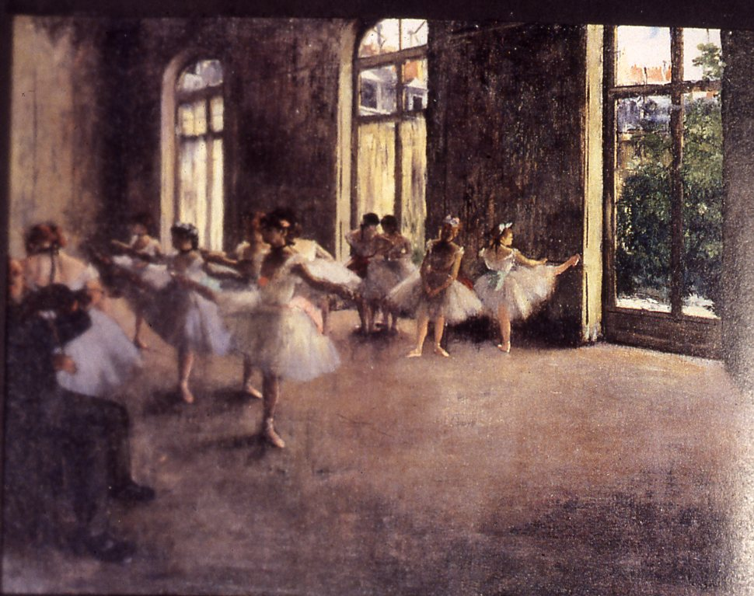
French painting, 19th century, Edgar Degas, The Rehearsal.

Slide 6
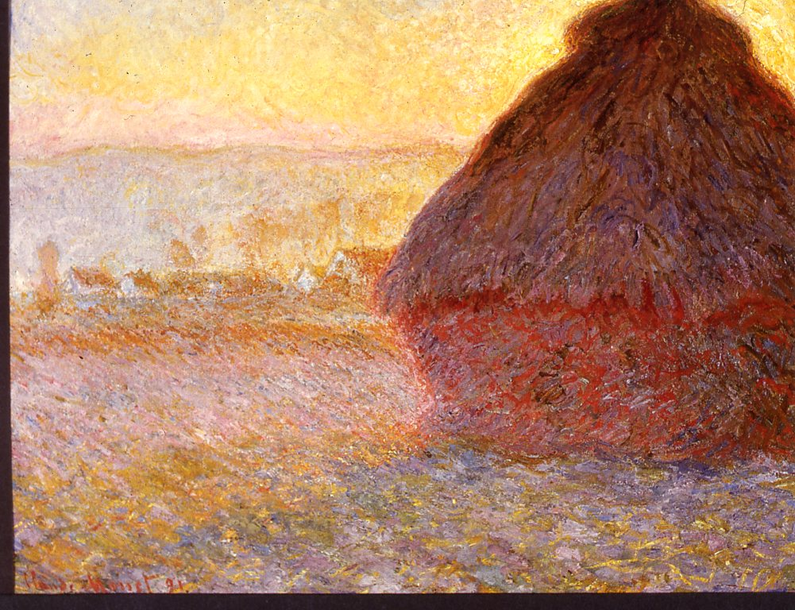
French painting, 19th century, Monet, Grainstacks Sunset.

Slide 7
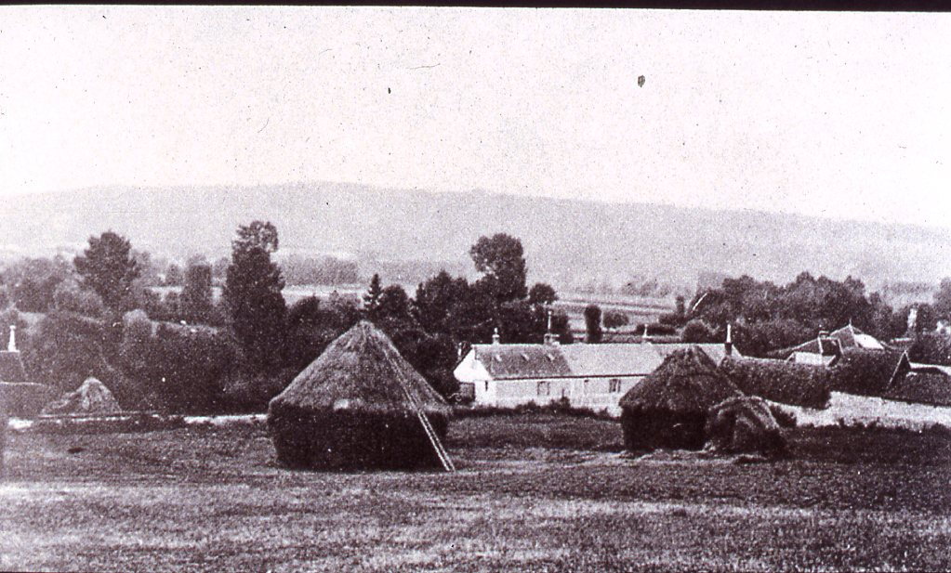
Photograph of Claude Monet’s house at Giverny.

Slide 8
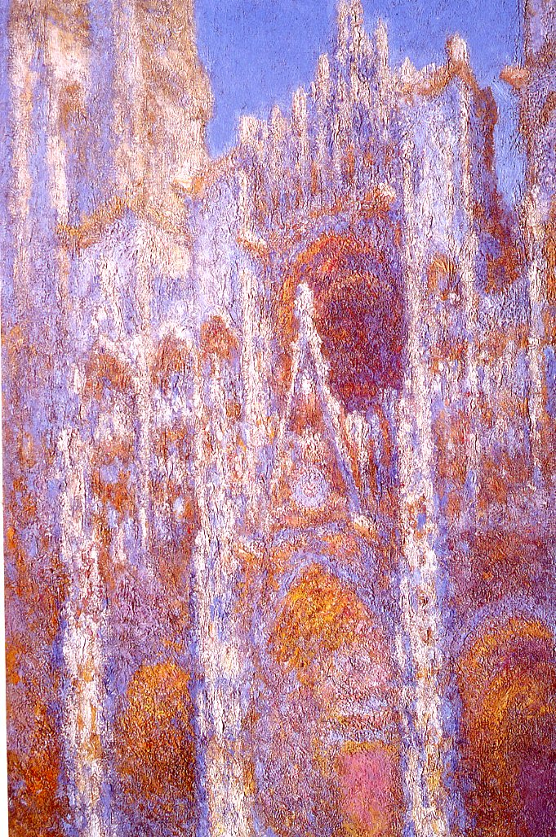
French painting, 19th century, Monet, Rouen Cathedral, Façade.

Slide 9
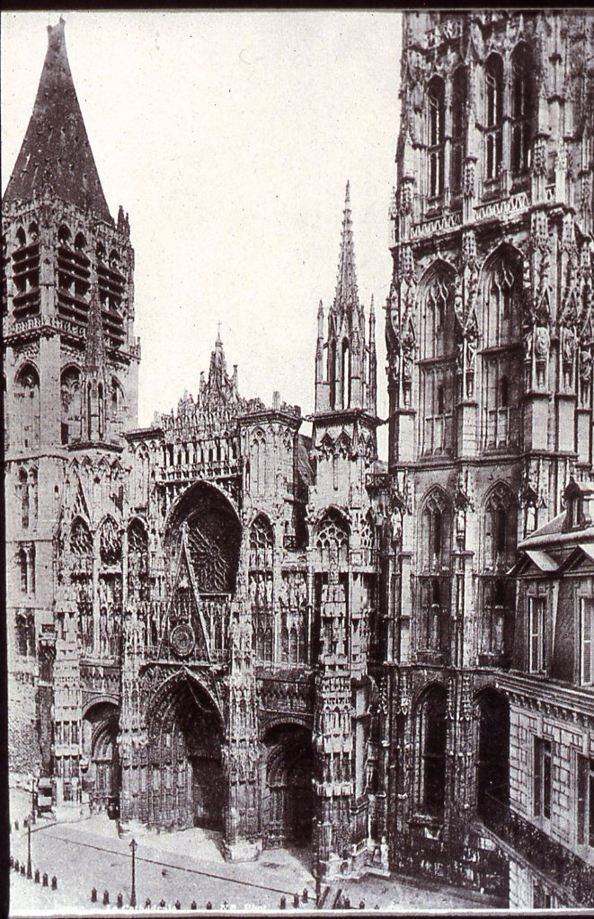
Photograph of Rouen Cathedral.

Slide 10
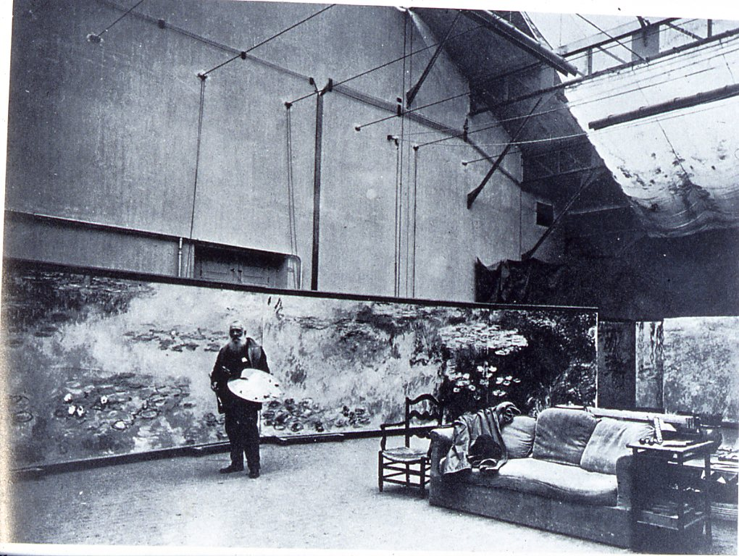
Photograph of Claude Monet in his studio.

Slide 11
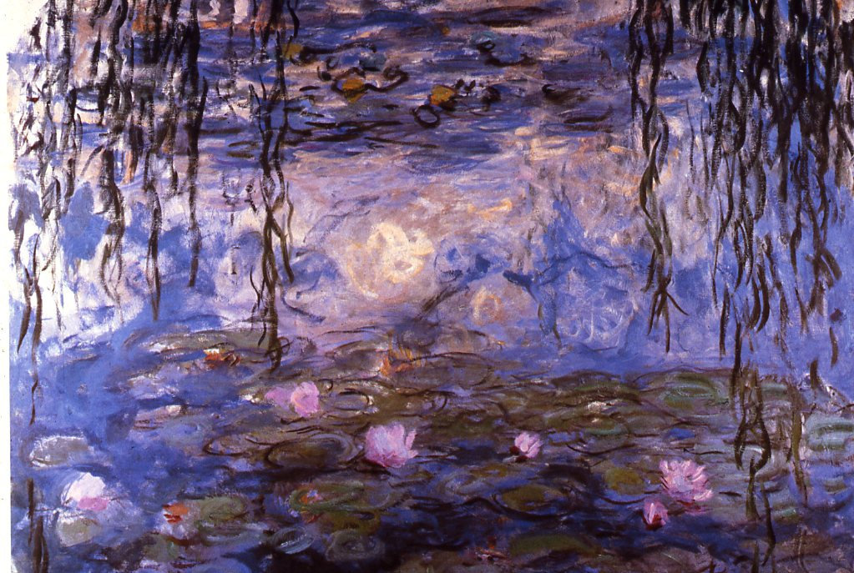
French painting, 19th century, Claude Monet, Water Lilies.

Slide 12
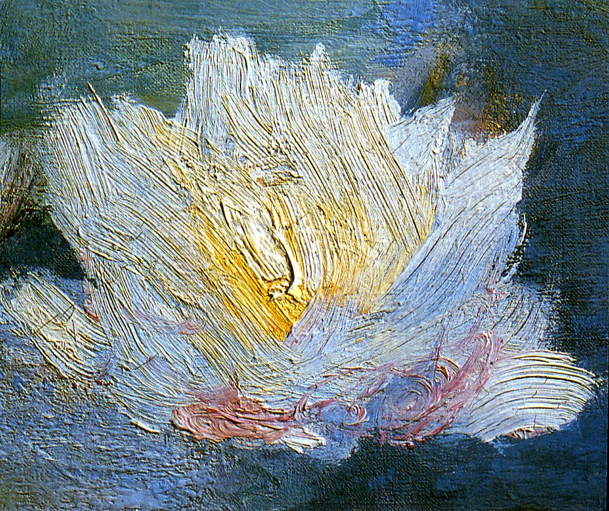
French painting, 19th century, Claude Monet, Water Lilies, detail.

Slide 13
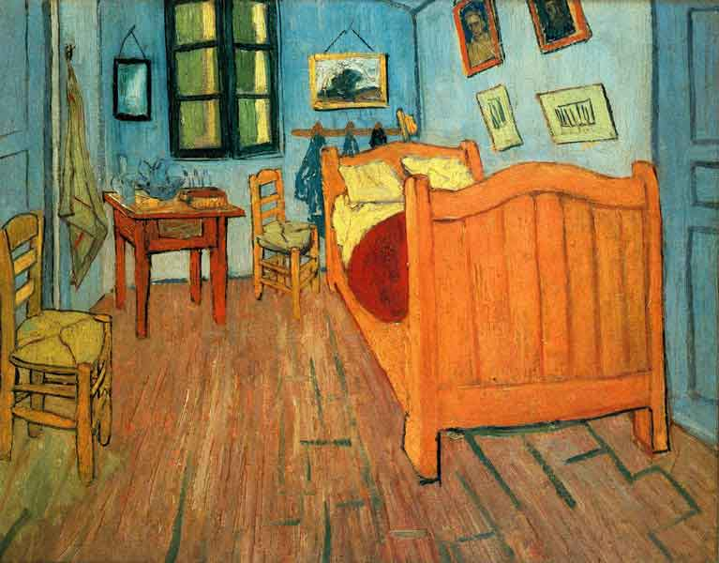
Vincent Van Gogh Dutch, Post- Impressionist
TheTh
The Bedroom at
Arles
1888
Oil on canvas
24x32”

Slide 14
Edvard Munch, The Scream

Slide 15
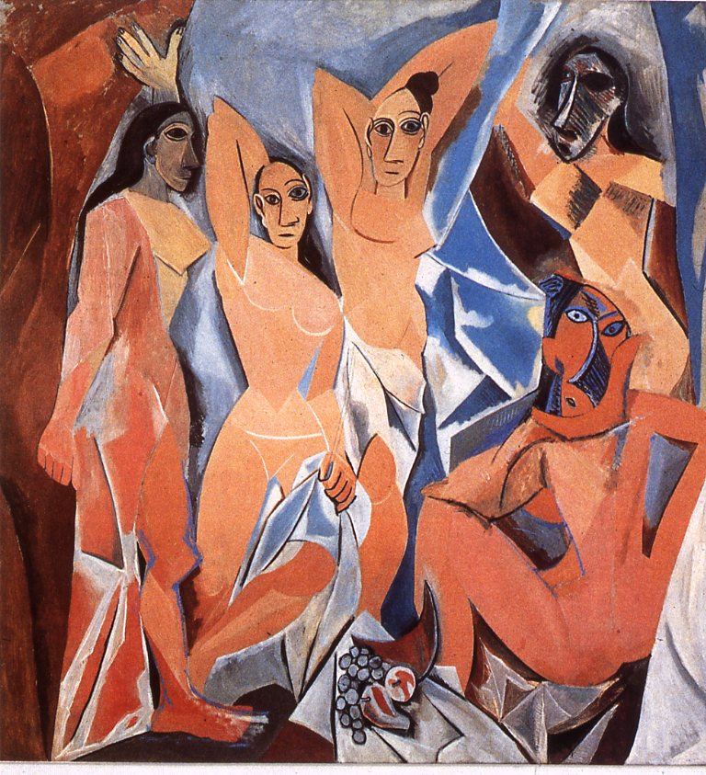
Pablo Picasso, Les Demoiselles D’Avignon.

Slide 16
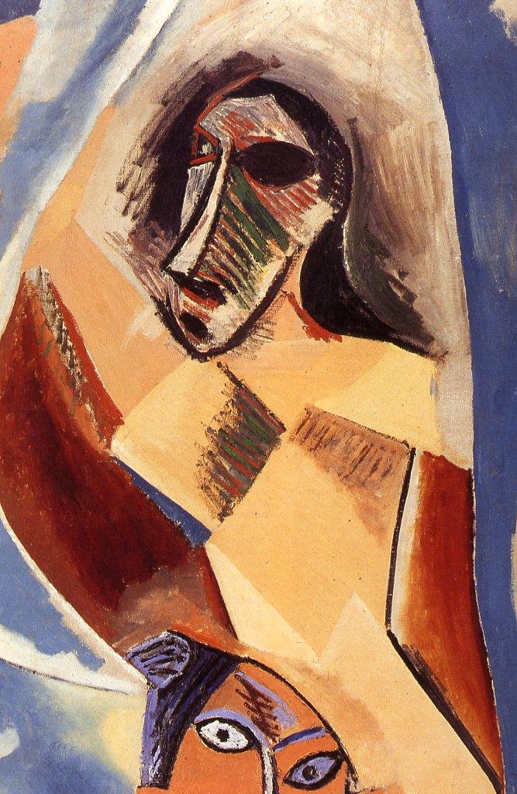
Pablo Picasso, Les Demoiselles D’Avignon, detail.

Slide 17
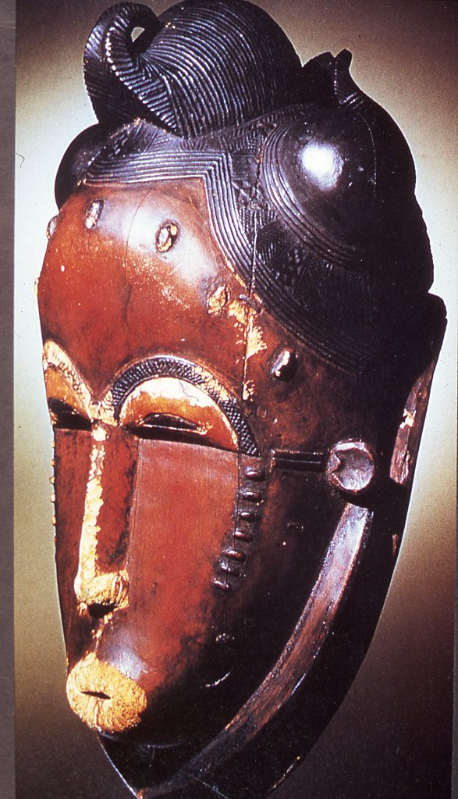
African sculpture, Ivory Coast, Baule, Kapan Face Mask.

Slide 18
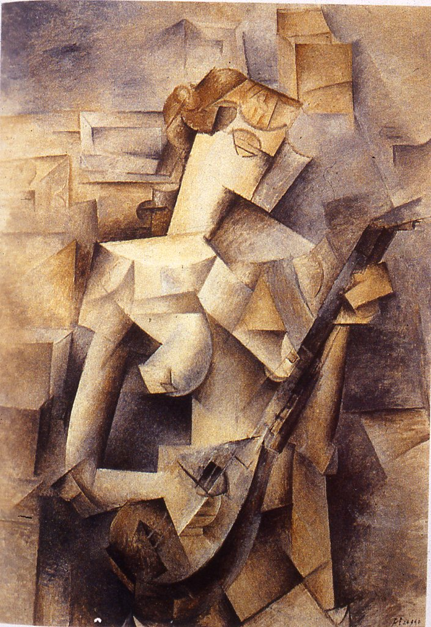
Pablo Picasso, Girl with a Mandolin.

Slide 19
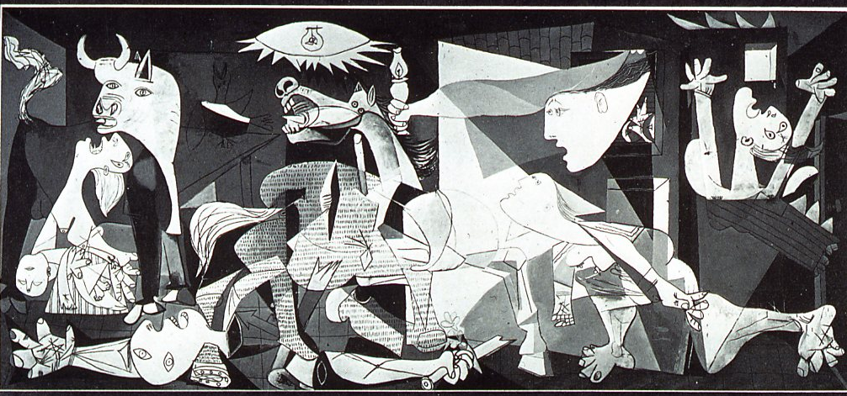
Pablo Picasso, Guernica.

Slide 20
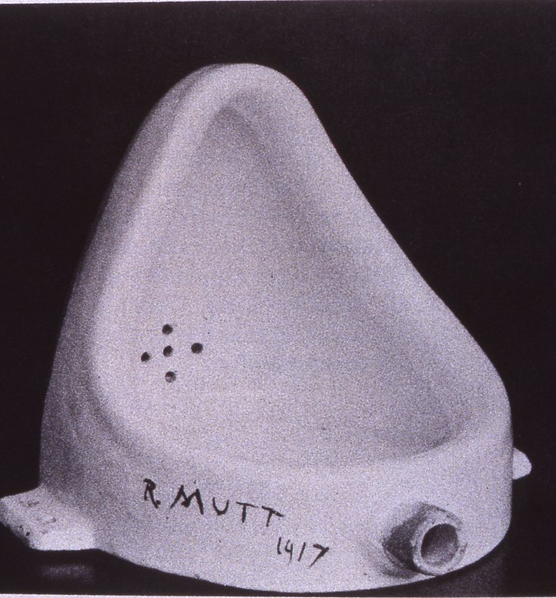
Marcel Duchamp, Fountain. 1917 The Dadaist movement

Slide 21
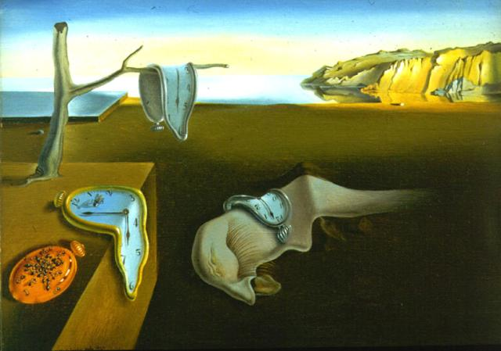
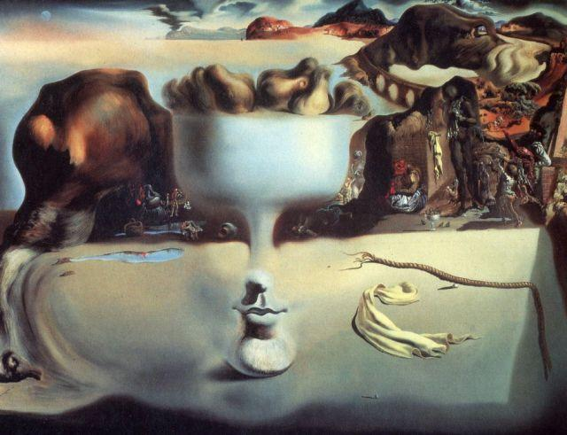
Salvador Dali
Persistence of Memory,1931
Apparition of Face and fruit on the Beach, 1938

Slide 22
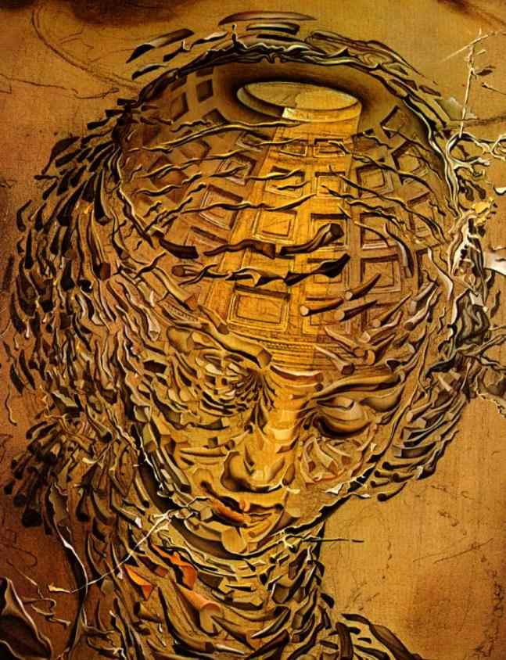
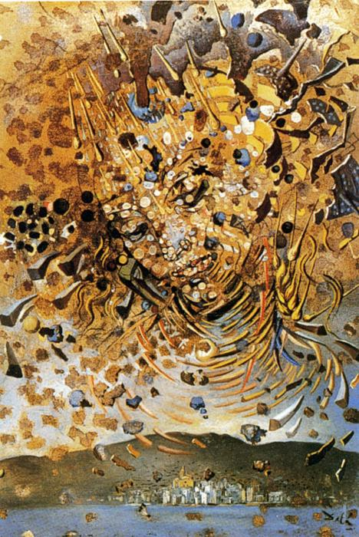
Raphaelesque Head Exploding, 1951
Head Bombarded with Grain of Wheat, 1954

Slide 23
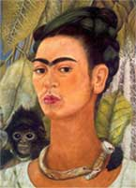
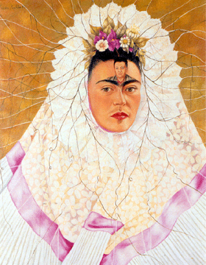
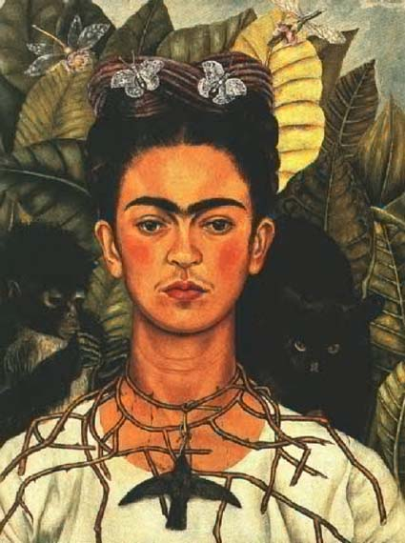
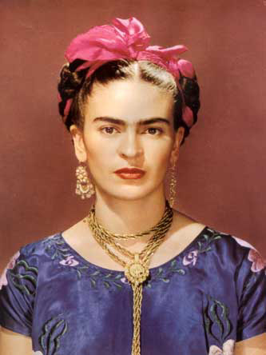
Frida Kahlo

Slide 24
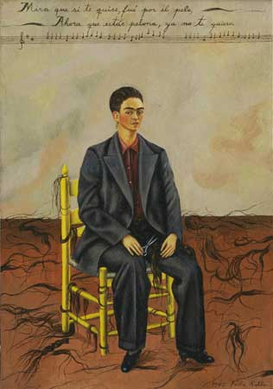
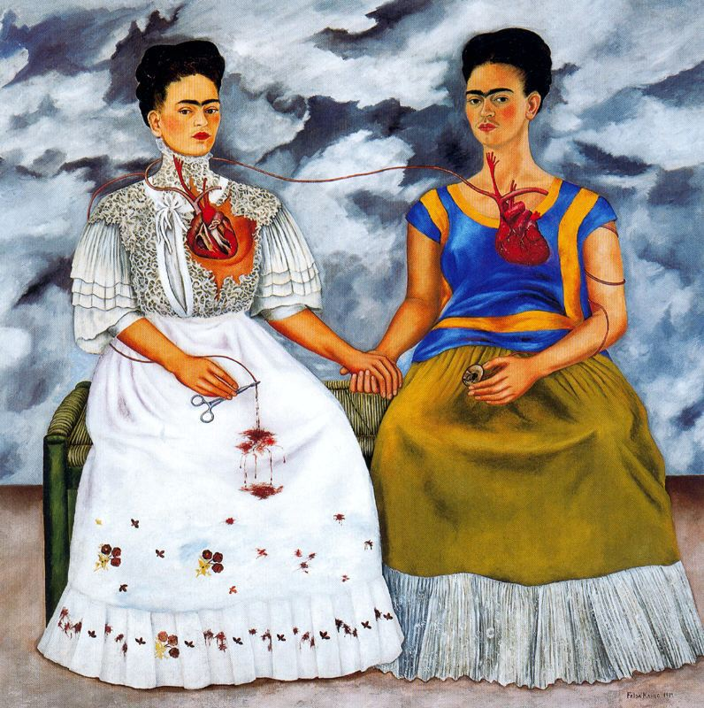
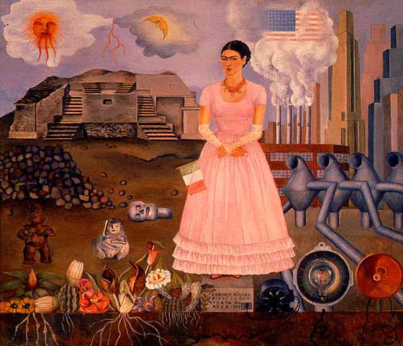

Slide 25
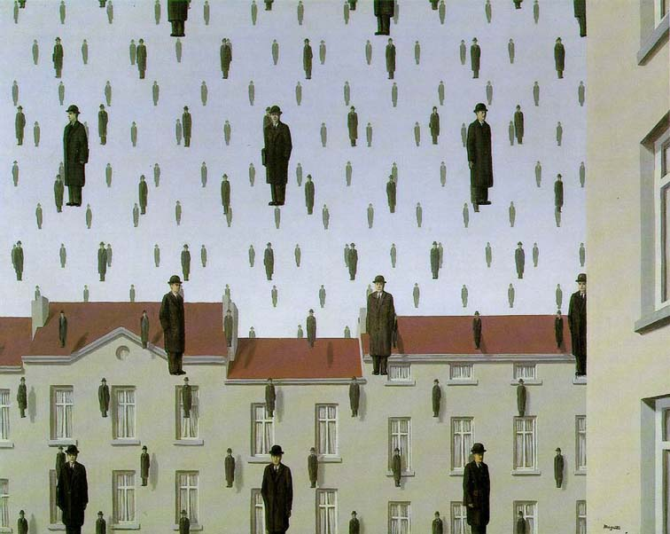
Rene Magritte
Belgium
1898-1967
Golconde, 1953
The Son of Man, 1964

Slide 26
M.C. Escher

Slide 27
Dutch painting, 20th century, Mondrian, Piet, Broadway Boogie-Woogie.

Slide 28
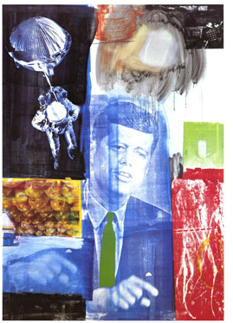
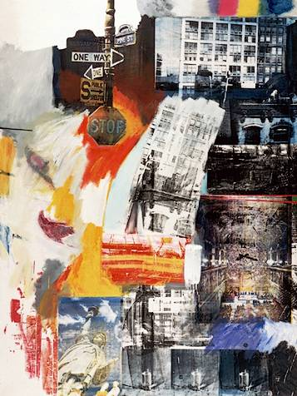
Robert Rauschenberg

Slide 29
American painting, 20th century, Lichtenstein, Roy, Oh Jeff….

Slide 30
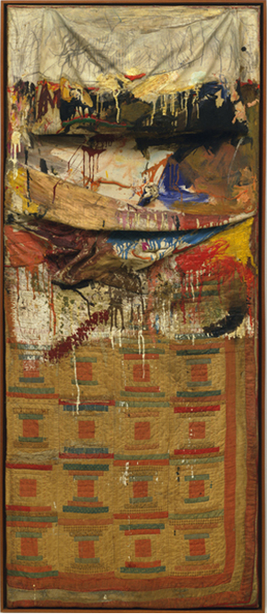
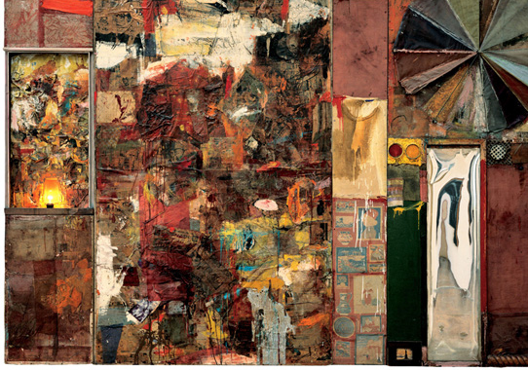
“Combines”
Monogram, 1956-59
Charlene, 1954

Slide 31
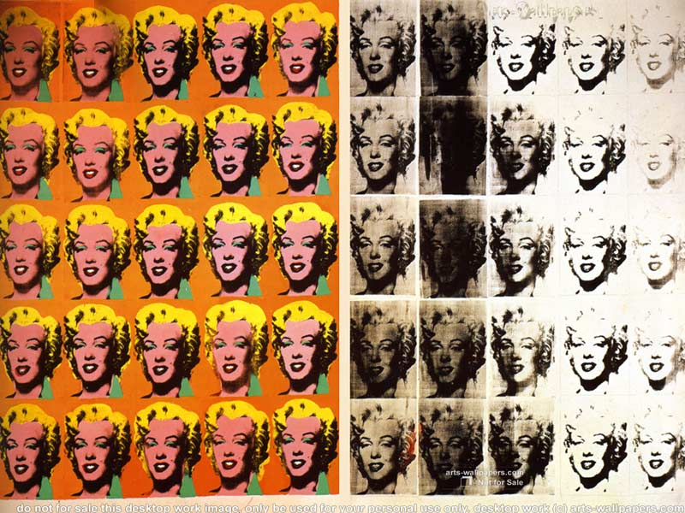
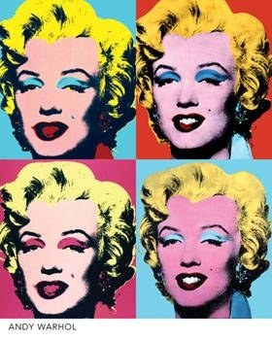
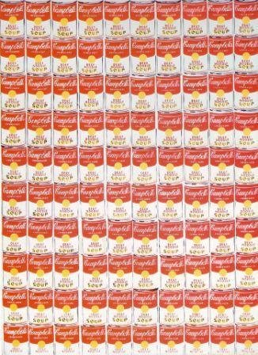
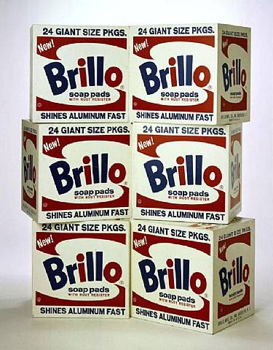
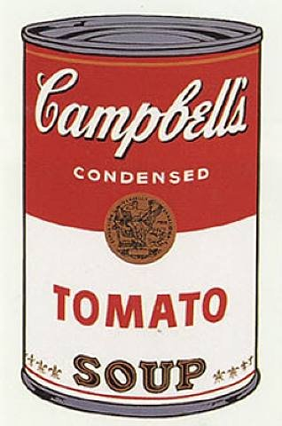
Andy Warhol: Appropriating Pop Culture
100 Cans, 1962

Slide 32
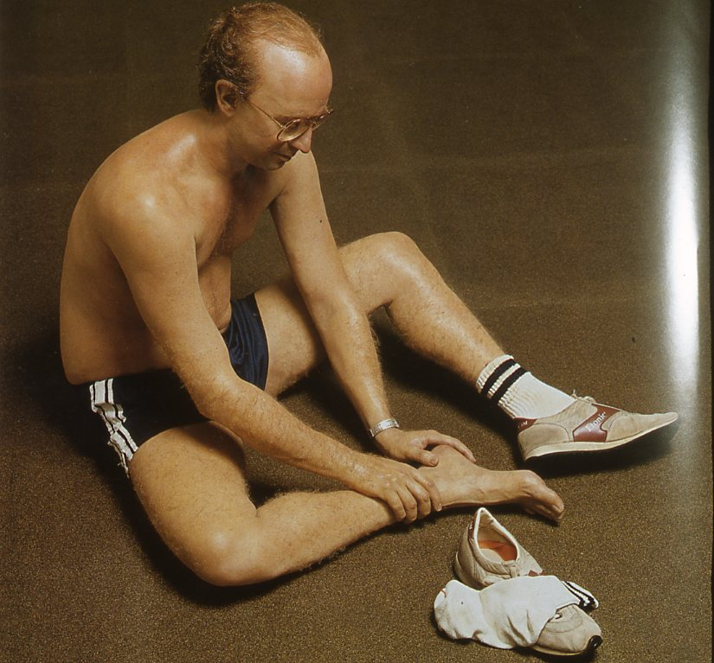
American sculpture, 20th century, Duane Hanson, The Jogger, 1983-84.

Slide 33
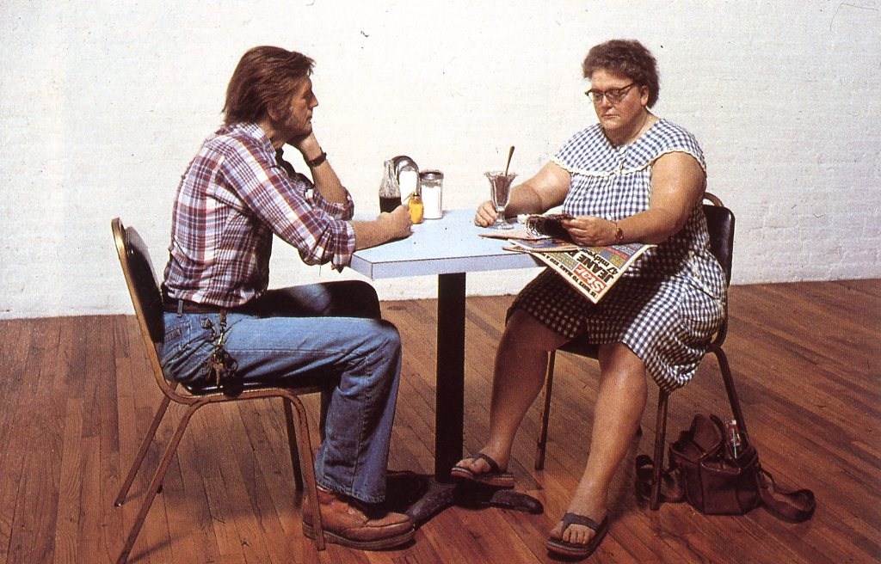
American sculpture, 20th century, Duane Hanson, Self Portrait with Model.

Slide 34
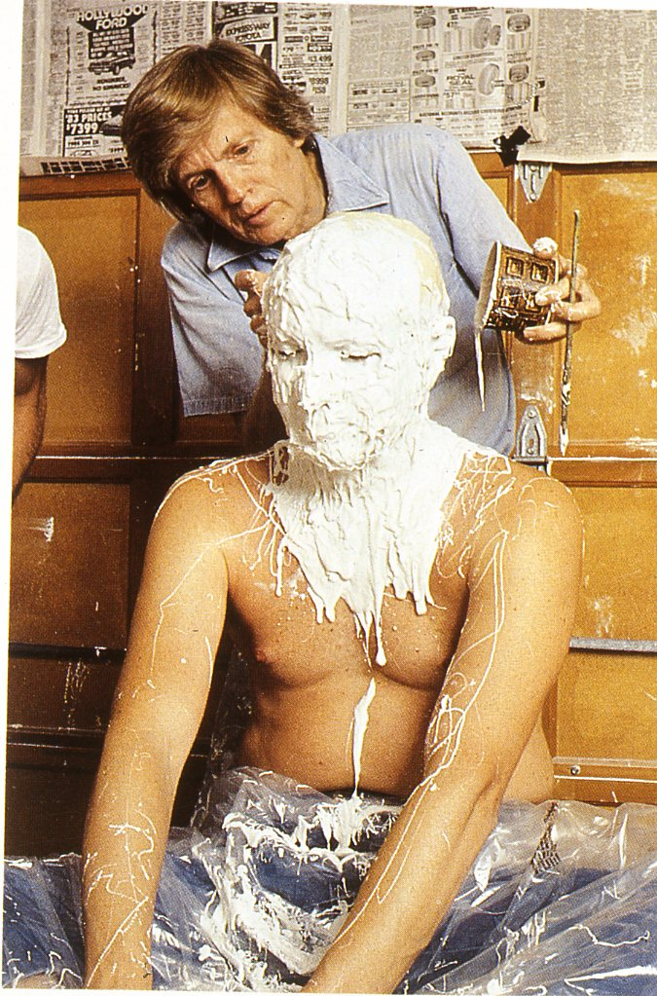
American sculpture, 20th century, Duane Hanson making head mold from live model.

Slide 35
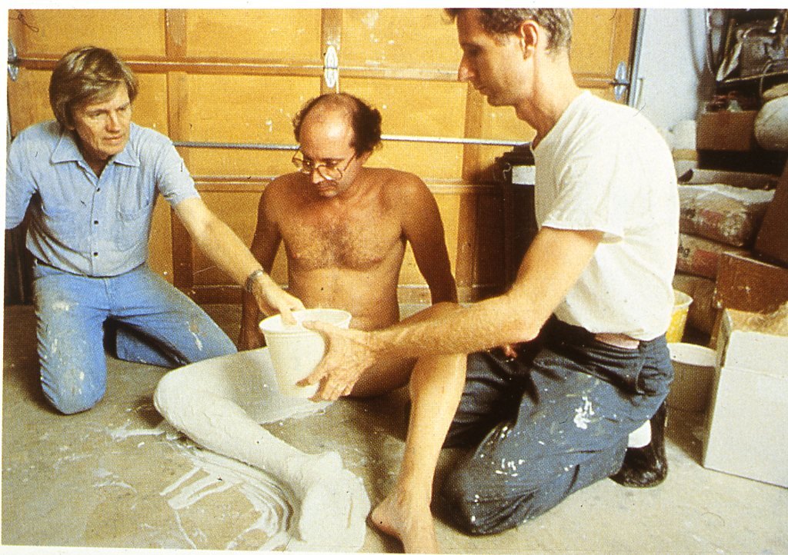
American sculpture, 20th century, Duane Hanson making leg mold.

Slide 36
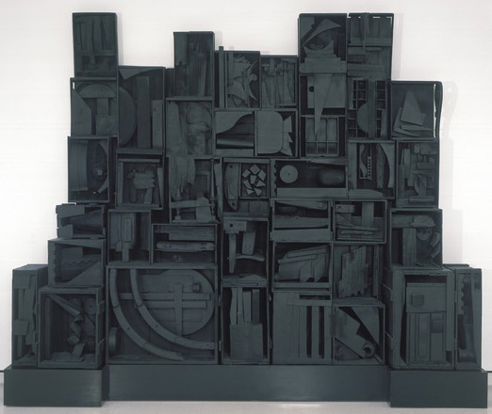
Recycled Dream Works Playground with Louise Nevelson
Sky Cathedral, 1958 Wood, painted black
By, Crystal Conley

Slide 37
Louise Nevelson Biography
Born Sep 23, 1899 in Kiev Russia, and died in New York in 1988
Studied art at the Art Students League in New York, and at Hans Hofmann’s school in Munich, Germany in 1931
1937 taught at the Educational Alliance Art School in the lower eastside of NYC
Considered an abstract expressionist sculptor
Used discarded and found objects such as wood and scrap metal to create sculptures

Slide 38
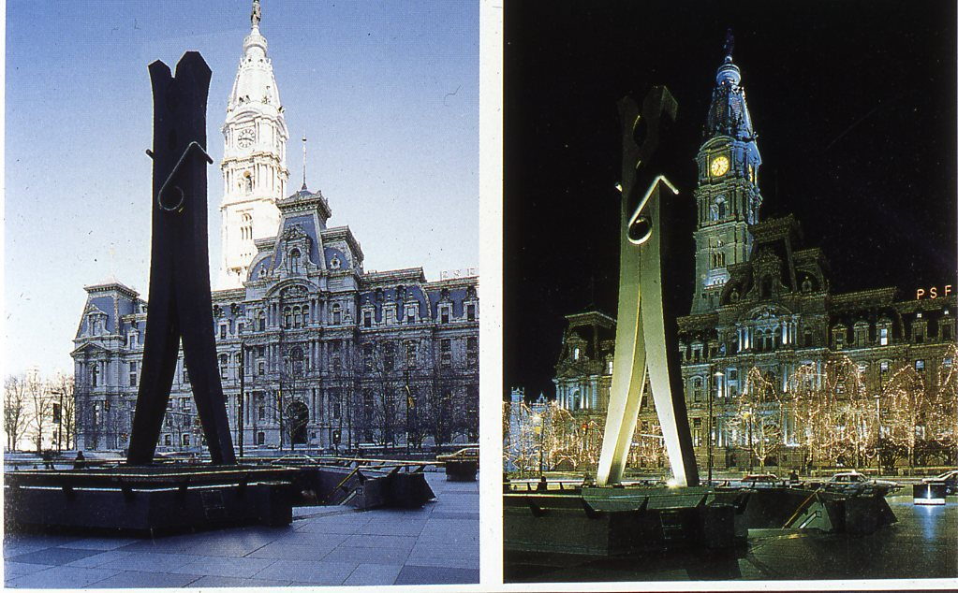
American sculpture, 20th century, Claes Oldenburg and Coosje Van Bruggen, Clothespin, Philadelphia.

Slide 39
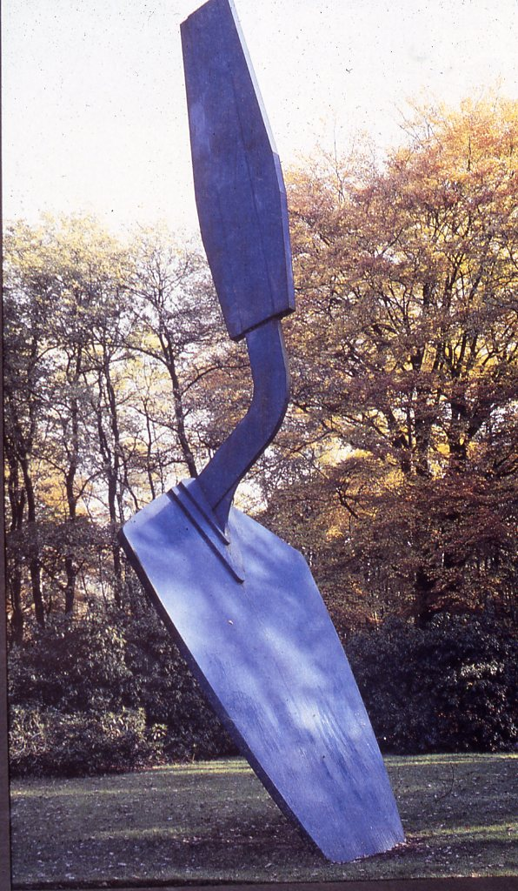
American sculpture, 20th century, Claes Oldenburg, Standing Trowel, Netherlands.

Slide 40
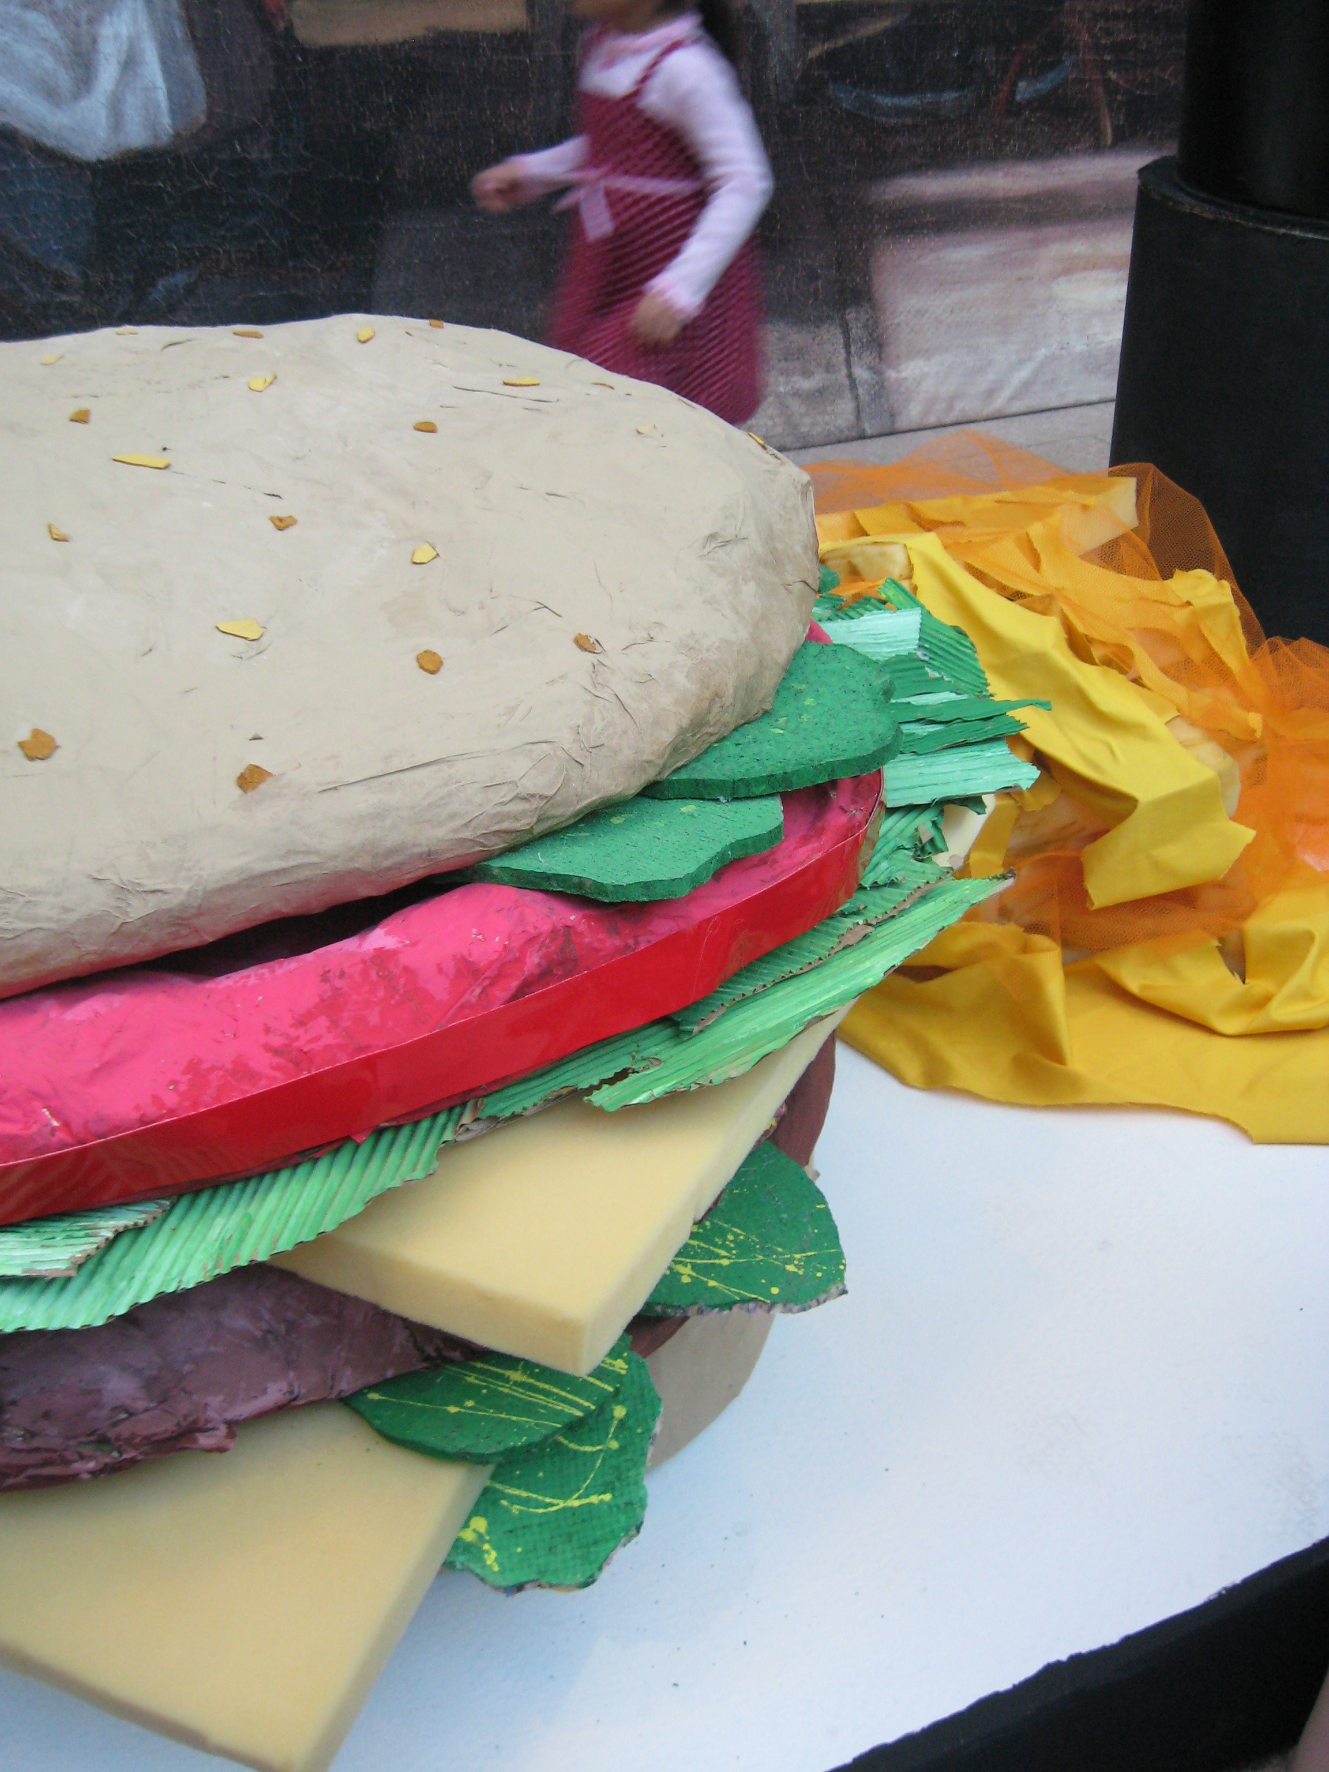

Slide 41
Joseph Cornell
self-taught, inspired by Surrealists, NY 1940’s
The Object
Hotel Eden
Navigating the Imagination
boxes are made of found objects, maps, photographs, Victorian bric-à-brac, engravings,
drinking glasses, a cork ball, a clay pipe, a diagram of the orbits of the Earth and the moon,
images of a Medici Princess, translucent marble in a cascade of blue sand

Slide 42
Sculptural Paintings Inspired by Elizabeth Murray
STEPS:
1) Discuss Murray’s work
2) Choose a story, event, or object
3) Complete colored sketch of
simplified shapes
4) Cut foam core or styro foam
pieces
5) Paint
6) Stack, assemble, and glue layers

