Slide 1
High school Sculpture

Slide 2
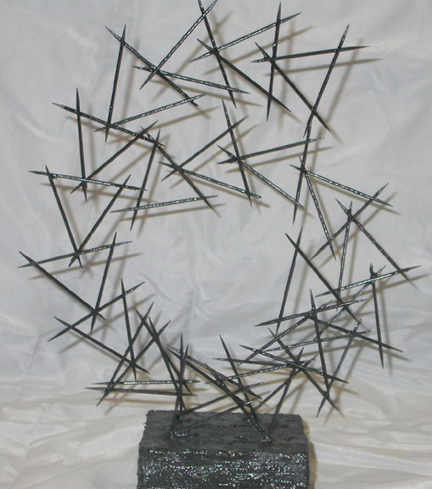
Linear Abstraction using toothpicks

Slide 3
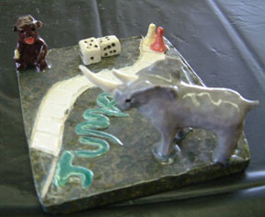
Clay Storybook Projects

Slide 4
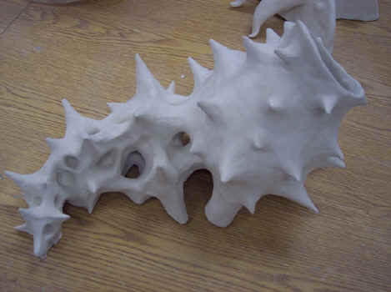
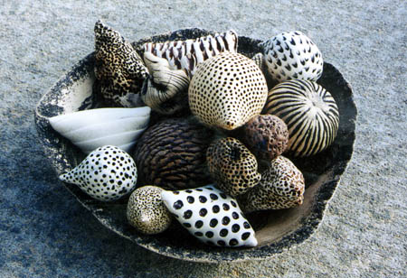
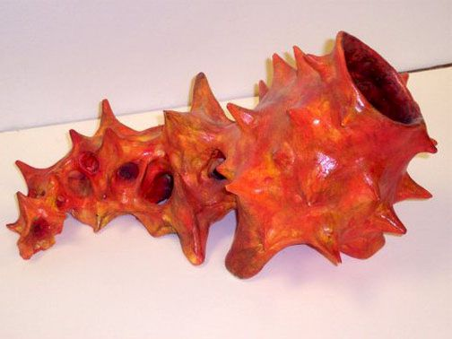
Clay Organic Nature Abstractions
Inspired by artist Kelly Jean Ohi,s PODS

Slide 5
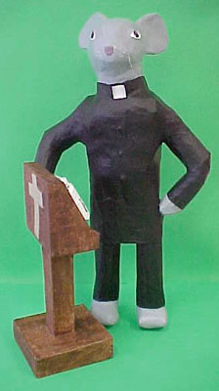
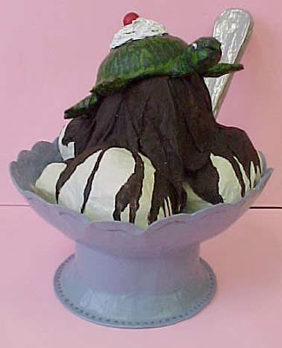
Visual Puns Paper Mache
Grandfather Clock Church Mouse Turtle Sundae

Slide 6
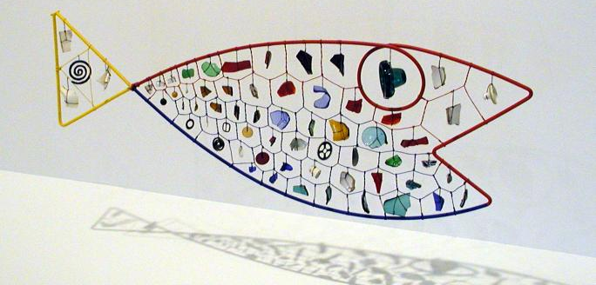
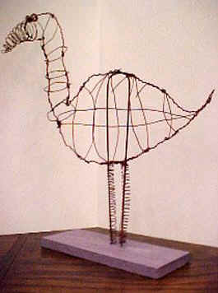
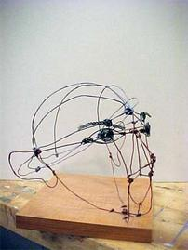
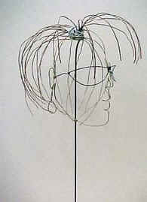
Calder Inspired Wire Sculpture
Alexander Calder’s “Fish”

Slide 7
Claes Oldensburg Inspired

Slide 8
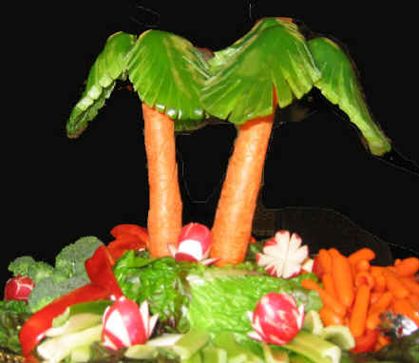
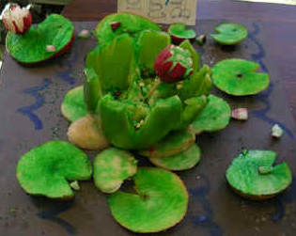
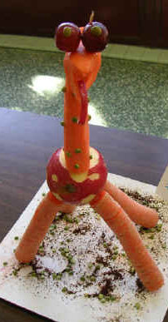
Food Sculptures

Slide 9
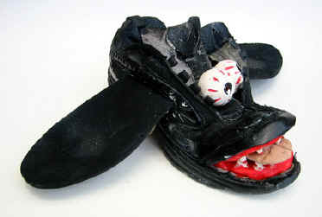
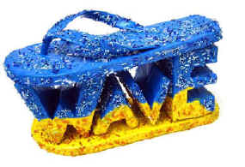
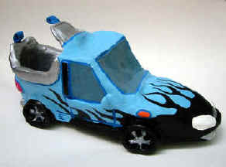
Design A Shoe Sculpture

Slide 10
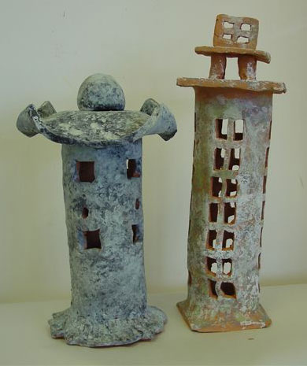
Clay Japanese Lanterns

Slide 11
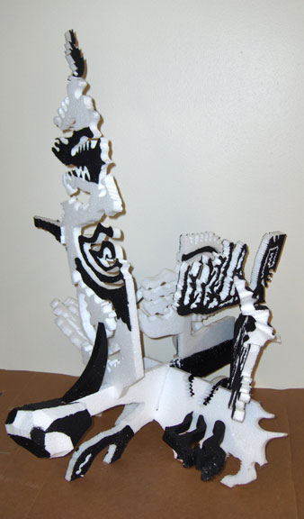
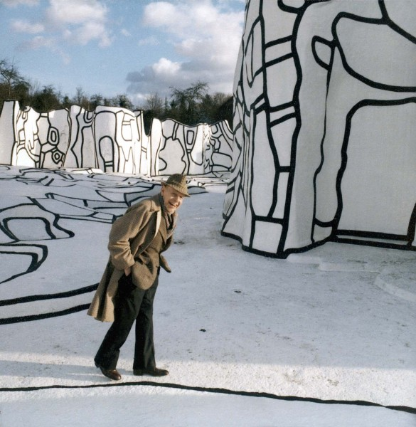
Dubuffet inspired Styrofoam Works

Slide 12
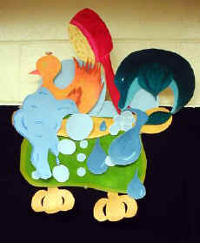
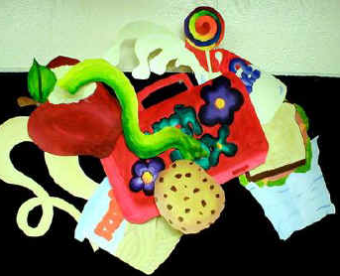
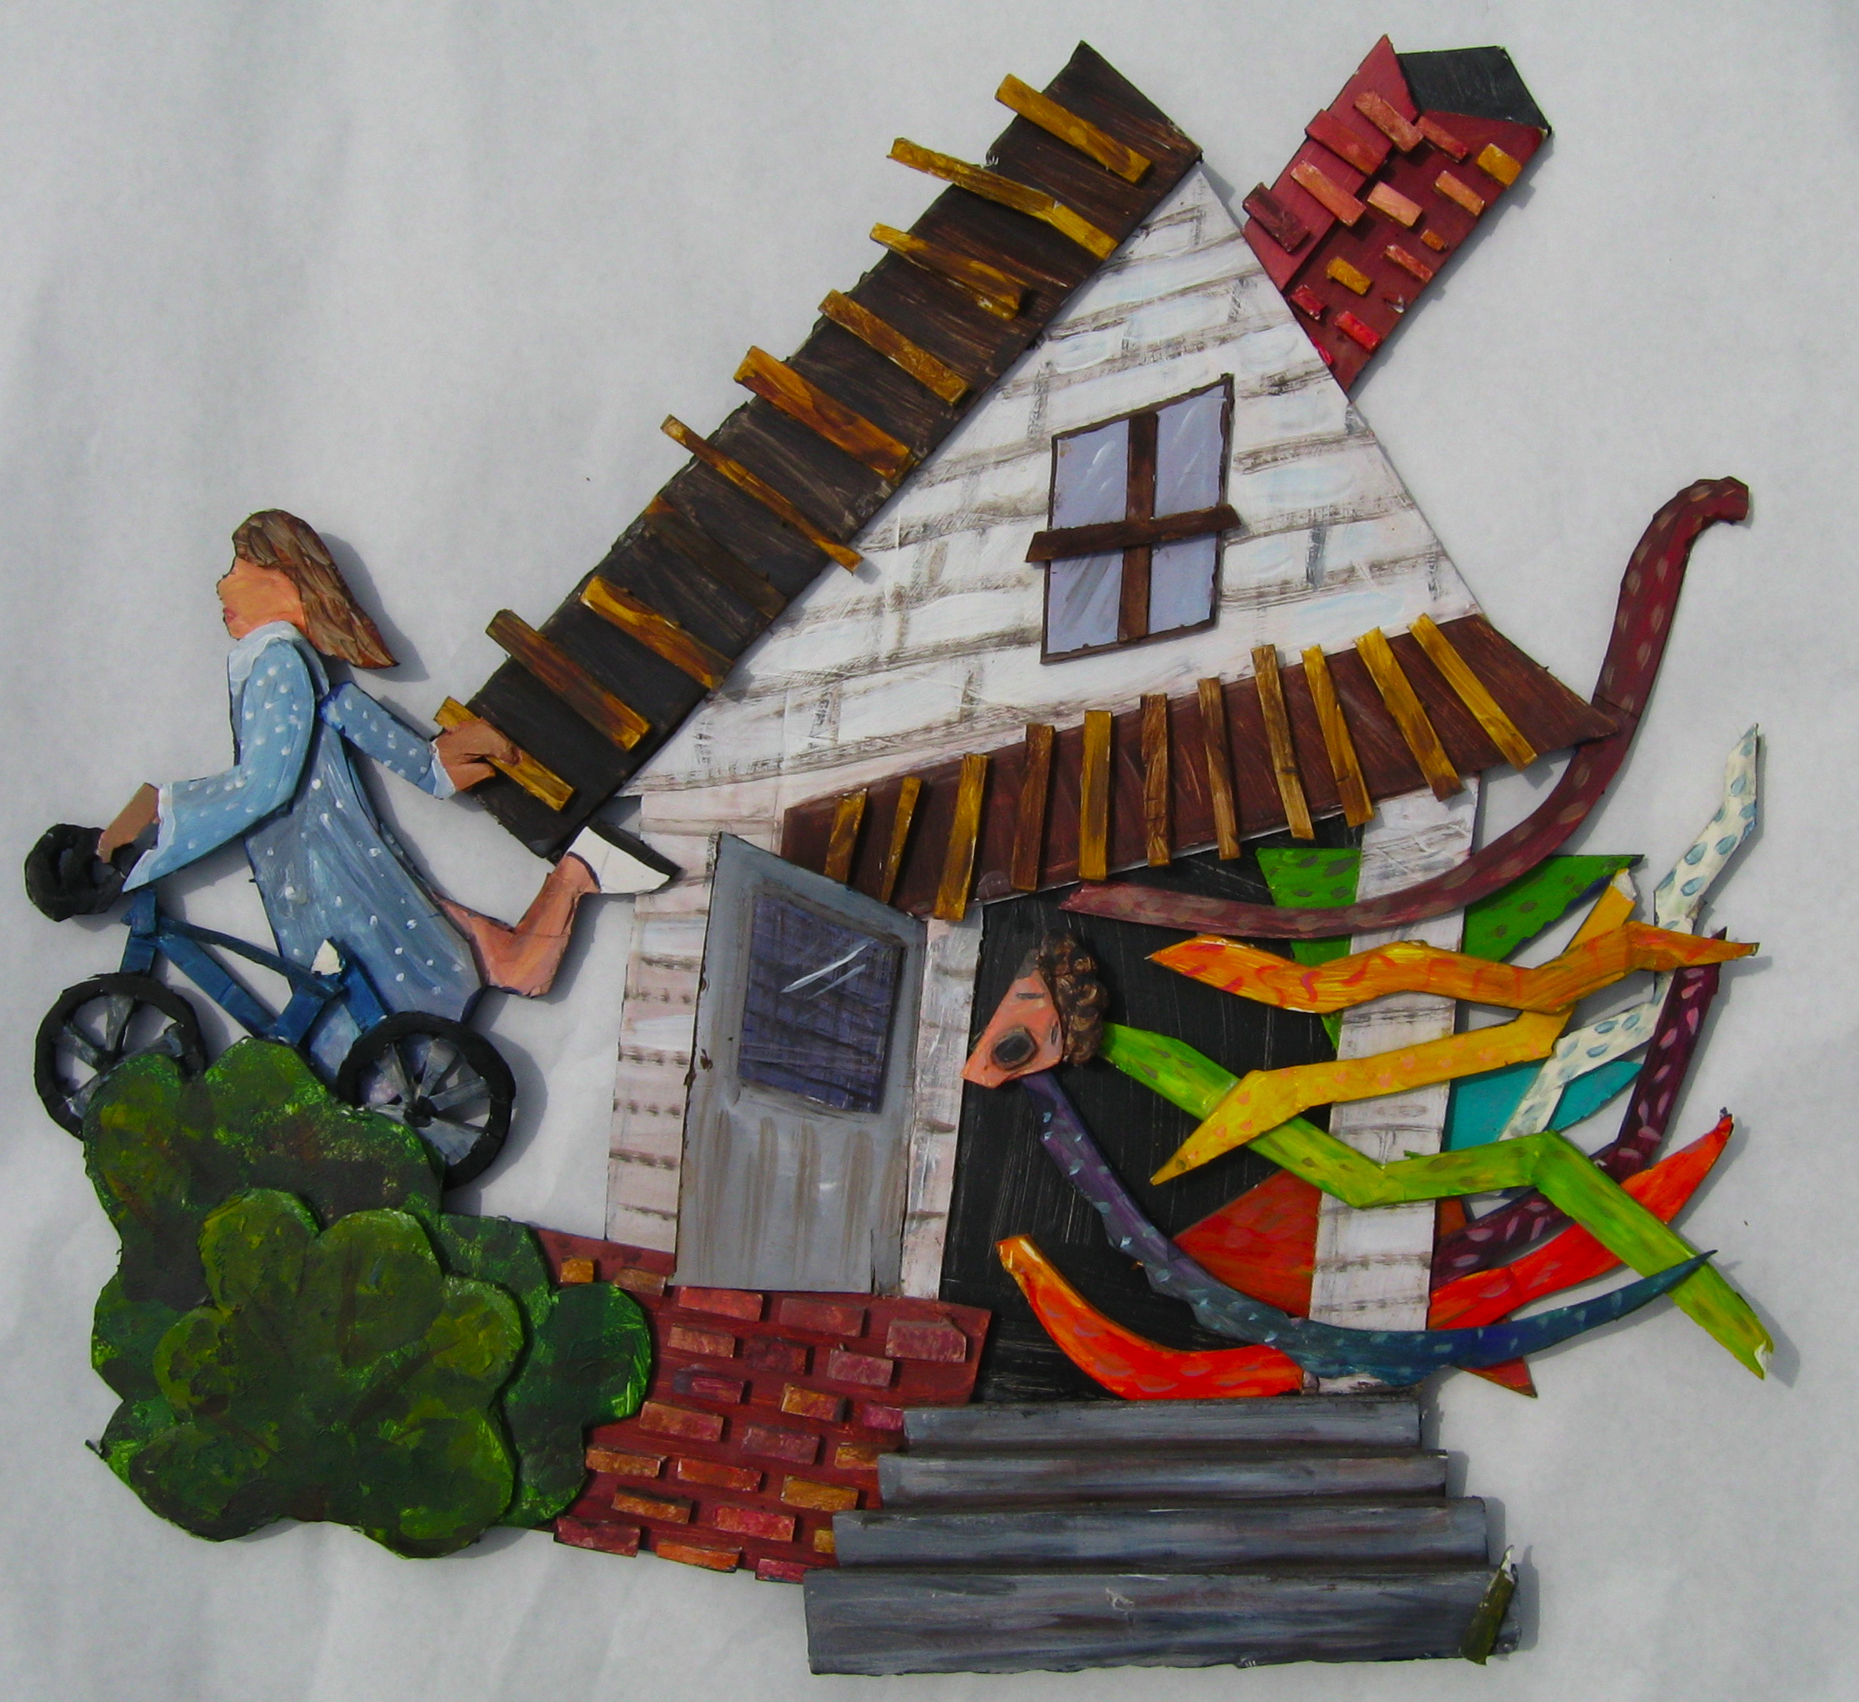
Sculptural Paintings Inspired by Elizabeth Murray
STEPS:
1) Discuss Murray’s work
2) Choose a story, event, or object
3) Complete colored sketch of
simplified shapes
4) Cut foam core or styro foam
pieces
5) Paint
6) Stack, assemble, and glue layers

Slide 13
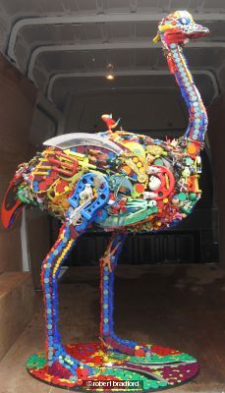
Robert Bradford Inspired

