Slide 1
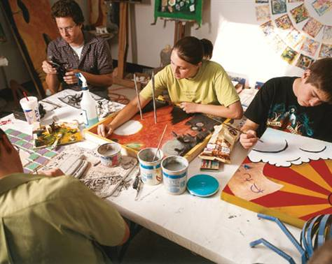
Art Skills for Middle & Secondary Students

Slide 2
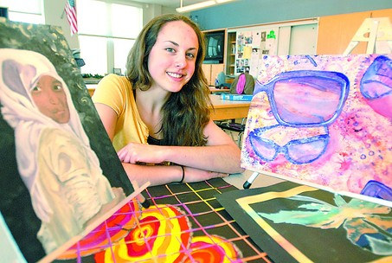
What art skills should teens learn?

Slide 3
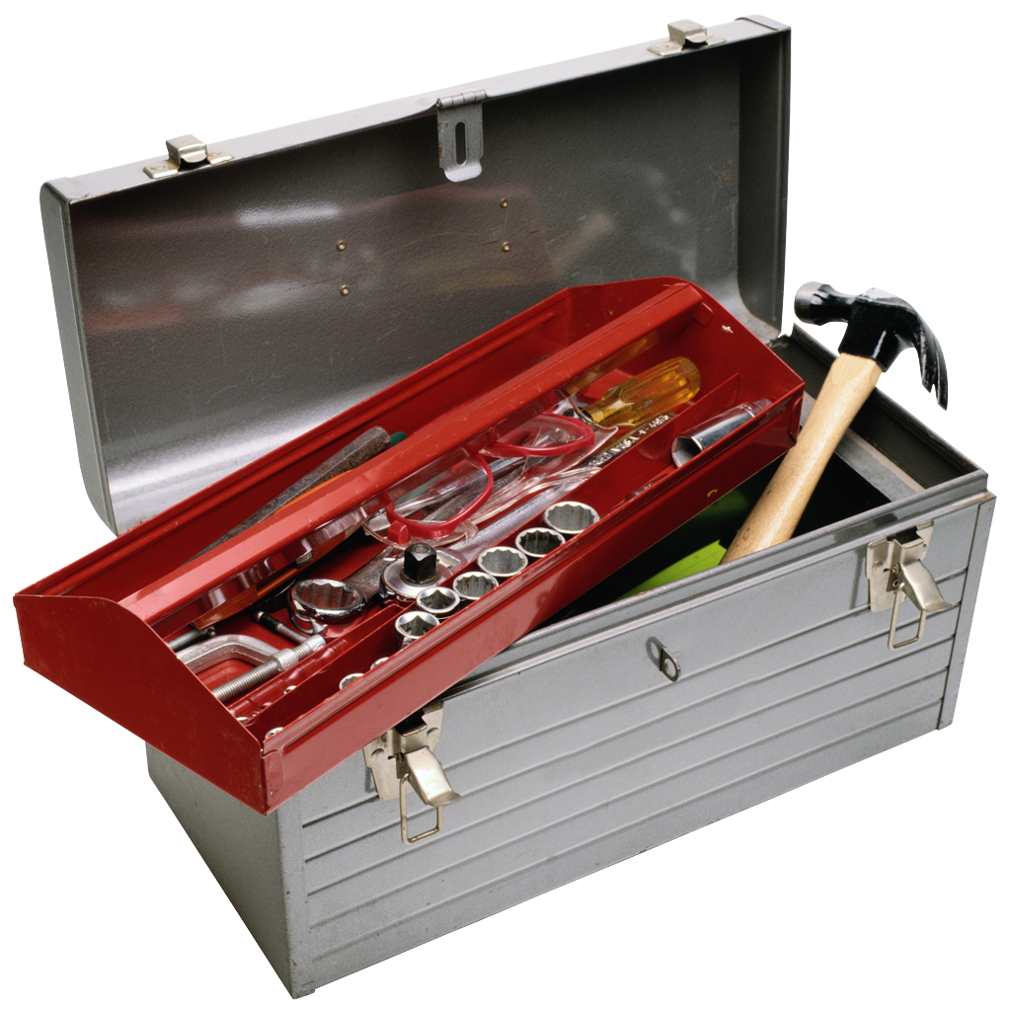
Art Skill Toolbox
Use of art media, techniques, elements
Representation & Expression of Ideas
Imagination and problem-solving What if we used….?)
Visual Literacy &criticism
Inquiry about art & the world (how do artists? Why did Van Gogh use..
Social Skills
Basic Skills

Slide 4
Art Skills are Developmentally Progressive
7th-8 Grade: Exploration of media, skills,
personal expression
9th Grade: Basic Fundamentals of Studio Art
10-11th Grade: Skills, emerging conceptual
thinking & social conscience
12th Grade: Independent Study- Advanced
Studio, Portfolio, personal voice

Slide 5
Art Skills-8th graders
Range of techniques and possibilities with various media
Understanding of usage of tools
Ability to mix intermediate, analogous colors and monochromatic tones
Contour Drawings, one point perspective, basic proportions for portraiture
Skills of perception & observation
Representational , abstraction image making, and symbolic story-telling
Understanding of Craftsmanship
Project Planning and Drafting of ideas
Emerging Appropriate vocabulary of art – able to communicate steps and process
Maintains a workspace
Prepares/Mounts artwork for display

Slide 6
12th grade skills
Illusion of 3D on 2D picture plane
Demonstration of mastery of tools/techniques
Details in textures, patterns, color nuances
Symbolic-metaphorical thinking- idea based work
Ability to conceptualize original ideas
Sensitive to qualities of media and tools
Portrayal of human emotion
Focus and motivation over long periods of time
Create and exhibit a cohesive style-body of work

Slide 7
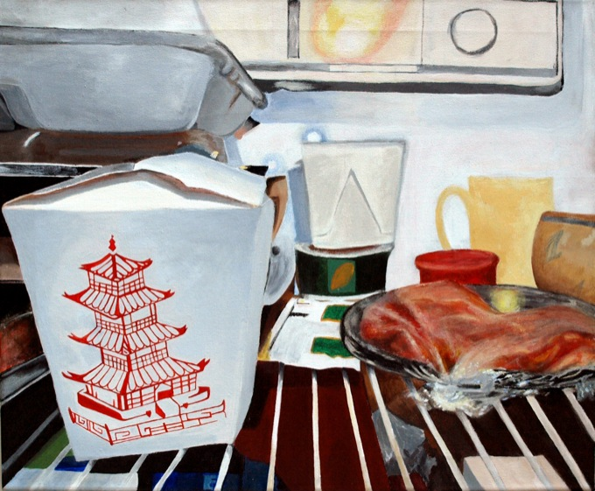

Slide 9
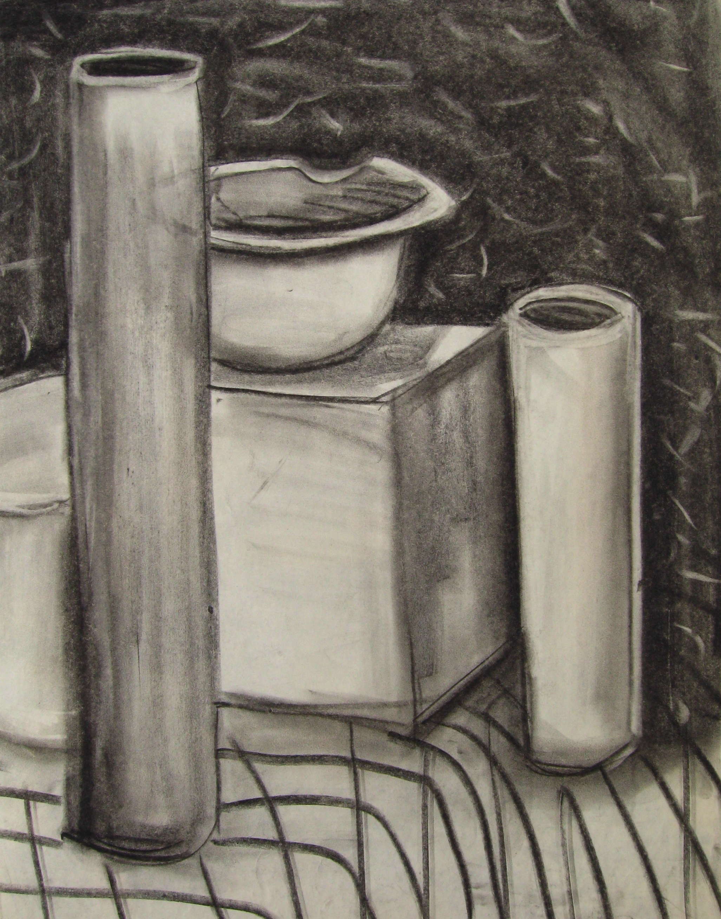

Slide 10
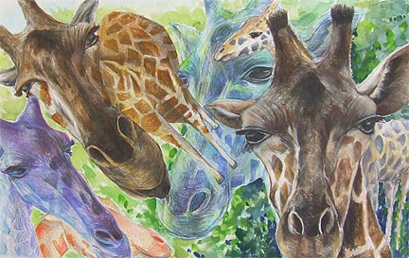

Slide 11
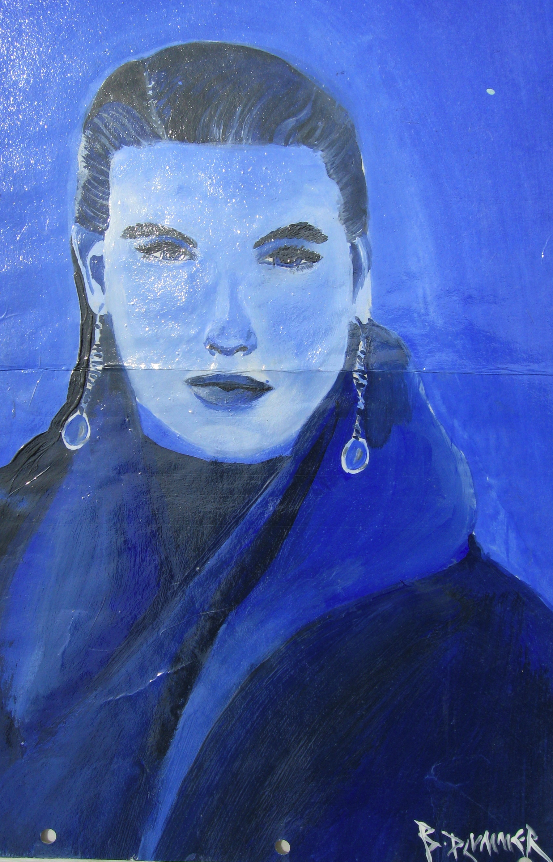

Slide 12
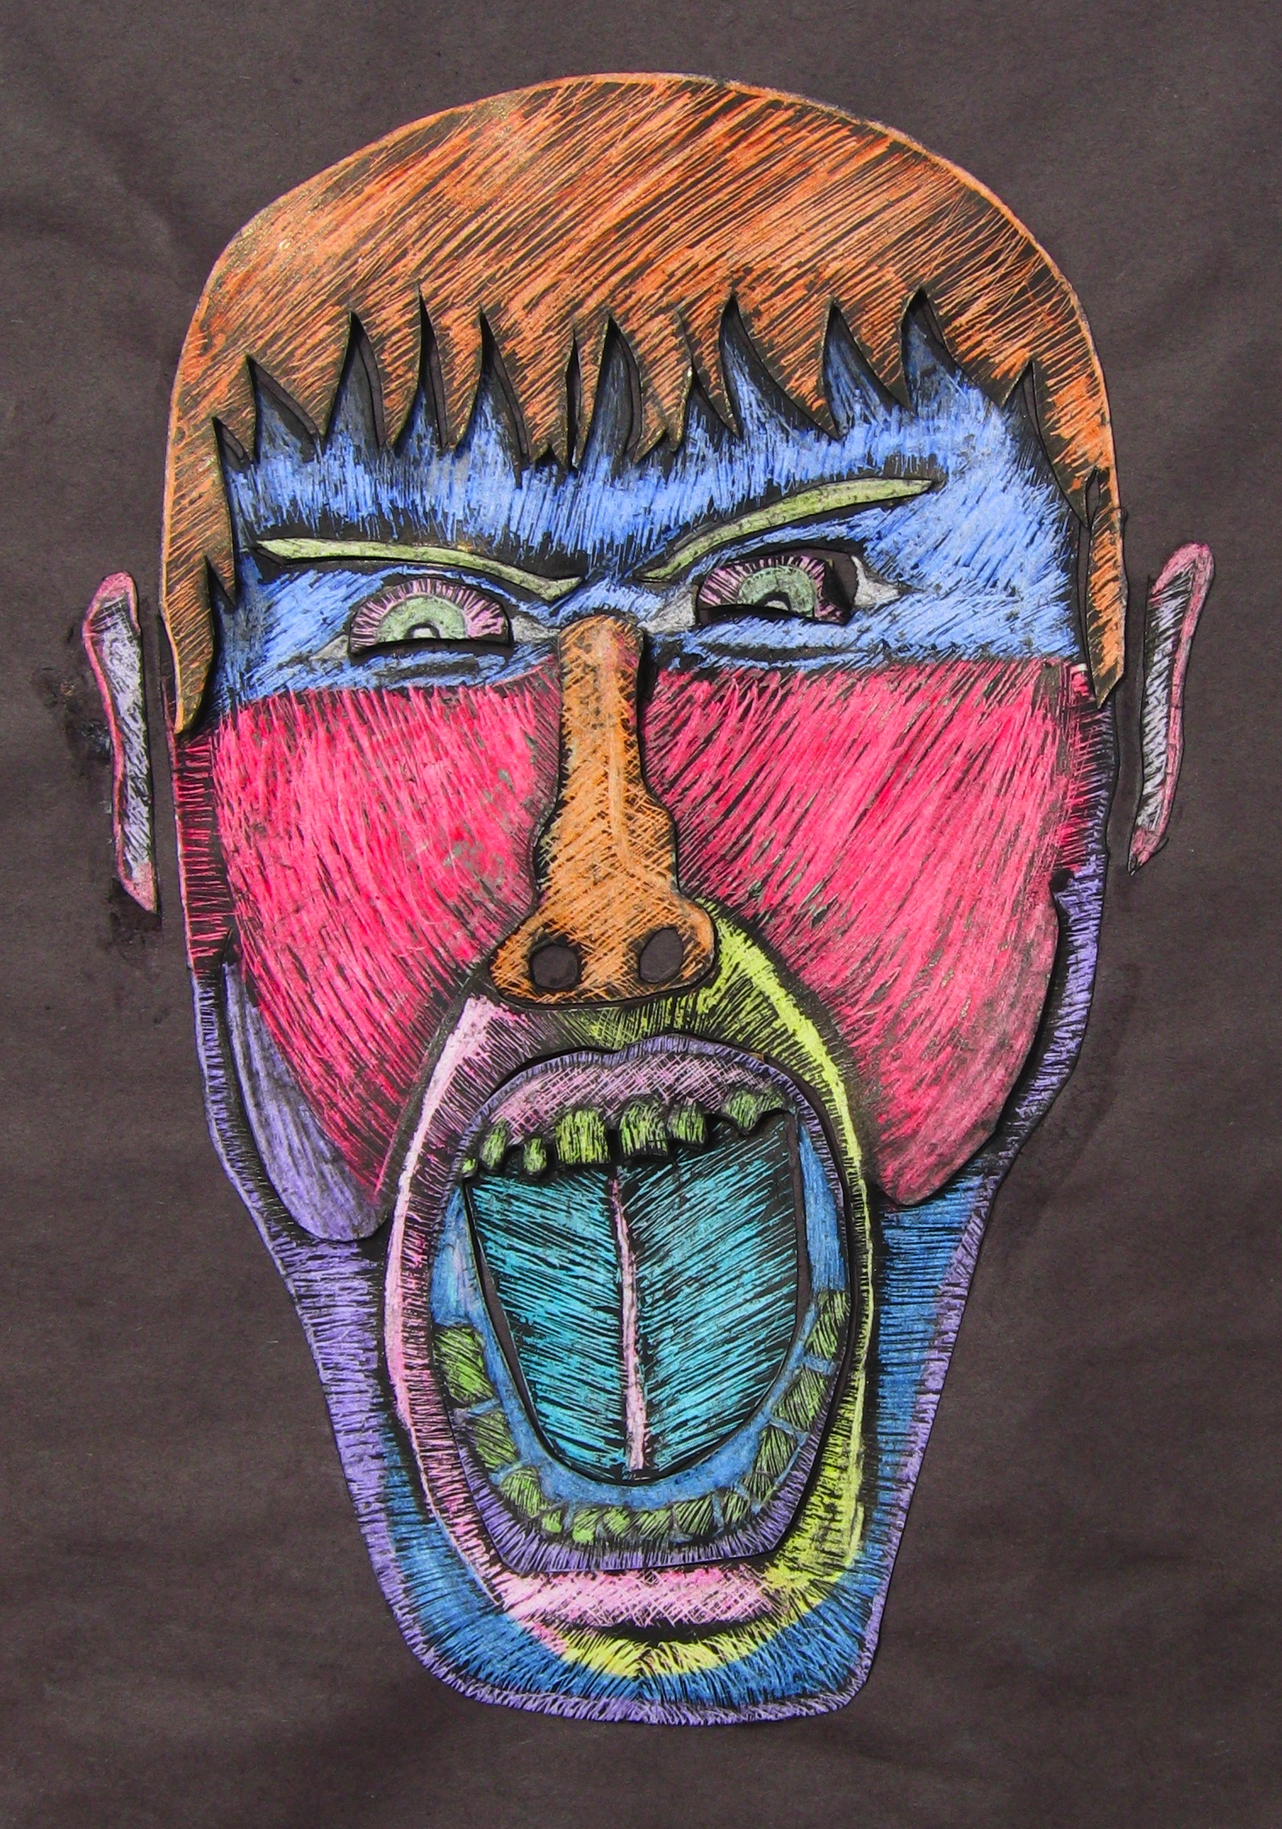

Slide 13
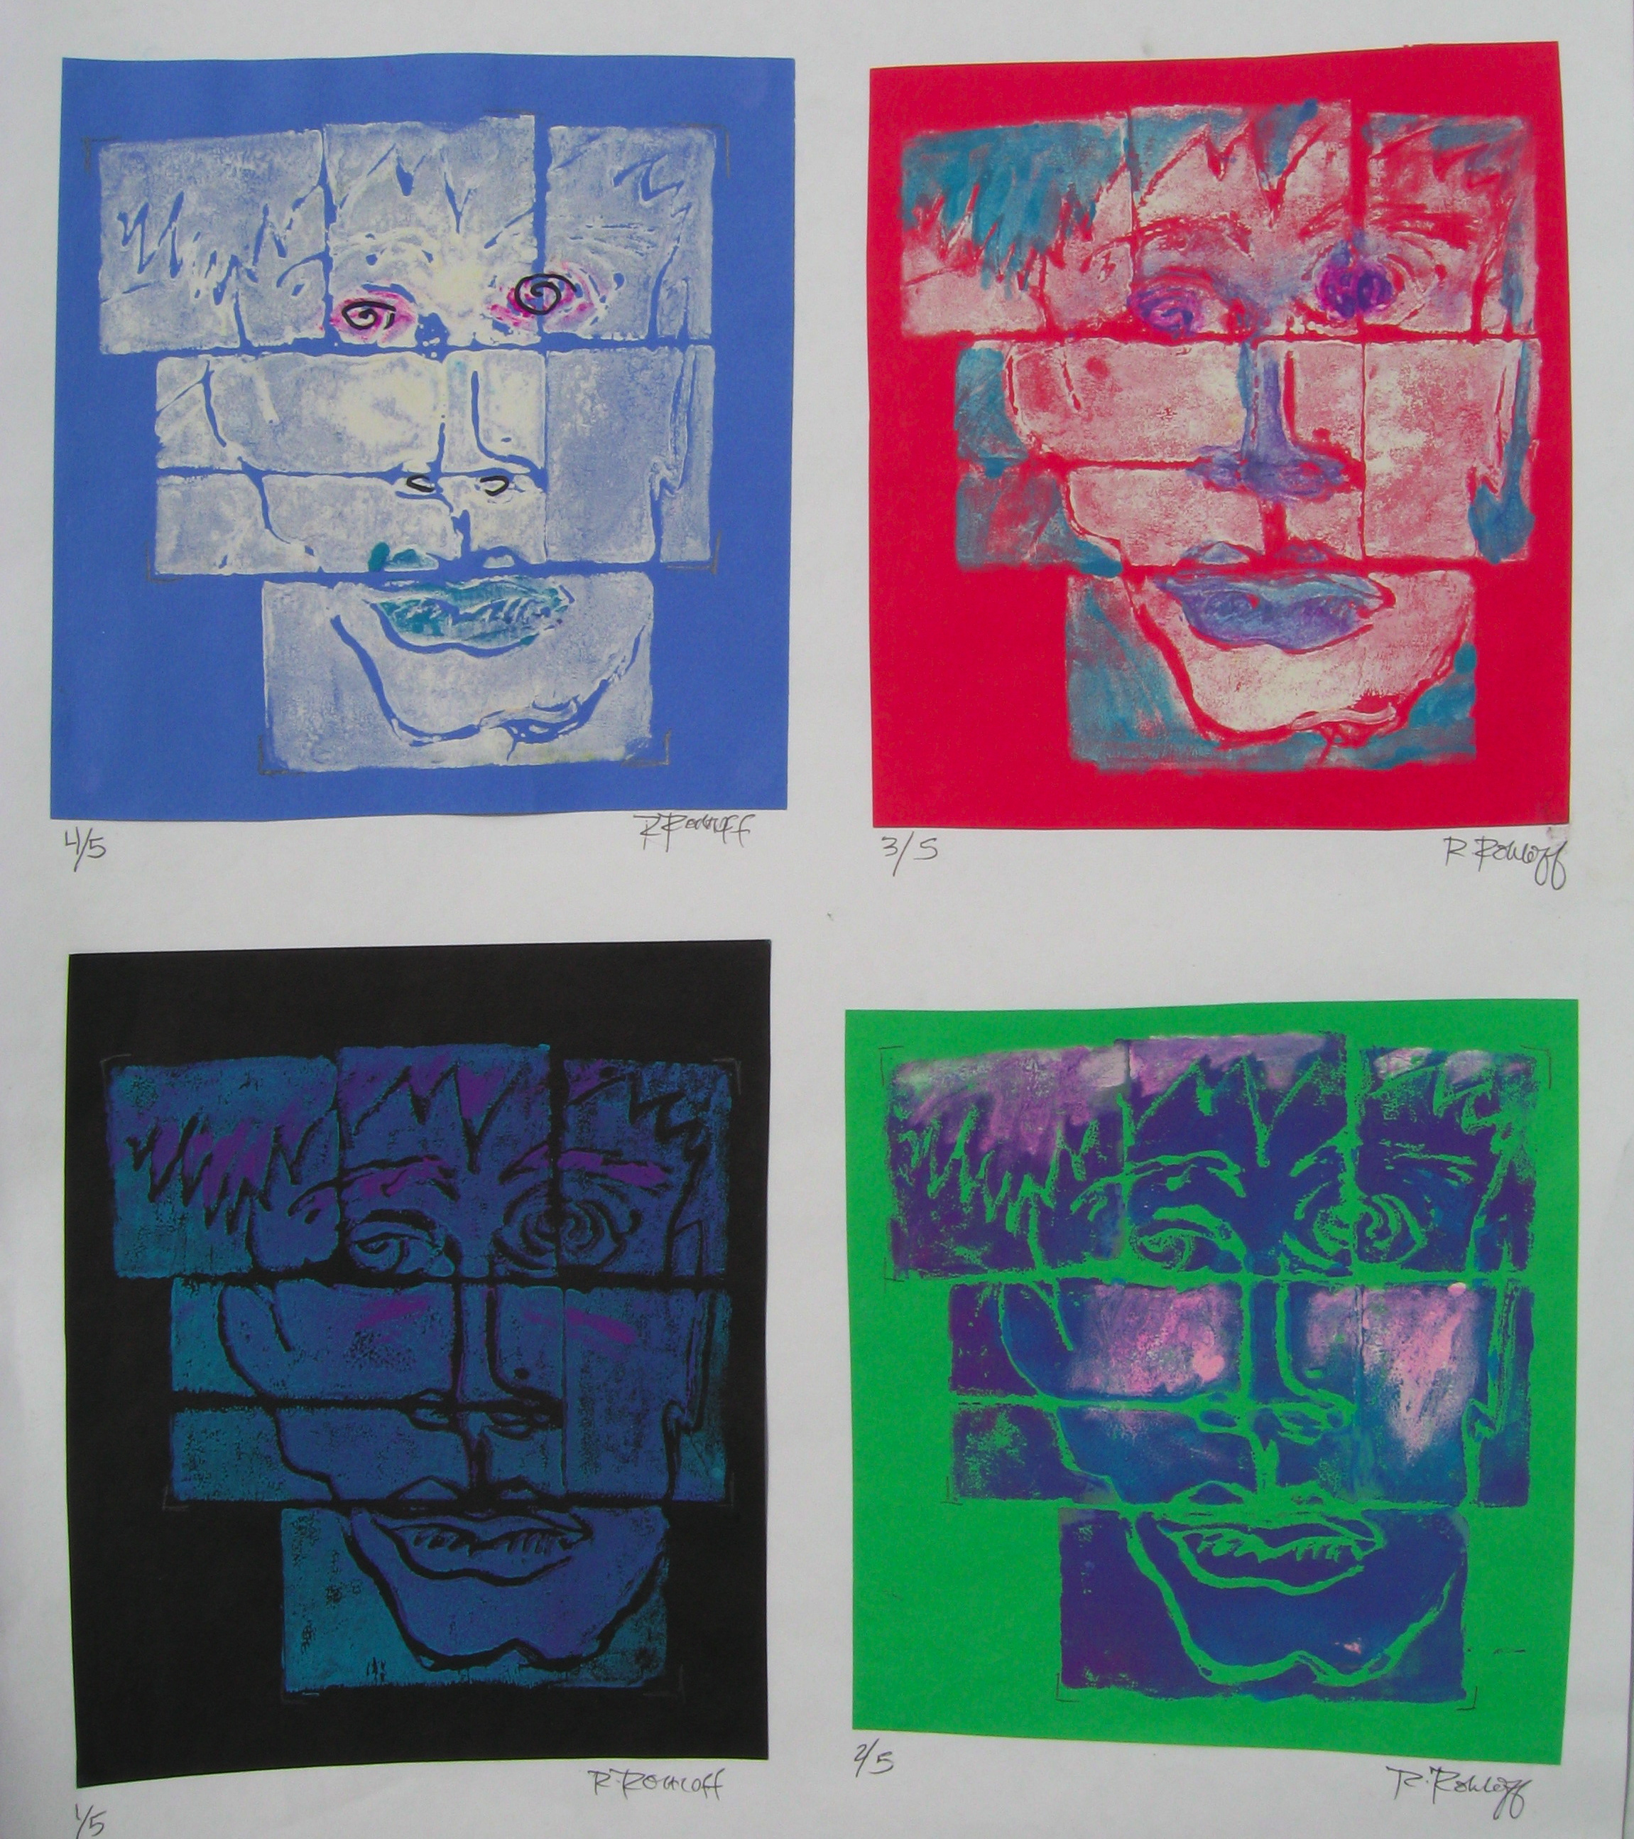

Slide 16
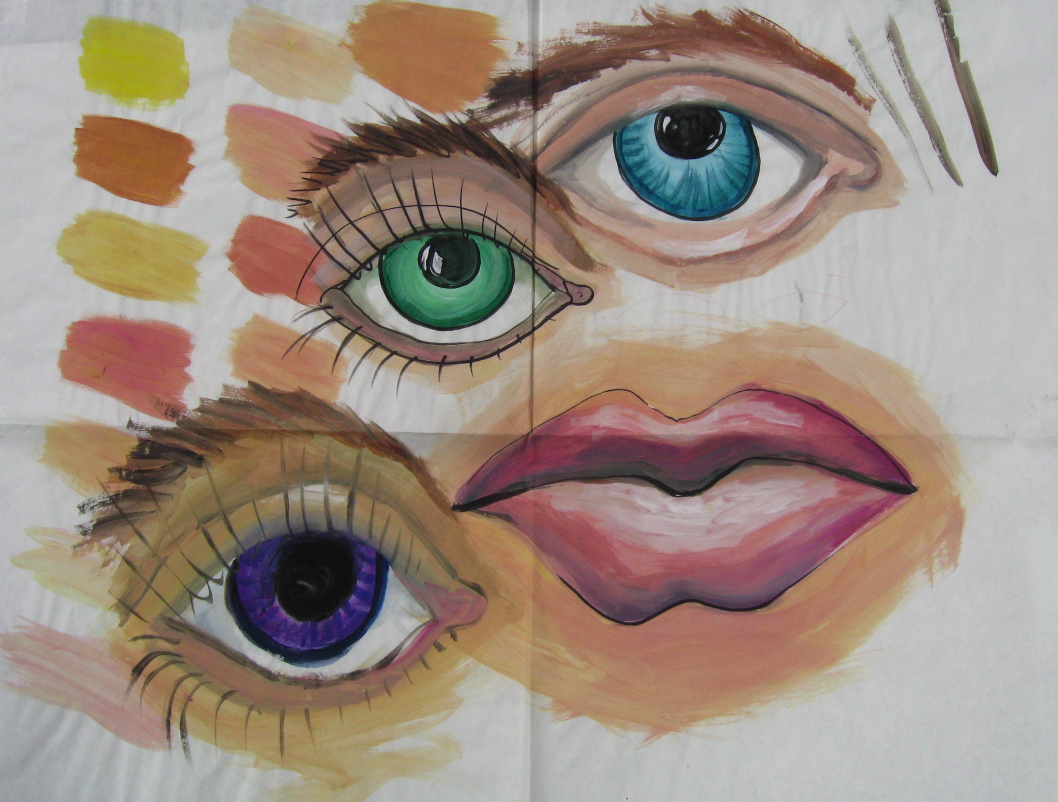

Slide 17
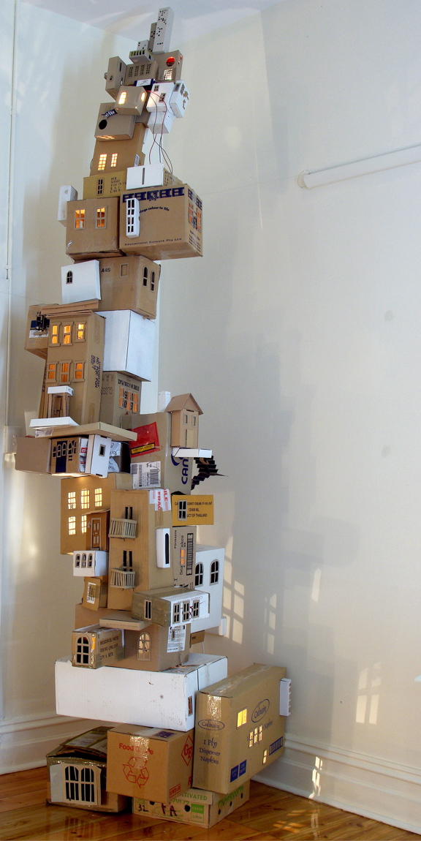

Slide 18
