Slide 1
Chapter 4: Measures of Variability
Leon-Guerrero and Frankfort-Nachmias,
Essentials of Statistics for a Diverse Society

Slide 2
Chapter 4: Measures of Variability
The Importance of Measuring Variability
The Range
The Inter-Quartile Range
The Variance and the Standard Deviation
Considerations for Choosing a Measure of Variation
Reading the Research Literature: Differences in College Aspirations and Expectations Among Latino Adolescents

Slide 3
The Importance of Measuring Variability
Central tendency - Numbers that describe what is typical or average (central) in a distribution
Measures of Variability - Numbers that describe diversity or variability in the distribution.
These two types of measures together help us to sum up a distribution of scores without looking at each and every score. Measures of central tendency tell you about typical (or central) scores. Measures of variation reveal how far from the typical or central score that the distribution tends to vary.

Slide 4
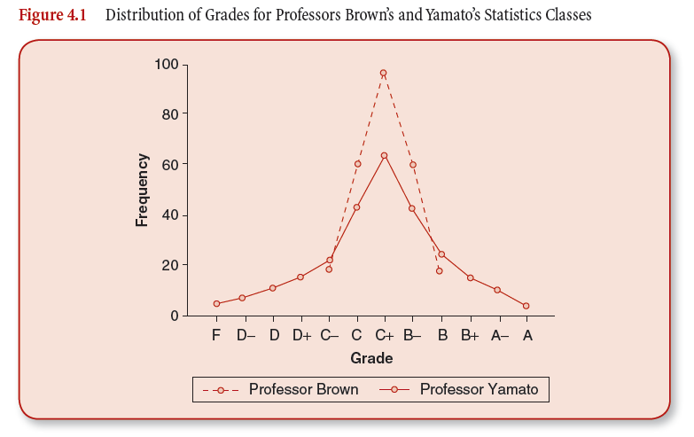
Notice that both distributions have the same mean, yet they are shaped differently

Slide 5
The Range
Range = highest score - lowest score
Range – A measure of variation in interval-ratio variables. It is the difference between the highest (maximum) and the lowest (minimum) scores in the distribution.
Notes:
Range is a good thing to look at to make sure your data are as you expect them to be.

Slide 6
Inter-Quartile Range
Inter-Quartile Range (IQR) – A measure of variation for interval-ratio data. It indicates the width of the middle 50 percent of the distribution and is defined as the difference between the lower and upper quartiles (Q1 and Q3.)
IQR = Q3 – Q1
Q3 = 75th percentile
Q1 = 25th percentile

Slide 7
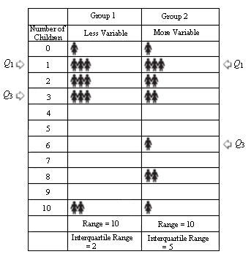
The Difference Between the Range and IQR
These values fall together closely
Shows greater variability
Importance of the IQR
Yet the ranges are equal!

Slide 8
Variance
Variance – A measure of variation for interval-ratio variables; it is the average of the squared deviations from the mean

Slide 9
Standard Deviation
Standard Deviation – A measure of variation for interval-ratio variables; it is equal to the square root of the variance.

Slide 10
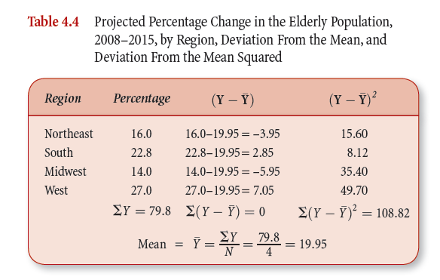
Finding the Mean

Slide 11
Finding the Standard Deviation

Slide 12
Considerations for Choosing a Measure of Variability
For nominal variables, you can only use IQV (Index of Qualitative Variation.)
For ordinal variables, you can calculate the IQV or the IQR (Inter-Quartile Range.) Though, the IQR provides more information about the variable.
For interval-ratio variables, you can use IQV, IQR, or variance/standard deviation. The standard deviation (also variance) provides the most information, since it uses all of the values in the distribution in its calculation.

