Slide 1
Chapter 8: Relationships Between Two Variables
Leon-Guerrero and Frankfort-Nachmias,
Essentials of Statistics for a Diverse Society

Slide 2
Chapter 8: Relationships Between Two Variables
Independent and Dependent Variables
How to Construct and Percentage a Bivariate Table
Dealing with Ambiguous Relationships Between Variables
Properties of a Bivariate Relationship
Elaboration
Hypothesis Testing and Bivariate Tables
The Concept of Chi-Square as a Statistical Test
The Concept of Statistical Independence
The Structure of Hypothesis Testing with Chi-Square
Sample Size and Statistical Significance for Chi-Square
The Proportional Reduction of Error: A Brief Introduction
Lambda: A Measure of Association for Nominal Variables
Gamma: A Measure of Association for Ordinal Variables

Slide 3
Introduction
Bivariate Analysis: A statistical method designed to detect and describe the relationship between two variables.
Cross-Tabulation: A technique for analyzing the relationship between two variables that have been organized in a table.

Slide 4
Understanding Independent and Dependent Variables
Example: If we hypothesize that English proficiency varies by whether person is native born or foreign born, what is the independent variable, and what is the dependent variable?
Independent variable: nativity
Dependent variable: English proficiency

Slide 5
Constructing a Bivariate Table
Bivariate table: A table that displays the distribution of one variable across the categories of another variable.
Column variable: A variable whose categories are the columns of a bivariate table.
Row variable: A variable whose categories are the rows of a bivariate table.
Cell: The intersection of a row and a column in a bivariate table.
Marginals: The row and column totals in a bivariate table.

Slide 6
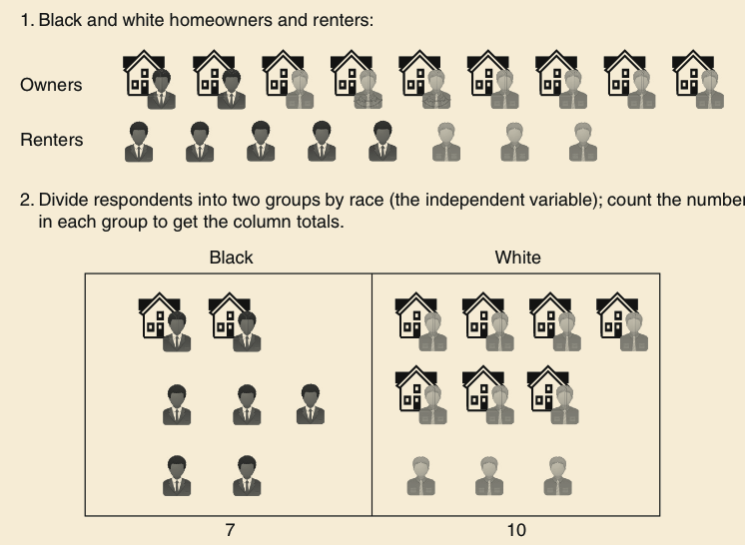
Percentaging a Bivariate Table

Slide 7
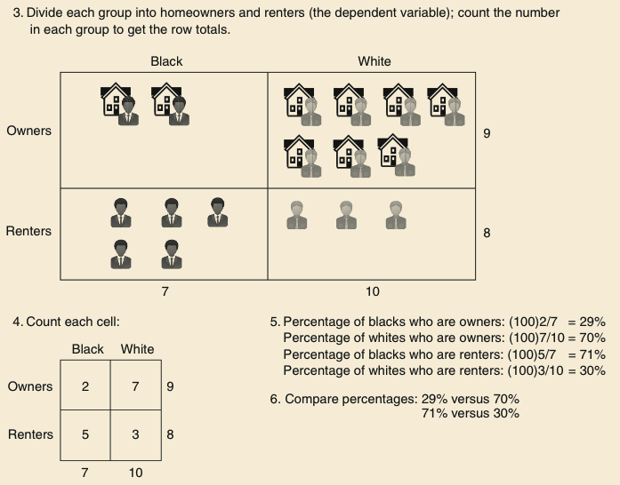
Percentaging a Bivariate Table

Slide 8
Percentages Can Be Computed in Different Ways:
Column Percentages: column totals as base
Row Percentages: row totals as base

Slide 9
Properties of a Bivariate Relationship
Does there appear to be a relationship?
How strong is it?
What is the direction of the relationship?

Slide 10
Existence of a Relationship
IV: Number of Traumas
DV: Support for Abortion
If the number of traumas were unrelated to attitudes toward abortion among women, then we would expect to find equal percentages of women who are pro-choice (or pro-life), regardless of the number of traumas experienced.

Slide 11
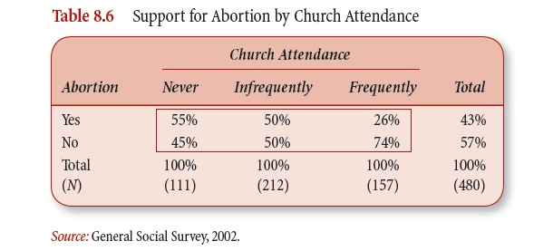
Existence of the Relationship

Slide 12
Determining the Strength of the Relationship
A quick method is to examine the percentage difference across the different categories of the independent variable.
The larger the percentage difference across the categories, the stronger the association.
We rarely see a situation with either a 0% or a 100% difference.

Slide 13
Direction of the Relationship
Positive relationship: A bivariate relationship between two variables measured at the ordinal level or higher in which the variables vary in the same direction.
Negative relationship: A bivariate relationship between two variables measured at the ordinal level or higher in which the variables vary in opposite directions.

Slide 14
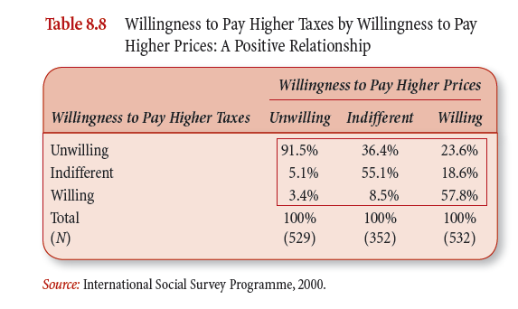
A Positive Relationship

Slide 15
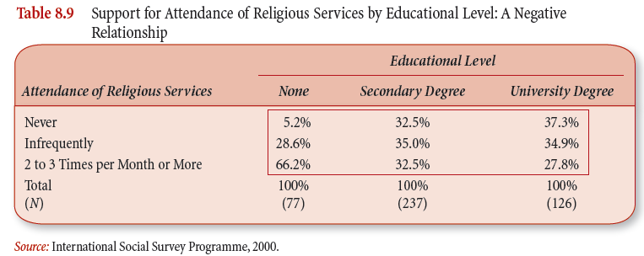
A Negative Relationship

Slide 16
Elaboration
Elaboration is a process designed to further explore a bivariate relationship; it involves the introduction of control variables.
A control variable is an additional variable considered in a bivariate relationship. The variable is controlled for when we take into account its effect on the variables in the bivariate relationship.

Slide 17
Three Goals of Elaboration
Elaboration allows us to test for non-spuriousness.
Elaboration clarifies the causal sequence of bivariate relationships by introducing variables hypothesized to intervene between the IV and DV.
Elaboration specifies the different conditions under which the original bivariate relationship might hold.

Slide 18
Process of Elaboration
Partial tables: bivariate tables that display the relationship between the IV and DV while controlling for a third variable.
Partial relationship: the relationship between the IV and DV shown in a partial table.

Slide 19
The Process of Elaboration
Divide the observations into subgroups on the basis of the control variable. We have as many subgroups as there are categories in the control variable.
Re-examine the relationship between the original two variables separately for the control variable subgroups.
Compare the partial relationships with the original bivariate relationship for the total group.

Slide 20
Chi-Square as a Statistical Test
Chi-square test: an inferential statistics technique designed to test for significant relationships between two variables organized in a bivariate table.
Chi-square requires no assumptions about the shape of the population distribution from which a sample is drawn.
It can be applied to nominally or ordinally measured variables.

Slide 21
Statistical Independence
Independence (statistical): the absence of association between two cross-tabulated variables. The percentage distributions of the dependent variable within each category of the independent variable are identical.

Slide 22
Hypothesis Testing with Chi-Square
Making assumptions (random sampling)
Stating the research and null hypotheses and selecting alpha
Selecting the sampling distribution and specifying the test statistic
Computing the test statistic
Making a decision and interpreting the results

Slide 23
The Assumptions
The chi-square test requires no assumptions about the shape of the population distribution from which the sample was drawn.
However, like all inferential techniques it assumes random sampling.
It can be applied to variables measured at a nominal and/or an ordinal level of measurement.

Slide 24
Stating Research and Null Hypotheses
The research hypothesis (H₁) proposes that the two variables are related in the population.
The null hypothesis (H₀) states that no association exists between the two cross-tabulated variables in the population, and therefore the variables are statistically independent.

Slide 25
H₁: The two variables are related in the population.
Gender and fear of walking alone at night are statistically dependent.
Afraid Men Women Total
No 83.3% 57.2% 71.1%
Yes 16.7% 42.8% 28.9%
Total 100% 100% 100%

Slide 26
H₀: There is no association between the two variables.
Gender and fear of walking alone at night are statistically independent.
Afraid Men Women Total
No 71.1% 71.1% 71.1%
Yes 28.9% 28.9% 28.9%
Total 100% 100% 100%

Slide 27
The Concept of Expected Frequencies
Expected frequencies f_{e} : the cell frequencies that would be expected in a bivariate table if the two tables were statistically independent.
Observed frequencies f_{o}: the cell frequencies actually observed in a bivariate table.

Slide 28
Calculating Expected Frequencies
f_{e} = (column marginal)(row marginal)
N
To obtain the expected frequencies for any cell in any cross-tabulation in which the two variables are assumed independent, multiply the row and column totals for that cell and divide the product by the total number of cases in the table.

Slide 29
Chi-Square (obtained)
The test statistic that summarizes the differences between the observed (fo) and the expected (fe) frequencies in a bivariate table.

Slide 30
Calculating the Obtained Chi-Square
Where f_{e} = expected frequencies
f_{o} = observed frequencies

Slide 31
The Sampling Distribution of Chi-Square
The sampling distribution of chi-square tells the probability of getting values of chi-square, assuming no relationship exists in the population.
The chi-square sampling distributions depend on the degrees of freedom.
The χ² sampling distribution is not one distribution, but is a family of distributions.

Slide 32
The Sampling Distribution of Chi-Square
The distributions are positively skewed. The research hypothesis for the chi-square is always a one-tailed test.
Chi-square values are always positive. The minimum possible value is zero, with no upper limit to its maximum value.
As the number of degrees of freedom increases, the χ² distribution becomes more symmetrical.

Slide 33
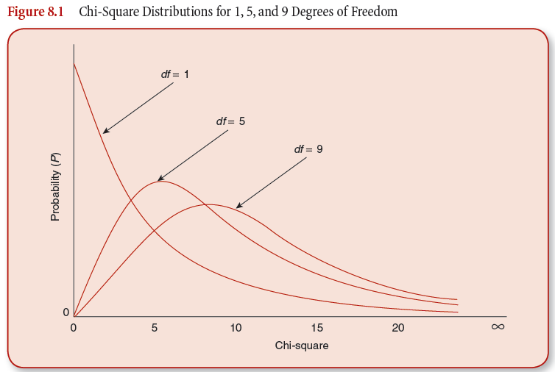
The Sampling Distribution of Chi-Square

Slide 34
Determining the Degrees of Freedom
df = (r – 1)(c – 1)
where
r = the number of rows
c = the number of columns

Slide 35
Calculating Degrees of Freedom
How many degrees of freedom would a table with 3 rows and 2 columns have?
(3 – 1)(2 – 1) =
2
2 degrees of freedom

Slide 36
Limitations of the Chi-Square Test
The chi-square test does not give us much information about the strength of the relationship or its substantive significance in the population.
The chi-square test is sensitive to sample size. The size of the calculated chi-square is directly proportional to the size of the sample, independent of the strength of the relationship between the variables.
The chi-square test is also sensitive to small expected frequencies in one or more of the cells in the table.

Slide 37
Measures of Association
Measure of association—a single summarizing number that reflects the strength of a relationship, indicates the usefulness of predicting the dependent variable from the independent variable, and often shows the direction of the relationship.

Slide 38
Take your best guess?
If you know nothing else about a person except that he or she lives in United States and I asked you to guess his or her race/ethnicity, what would you guess?
The most common race/ethnicity for U.S. residents (e.g., the mode)!

Slide 39
Take your best guess?
Now, if we know that this person lives in San Diego, California, would you change your guess?
With quantitative analyses we are generally trying to predict or take our best guess at value of the dependent variable. One way to assess the relationship between two variables is to consider the degree to which the extra information of the independent variable makes your guess better.

Slide 40
Proportional Reduction of Error (PRE)
PRE—the concept that underlies the definition and interpretation of several measures of association. PRE measures are derived by comparing the errors made in predicting the dependent variable while ignoring the independent variable with errors made when making predictions that use information about the independent variable.

Slide 41
Proportional Reduction of Error (PRE)
where: E1 = errors of prediction made when the independent variable is ignored
E2 = errors of prediction made when the prediction is based on the independent variable

Slide 42
Two PRE Measures: Lambda & Gamma
Appropriate for…
Lambda NOMINAL variables
Gamma ORDINAL & DICHOTOMOUS NOMINAL variables

Slide 43
Lambda
Lambda—An asymmetrical measure of association suitable for use with nominal variables and may range from 0 (meaning the extra information provided by the independent variable does not help prediction) to 1 (meaning use of independent variable results in no prediction errors). It provides us with an indication of the strength of an association between the independent and dependent variables.
A lower value represents a weaker association, while a higher value is indicative of a stronger association

Slide 44
Lambda
where:
E1= N_{total} - N_{mode of dependent variable}

Slide 45
Example 1: 2000 Vote By Abortion Attitudes
Abortion Attitudes (for any reason)
Vote Yes No Row Total
Gore 46 39 85
Bush 41 73 114
Total 87 112 199
Source: General Social Survey, 2002
Step One—Add percentages to the table to get the data in a format that allows you to clearly assess the nature of the relationship.

Slide 46
Example 1: 2000 Vote By Abortion Attitudes
Abortion Attitudes (for any reason)
Vote Yes No Row Total
Gore 52.9% 34.8% 42.7% 46 39 85
Bush 47.1% 65.2% 57.3% 41 73 114
Total 100% 100% 100% 87 112 199
Source: General Social Survey, 2002
Now calculate E1
E1 = N_{total} – N_{mode} = 199 – 114 =
85

Slide 47
Example 1: 2000 Vote By Abortion Attitudes
Abortion Attitudes (for any reason)
Vote Yes No Row Total
Gore 52.9% 34.8% 42.7% 46 39 85
Bush 47.1% 65.2% 57.3% 41 73 114
Total 100% 100% 100% 87 112 199
Source: General Social Survey, 2002
Now calculate E2
E2 = [N_{(Yes column total)} – N_{(Yes column mode)}] +
[N_{(No column total)} – N_{(No column mode)}]
= [87 – 46] + …

Slide 48
Example 1: 2000 Vote By Abortion Attitudes
Abortion Attitudes (for any reason)
Vote Yes No Row Total
Gore 52.9% 34.8% 42.7% 46 39 85
Bush 47.1% 65.2% 57.3% 41 73 114
Total 100% 100% 100% 87 112 199
Source: General Social Survey, 2002
Now calculate E2
E2 = [N_{(Yes column total)} – N_{(Yes column mode)}] +
[N_{(No column total)} – N_{(No column mode)}]
= [87 – 46] +
[112 – 73]

Slide 49
Example 1: 2000 Vote By Abortion Attitudes
Abortion Attitudes (for any reason)
Vote Yes No Row Total
Gore 52.9% 34.8% 42.7% 46 39 85
Bush 47.1% 65.2% 57.3% 41 73 114
Total 100% 100% 100% 87 112 199
Source: General Social Survey, 2002
Now calculate E2
E2 = [N_{(Yes column total)} – N_{(Yes column mode)}] +
[N_{(No column total)} – N_{(No column mode)}]
= [87 – 46] + [112 – 73] =
80

Slide 50
Example 1: 2000 Vote By Abortion Attitudes
Abortion Attitudes (for any reason)
Vote Yes No Row Total
Gore 52.9% 34.8% 42.7% 46 39 85
Bush 47.1% 65.2% 57.3% 41 73 114
Total 100% 100% 100% 87 112 199
Source: General Social Survey, 2002
Lambda = [E1– E2] / E1
= [85 – 80] / 85 =
.06

Slide 51
Example 1: 2000 Vote By Abortion Attitudes
Abortion Attitudes (for any reason)
Vote Yes No Row Total
Gore 52.9% 34.8% 42.7% 46 39 85
Bush 47.1% 65.2% 57.3% 41 73 114
Total 100% 100% 100% 87 112 199
Source: General Social Survey, 2002
Lambda = .06
So, we know that six percent of the errors in predicting 2000 presidential election vote can be reduced by taking into account abortion attitudes.

Slide 52
Example 2: Victim-Offender Relationship and Type of Crime: 1993
Step One—Add percentages to the table to get the data in a format that allows you to clearly assess the nature of the relationship.
*Source: Kathleen Maguire and Ann L. Pastore, eds., Sourcebook of Criminal Justice Statistics 1994., U.S. Department of Justice, Bureau of Justice Statistics, Washington, D.C.: USGPO, 1995, p. 343.

Slide 53
Victim-Offender Relationship & Type of Crime: 1993
Now calculate E1
E1 = N_{total} – N_{mode} = 9,898,980 – 5,045,040 =
4,835,940

Slide 54
Victim-Offender Relationship & Type of Crime: 1993
Now calculate E2
E2 = [N(rape/sexual assault column total) – N(rape/sexual assault column mode)] +
[N_{(robbery column total)} – N_{(robbery column mode)}] +
[N_{(assault column total)} – N_{(assault column mode)}]
= [472,760 – 350,670] + …

Slide 55
Victim-Offender Relationship and Type of Crime: 1993
Now calculate E2
E2 = [N(rape/sexual assault column total) – N(rape/sexual assault column mode)] +
[N_{(robbery column total)} – N_{(robbery column mode)}] +
[N_{(assault column total)} – N_{(assault column mode)}]
= [472,760 – 350,670] +
[1,161,900 – 930,860] + …

Slide 56
Victim-Offender Relationship and Type of Crime: 1993
Now calculate E2
E2 = [N(rape/sexual assault column total) – N(rape/sexual assault column mode)] +
[N_{(robbery column total)} – N_{(robbery column mode)}] +
[N_{(assault column total)} – N_{(assault column mode)}]
= [472,760 – 350,670] +
[1,161,900 – 930,860] +
[8,264,320 – 4,272,230] = 4,345,220

Slide 57
Victim-Offender Relationship and Type of Crime: 1993
Lambda = [E1– E2] / E1
= [4,835,940 – 4,345,220] / 4,835,940 =
.10
So, we know that ten percent of the errors in predicting the relationship between victim and offender (stranger vs. non-stranger) can be reduced by taking into account the type of crime that was committed.

Slide 58
Asymmetrical Measure of Association
A measure whose value may vary depending on which variable is considered the independent variable and which the dependent variable.
Lambda is an asymmetrical measure of association.

Slide 59
Symmetrical Measure of Association
A measure whose value will be the same when either variable is considered the independent variable or the dependent variable.
Gamma is a symmetrical measure of association…

Slide 60
Before Computing GAMMA:
It is necessary to introduce the concept of paired observations.
Paired observations – Observations compared in terms of their relative rankings on the independent and dependent variables.

Slide 61
Tied Pairs
Same order pair (Ns) – Paired observations that show a positive association; the member of the pair ranked higher on the independent variable is also ranked higher on the dependent variable.
Inverse order pair (Nd) – Paired observations that show a negative association; the member of the pair ranked higher on the independent variable is ranked lower on the dependent variable.

Slide 62
Gamma
Gamma—a symmetrical measure of association suitable for use with ordinal variables or with dichotomous nominal variables. It can vary from 0 (meaning the extra information provided by the independent variable does not help prediction) to ±1 (meaning use of independent variable results in no prediction errors) and provides us with an indication of the strength and direction of the association between the variables. When there are more Ns pairs, gamma will be positive; when there are more Nd pairs, gamma will be negative.

Slide 63
Interpreting Gamma
The sign depends on the way the variables are coded:
+ the two “high” values are associated, as are the two “lows”
– the “highs” are associated with the “lows”
Interpretation….when Gamma = 0.xx, then xx% of the variation in the dependent variable can be accounted for by the variation in the independent variable.

Slide 64
Measures of Association
Measures of association—a single summarizing number that reflects the strength of the relationship. This statistic shows the magnitude and/or direction of a relationship between variables.
Magnitude—the closer to the absolute value of 1, the stronger the association. If the measure equals 0, there is no relationship between the two variables.
Direction—the sign on the measure indicates if the relationship is positive or negative. In a positive relationship, when one variable is high, so is the other. In a negative relationship, when one variable is high, the other is low.

