Slide 1
How to Create A Mentor Campus Tap Account

Slide 2
Create your Campus Tap account!
Begin to create your account by using the link provided in the Campus Tap email, or by going to https://salemstate.thecampustap.com/

Slide 3
You will come to the Landing Page, and on the right hand side you will see where you can log in, using your email address and temporary password provided by Campus Tap
After you log in and create your account, you can change the password in the Account Settings option

Slide 4
The first step will be to enter in your name, brief description of yourself, and other information listed (optional)

Slide 5
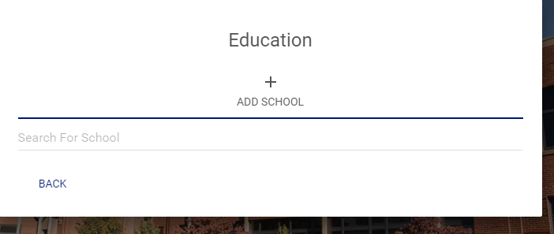
Please enter in your educational information as well. If your school is not on the auto-populated list, add the school!

Slide 6
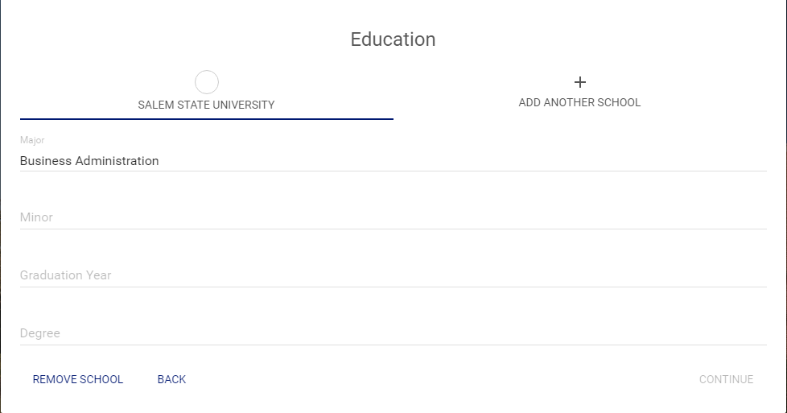
Please continue to fill in useful educational information about yourself.

Slide 7
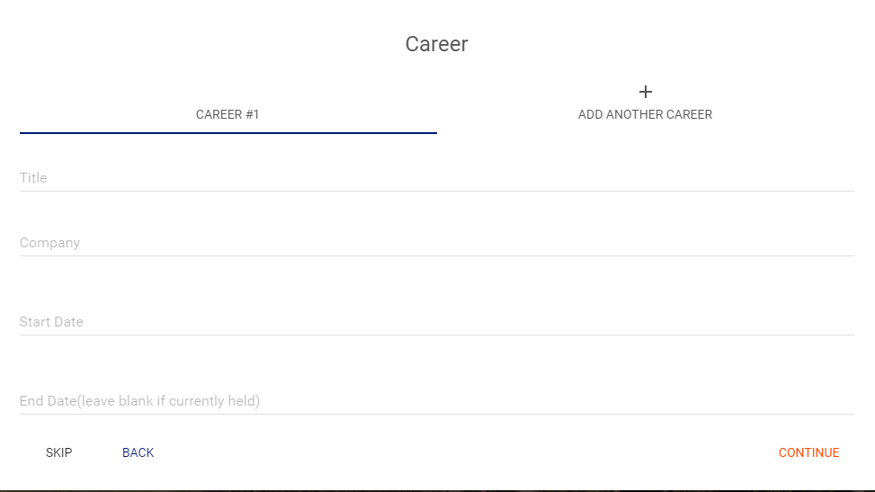
Next, please provide your career information (most current or as much experience as you would like) This step is optional

Slide 8
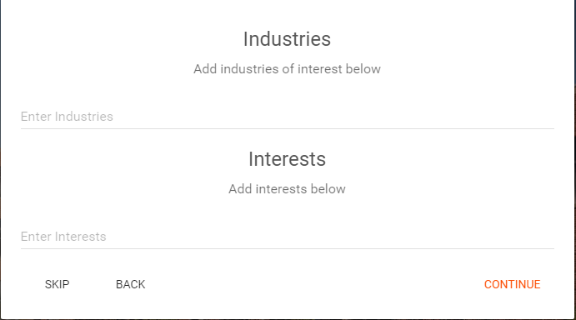
Optional-Provide information regarding the industries you are working/interested in as well as any interests you may have.

Slide 9
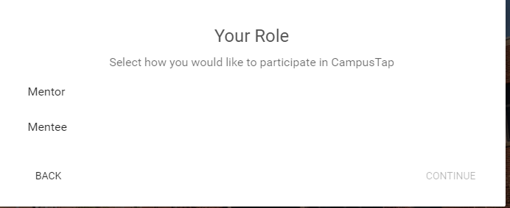
Please select the “Mentor” role

Slide 10
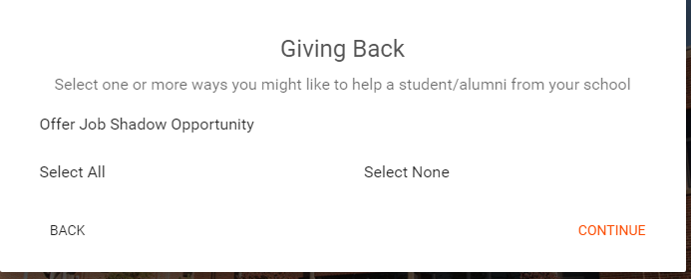
Then please select the “Offer Job Shadow Opportunity” option

Slide 11
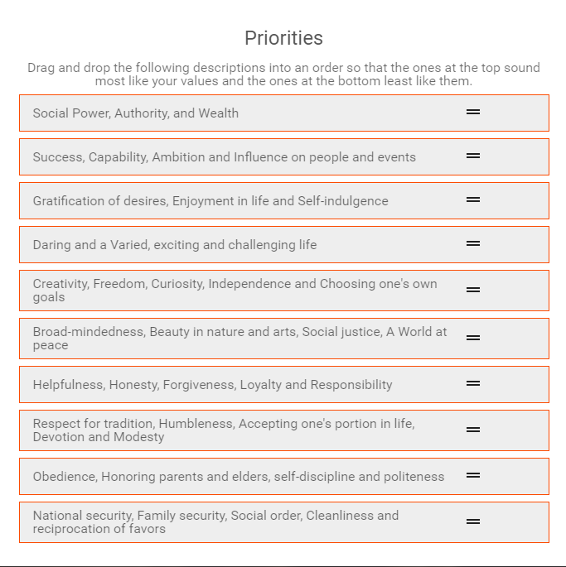
The final stage of account creation is are a set of personality compatibility questions, which Campus Tap can use to suggest mentors/mentees who share similar interests, priorities, and characteristics. This part is optional as well, but may be beneficial to helping engage mentors and mentees with similar interests

Slide 12
Once completed, your account will be created and you will be brought to your homepage. At the top of the homepage are different functions of Campus Tap
People- This page will display all members in the Campus Tap system
Groups- This page is where one can see all the Groups created in the system. All students will be placed into groups with Peer Mentors who will monitor activity and provide student support
Jobs- This page is where mentors can post job shadow opportunities, and where students can see and apply to those opportunities
Messages- This page is where a user can communicate in a group message or privately message users in the system

Slide 13
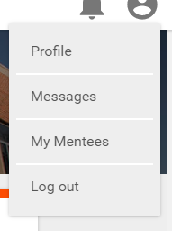
Notifications- This is where a user can see any notifications to their account (I.E. a message for another user, a response to a job shadow posting or application, etc)
The profile button (top right) is where a user can edit their profile, see their messages, and also see a list of the connected mentors or mentees, as well as log out of their current sessions

