Slide 1
How to create a job shadow posting on SSU Campus Tap

Slide 2
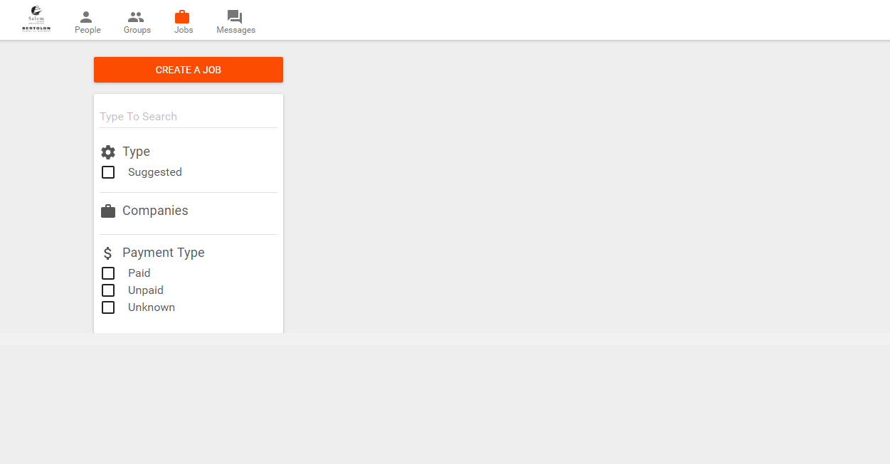
Click on the “Jobs” button at the top menu and select the “Create A Job” option

Slide 3
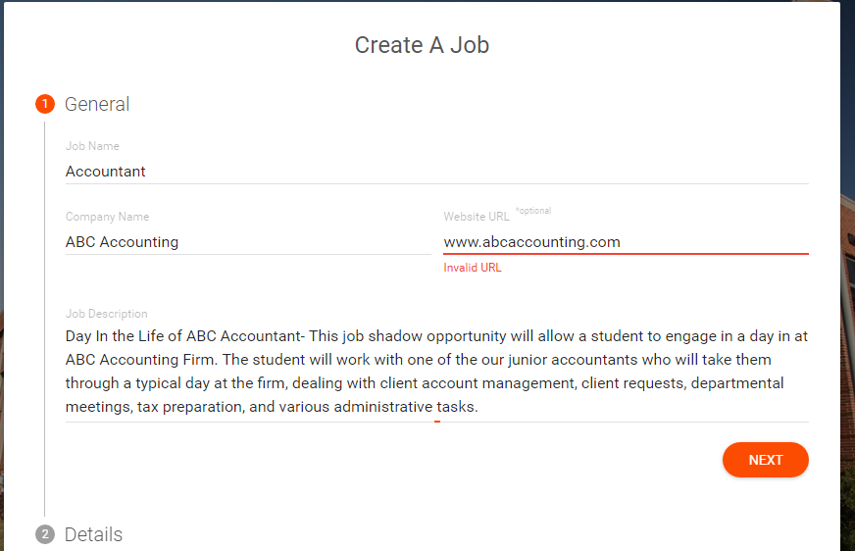
The first tab is General Information regarding the job shadow opportunity. Please list the opportunity title, name of company, website (optional) and a brief description of the job and what the student can expect for the day

Slide 4
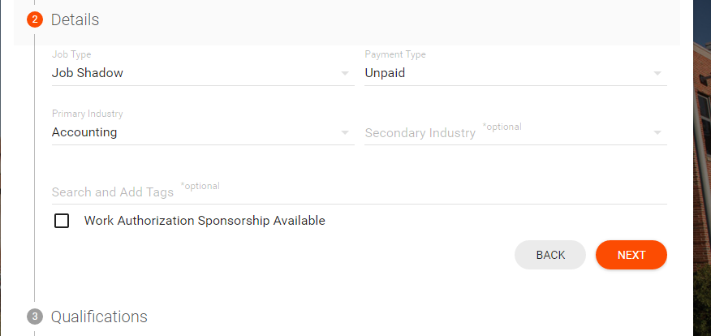
The next tab is further detail about the opportunity. Job Type will always be “Job Shadow” and the payment type “Unpaid”. You may select the corresponding “Primary Industry”. All other fields are optional. Note: Please do not check off Work Authorization Sponsorship Available” Click Next to continue

Slide 5
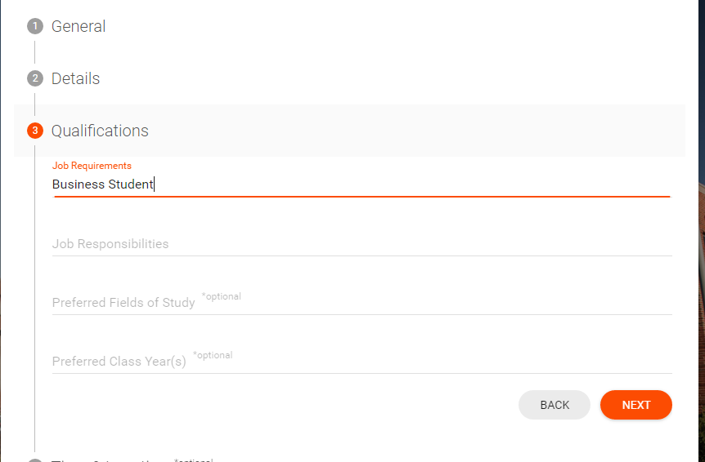
The next tab “Qualifications” is another general information tab necessary for the posting. Please put in Business Student for the requirement, and the rest of the fields are optional

Slide 6
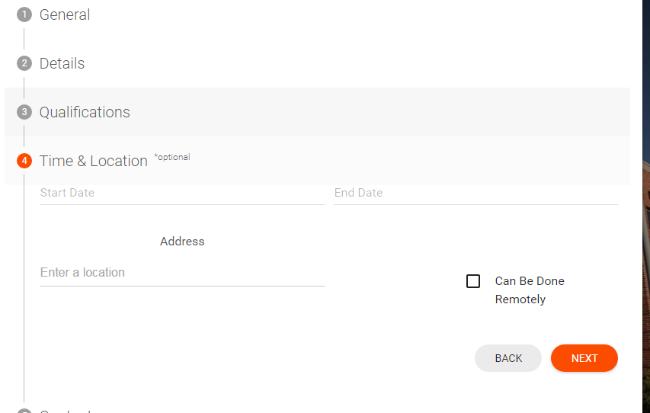
The “Time & Location” tab is where you can put the date(s) and time(s) the job shadow opportunity is available. Please put all date(s) you are available to provide an opportunity for, so as students can select the opportunity that best fits their schedule.

Slide 7
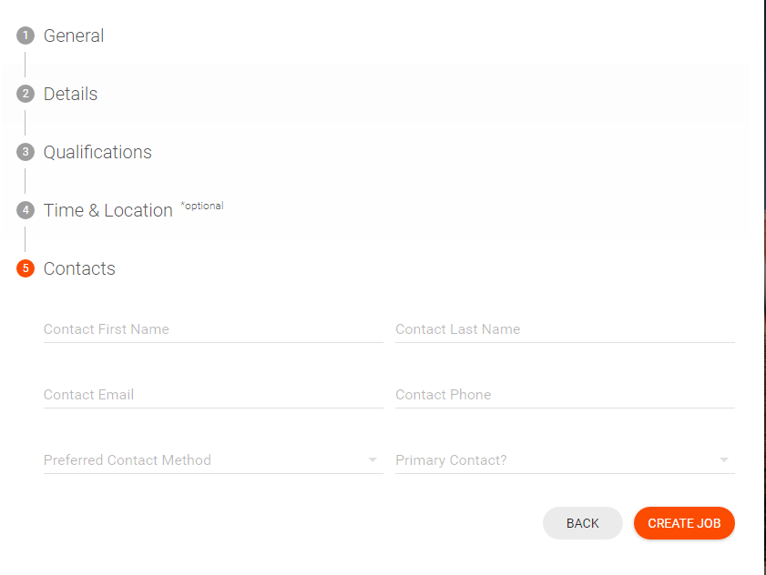
Last tab! The “Contacts” tab is where you can put your contact information you wish the student(s) to use to communicate with you regarding the opportunity.
Students can also communicate to you as well through Campus Tap, using the “Messages” feature.
Once your necessary contact info is complete, you can select “Create Job” and your opportunity will be posted! Students will be able to view and apply for the job shadow opportunity.
Note: Currently, there is no expiration setting for job shadow opportunities. Administrators will remove postings at mentor’s request or when it is notified within the system a student has received a certain opportunity.

