Slide 1
Graphic Syllabus
Aug 27, 2015
Marc Boots-Ebenfield
Director, Center for Teaching Innovation

Slide 2
What to MAP
Major outcomes /projects / activities
Where the activities occur (class/online)
Levels of activities (Bloom’s pyramid)
How activities tie together

Slide 3
Benefits
Reach nonverbal students
Multimodal presentation increases retention by all students
Teach a new form of organization/presentation
Foster better course design

Slide 4
Types of Graphic Syllabi
Concept maps
Flow charts
Tree diagrams
Matrices

Slide 5
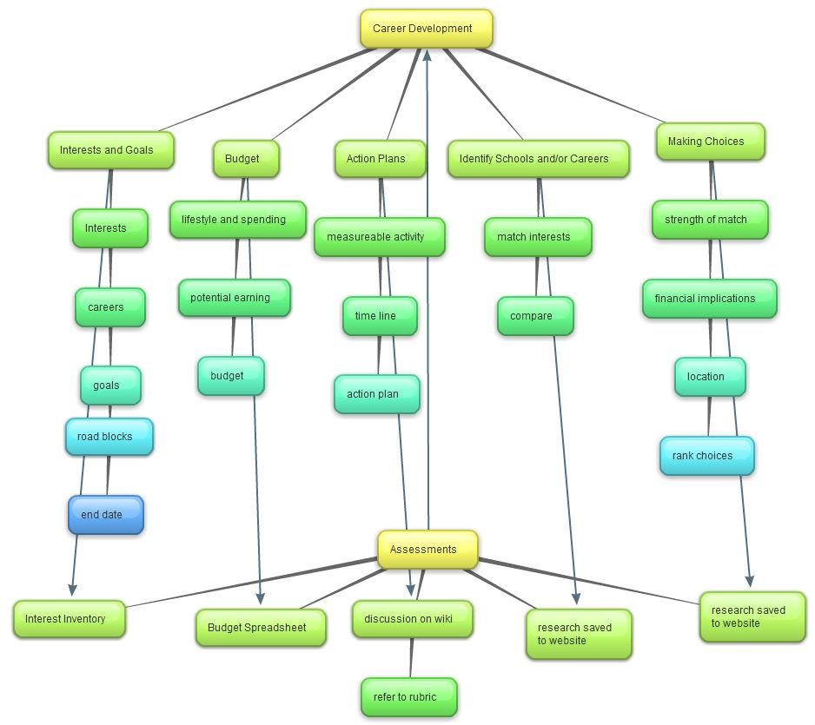
Concept Map

Slide 6
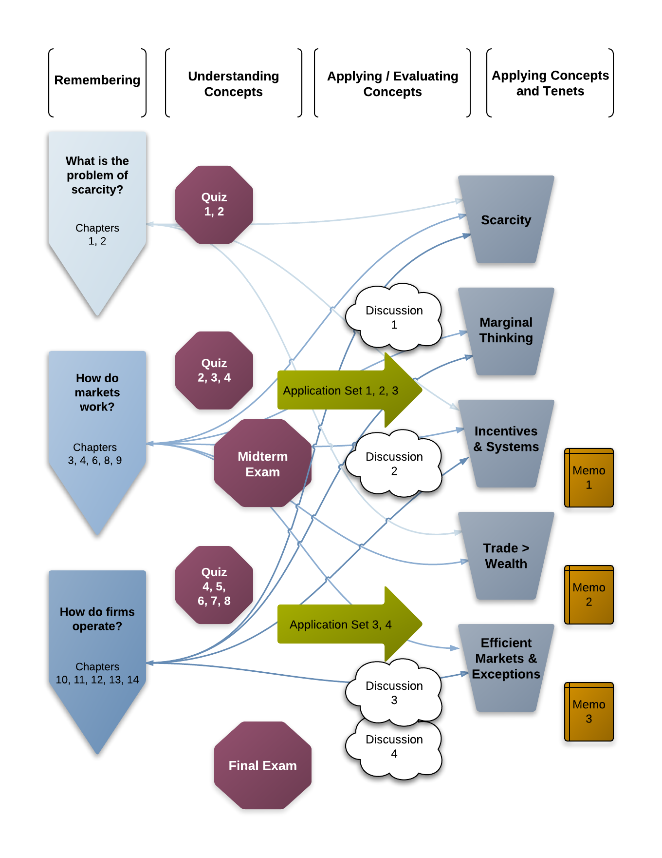
Flow Chart

Slide 7
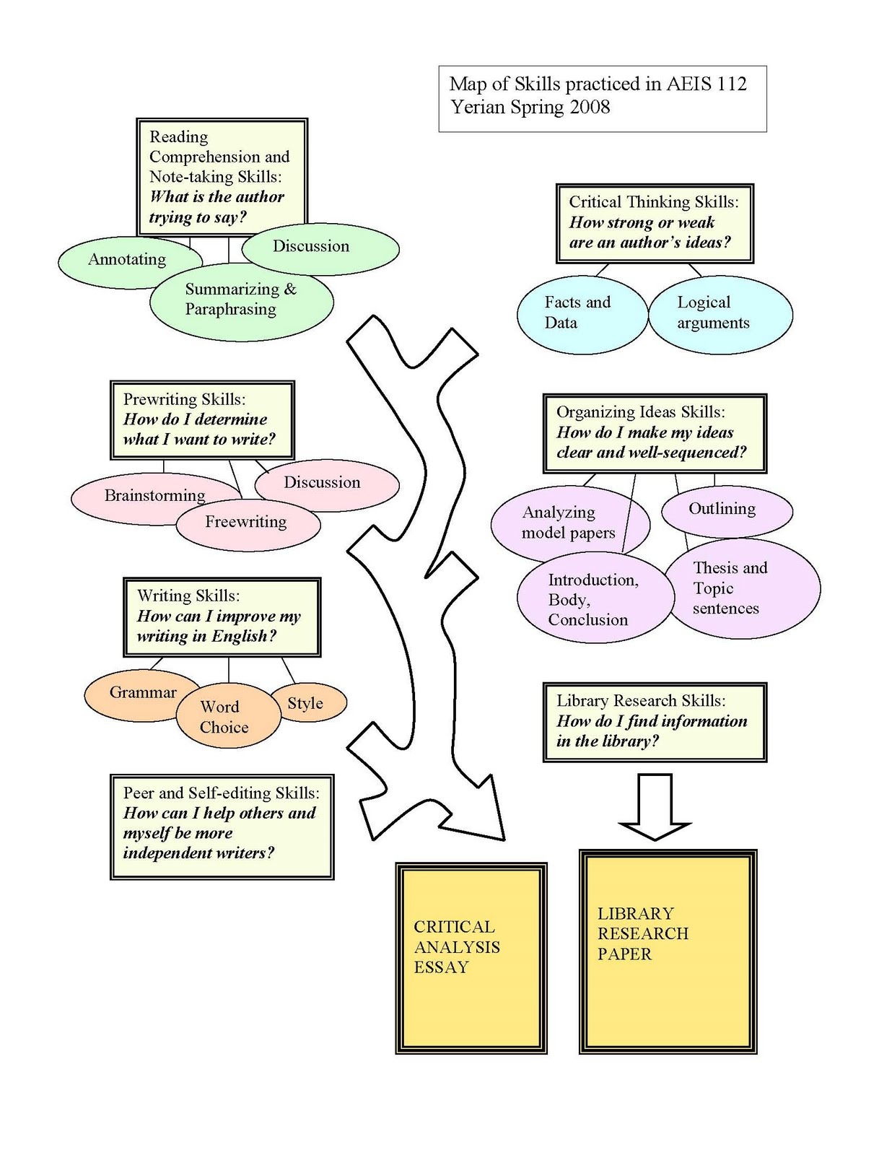
Tree Diagram

Slide 8
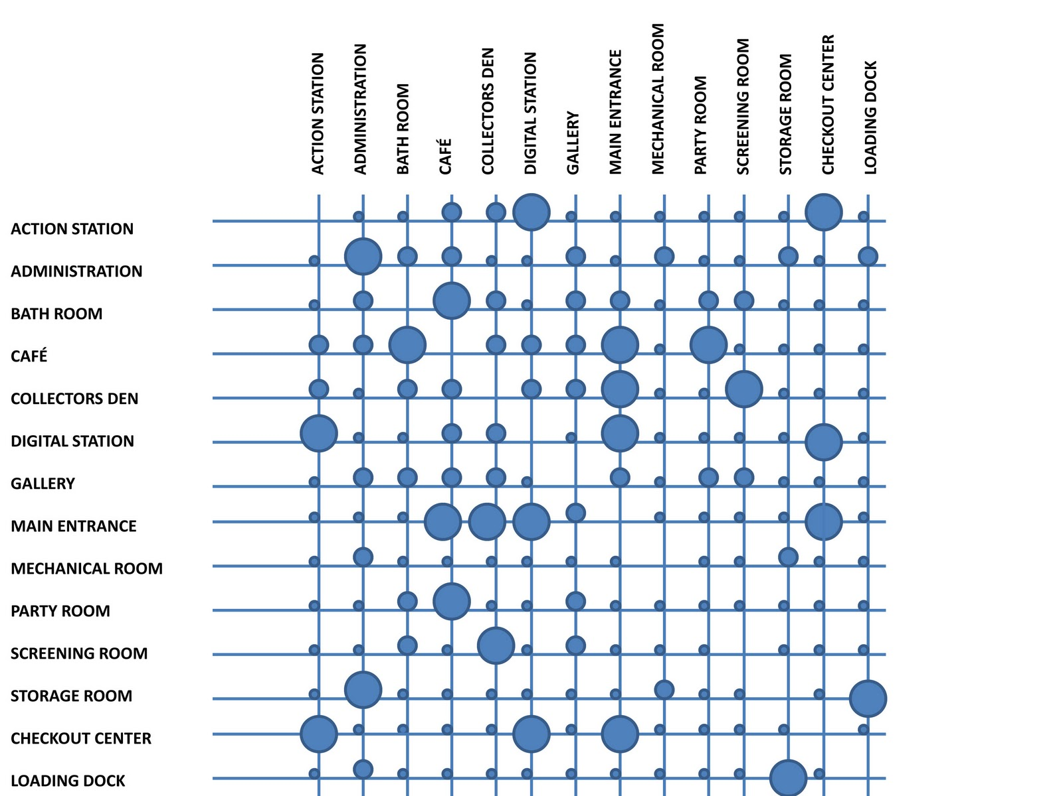
Matrix

Slide 9
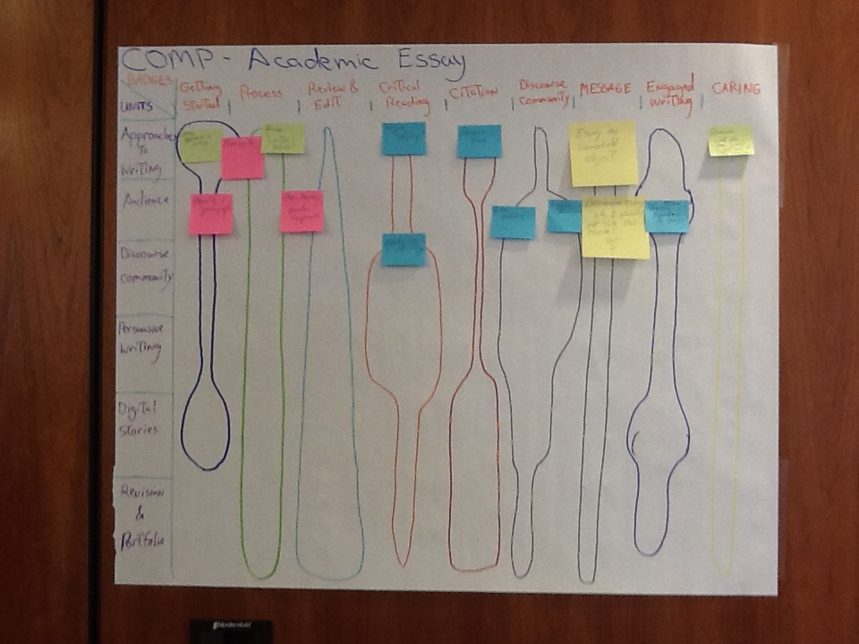

Slide 10
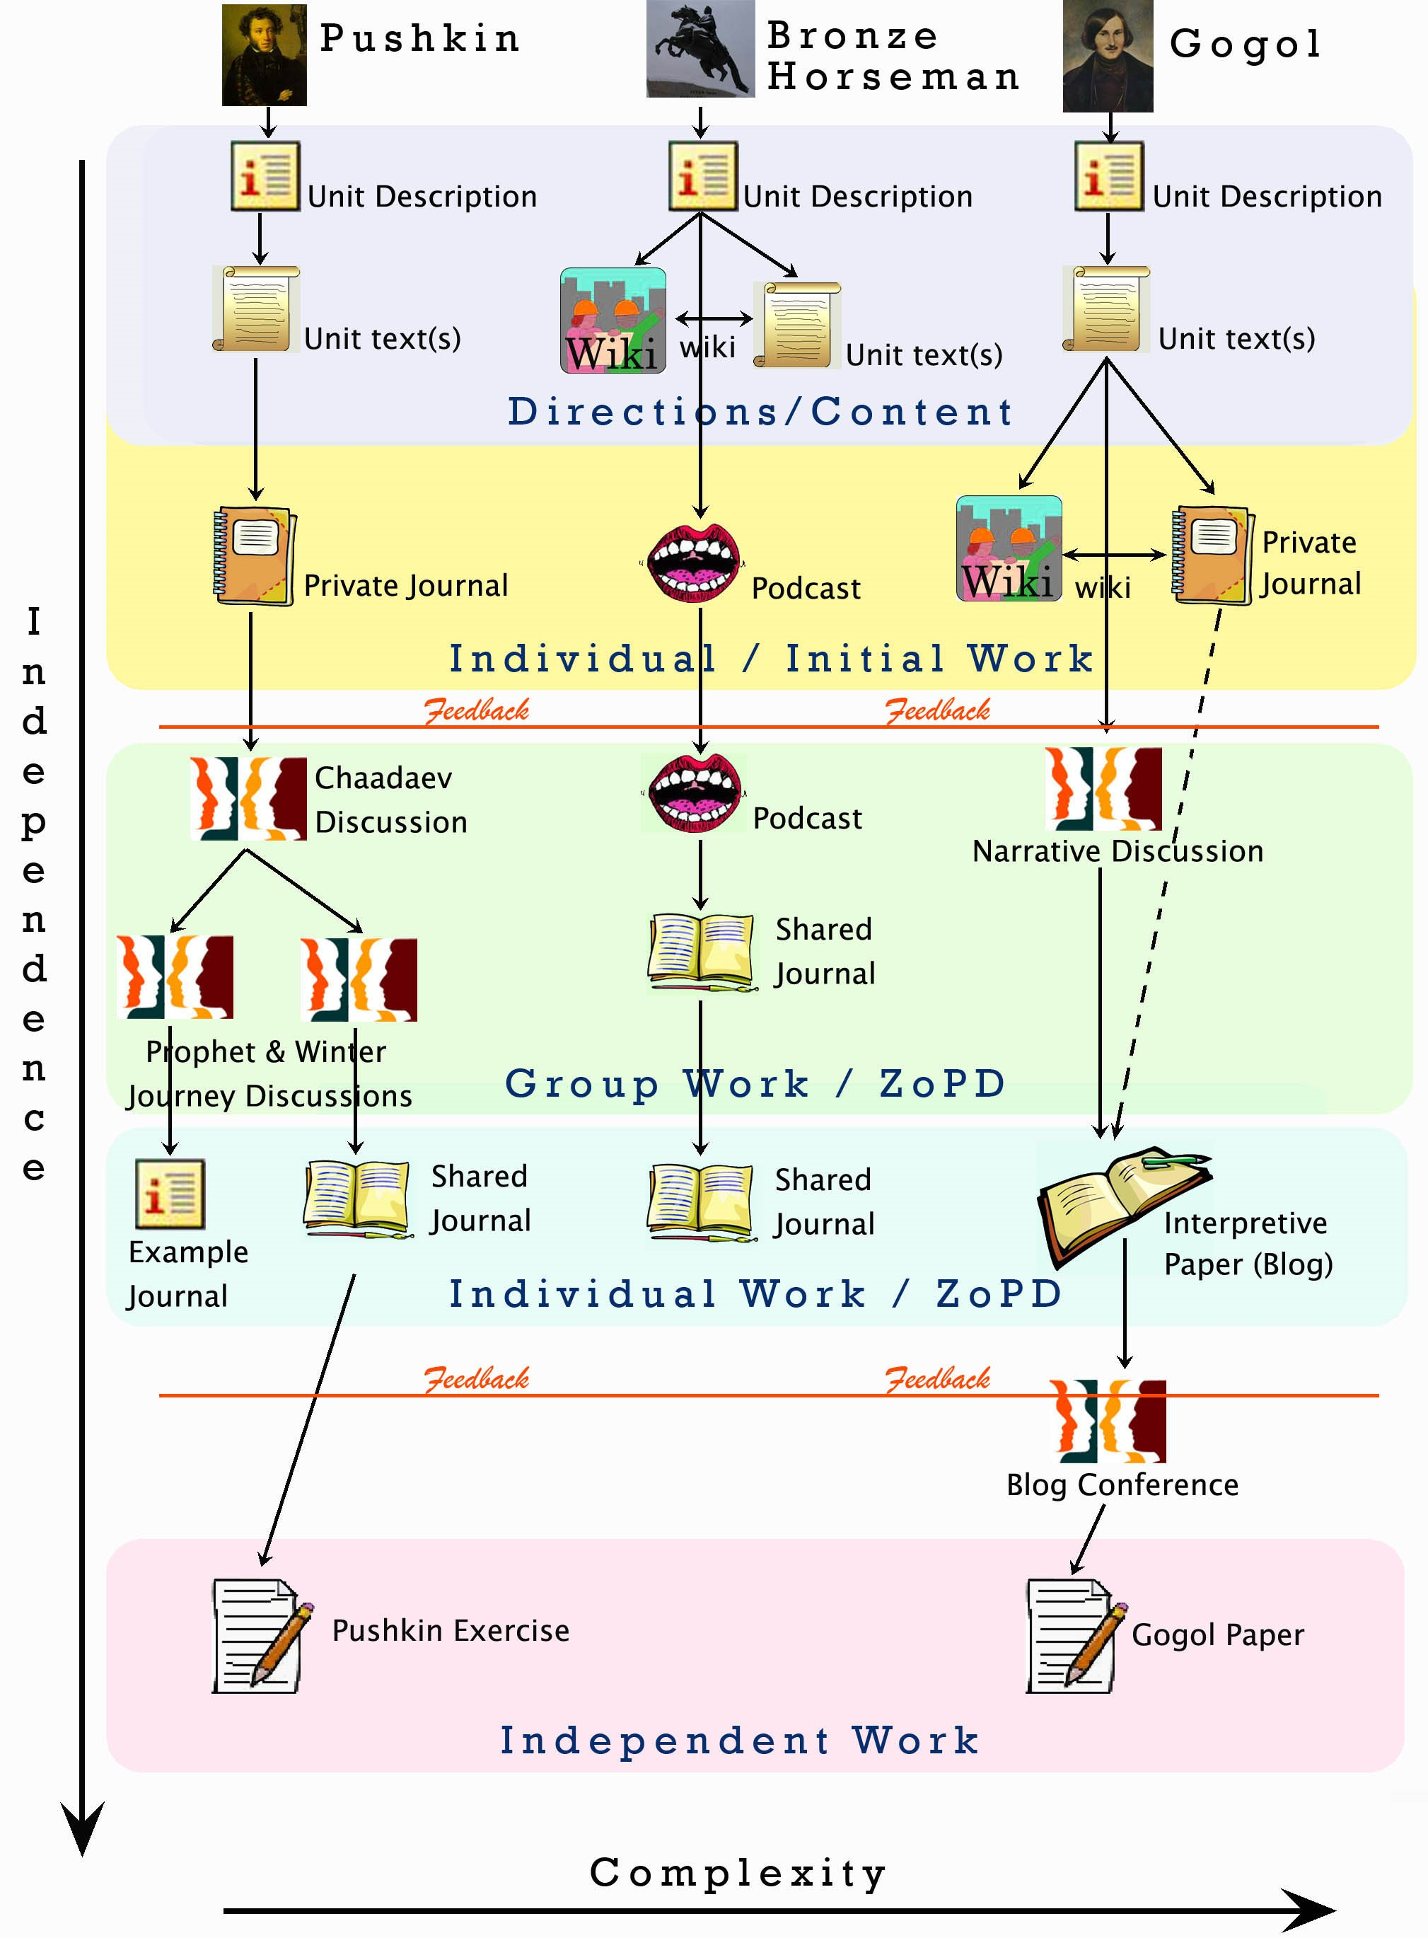
Flow of a Course

Slide 11
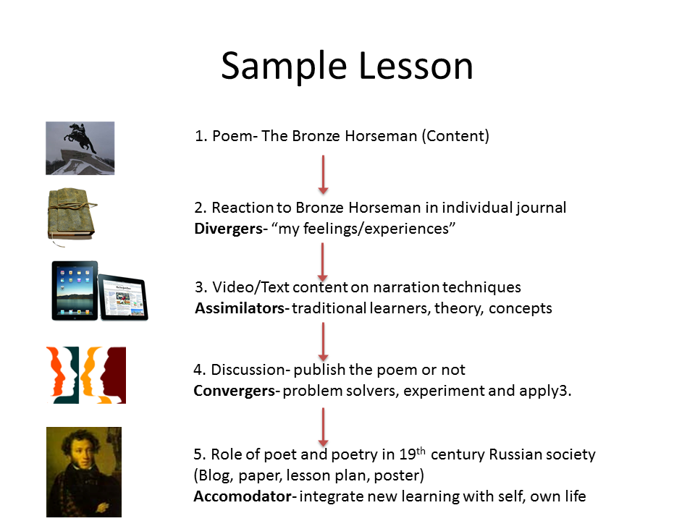
Learning Module

Slide 12
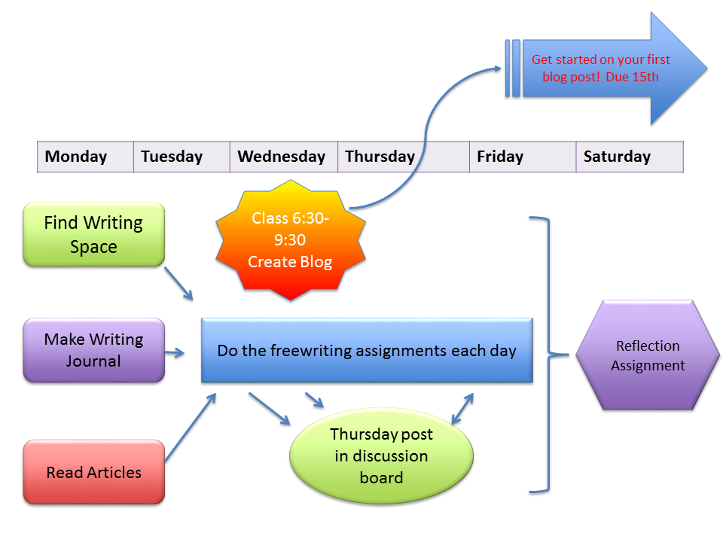
Unit Activities

Slide 13
How to Create Them
Keep it simple
Use same symbols for same concept
Use same colors for same symbols
Use icons/images & text together

Slide 14
In PPT

